Slide 3
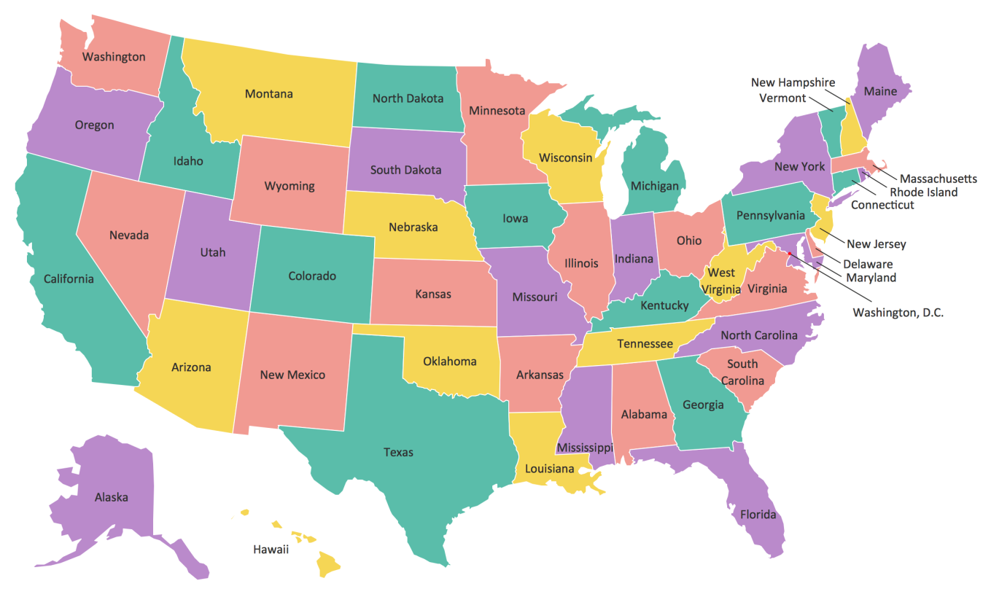

Slide 4
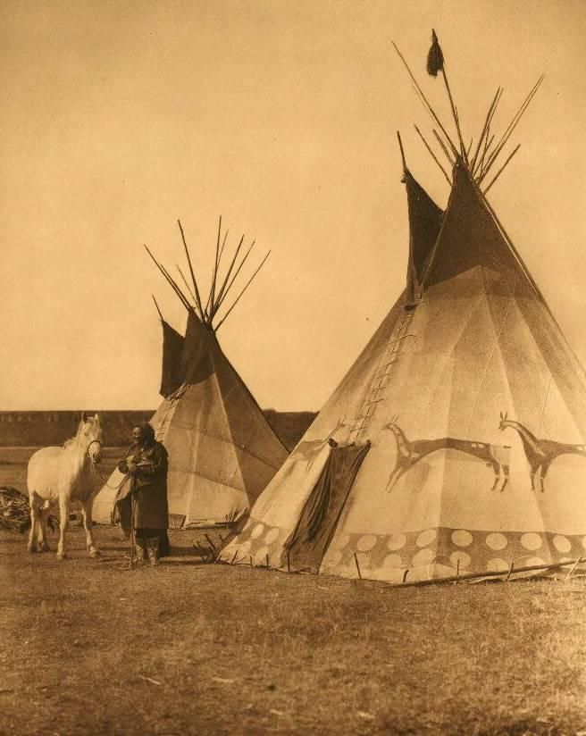
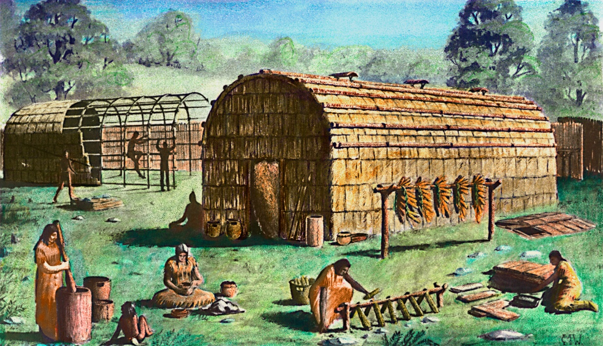
Teepee
Longhouse

Slide 5
Activity time!

Slide 8
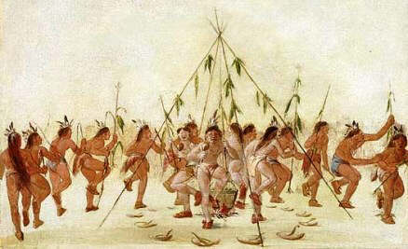
Doh nah dah go huh ee
or, as Cherockee said, “We should meet again”

