Slide 1
Earth
is our home

Slide 2
Environment
is the world around us.
It is:
Sky, clouds and are
Land, water and plants
Birds and fish
Animals and men

Slide 3
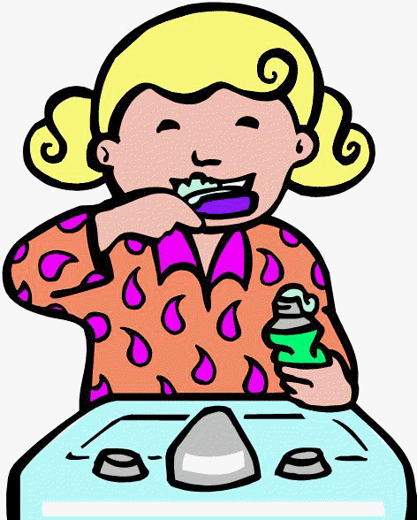
Keeping the environment
When brushing teeth, turn off the water

Slide 4
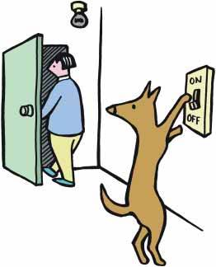
Keeping the environment
Turn off the light when you leave the room
Notes:
4

Slide 5
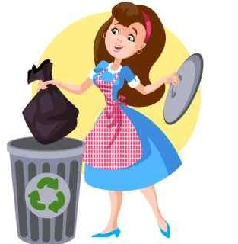
Keeping the environment
Through your trash only to the bin

Slide 6
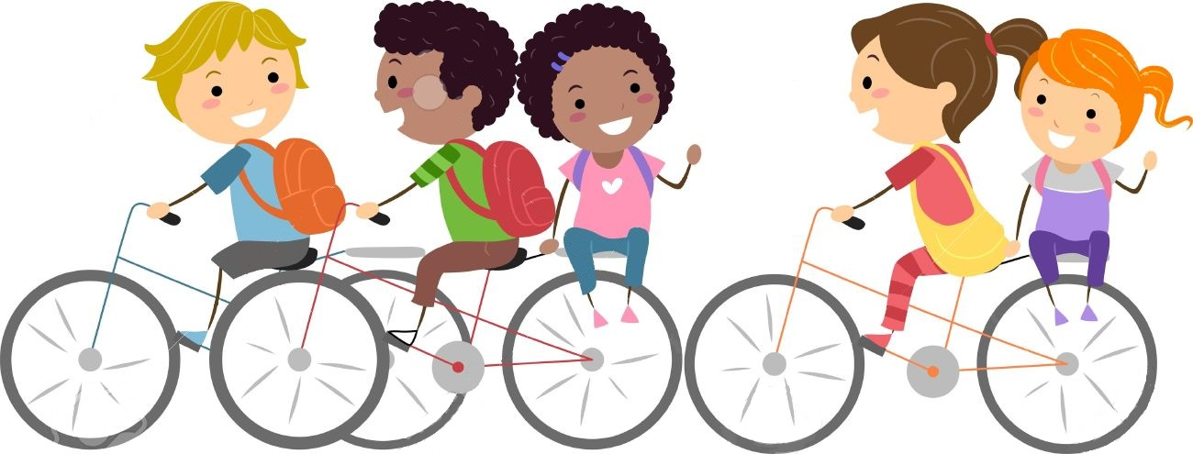
Keeping the environment
Walk or take your bicycle to school, not a car

Slide 7
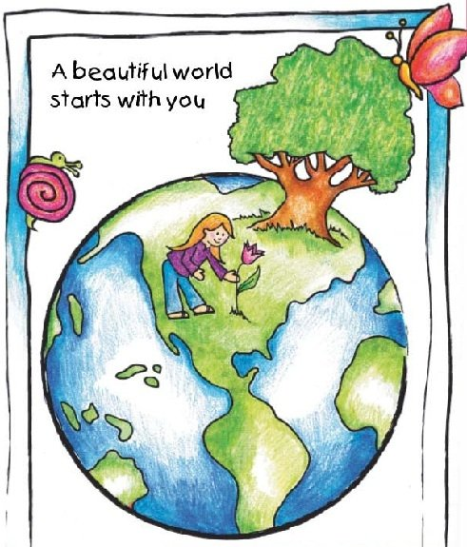
The world we want to see

