Slide 1
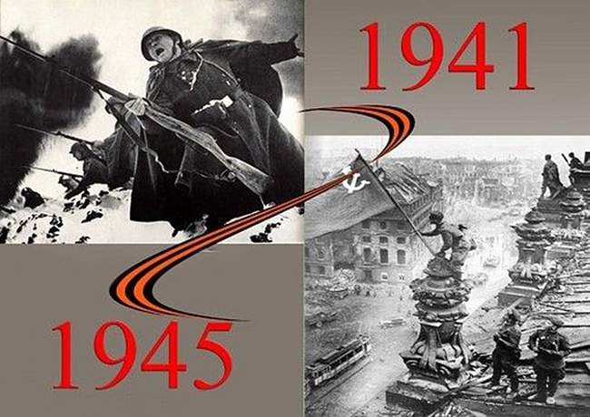
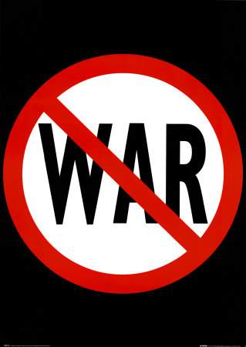
Say “NO” to war!
Field Marshal Bernard Montgomery: "One of the great laws of war is Never invade Russia"
Выполнили: Хабипова Рузанна, Тимербаева Софья ученицы 5 класса, Нургалиев Нургали ученик 8 класс МБОУ «Гимназия №4» г. Бавлы

Slide 2
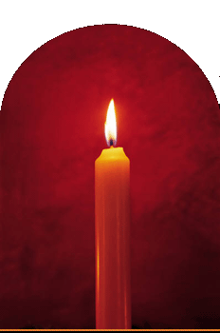
RUSSIA AT WAR 1941 - 1945
The Great Patriotic War of the Soviet Union Dedicated to The Blessed Memory of Those Millions of Valiant Men, Women, Children and Old People Who Gave Their Lives in the Sacred Fighting for The Freedom and Independence of Our Motherland During the Great Patriotic War in 1941 - 1945

Slide 3
Our Cause Is Right The Enemy Will Be Smashed Victory Will Be Ours! Наше Дело Правое Враг Будет Разбит Победа Будет За Нами!

Slide 4
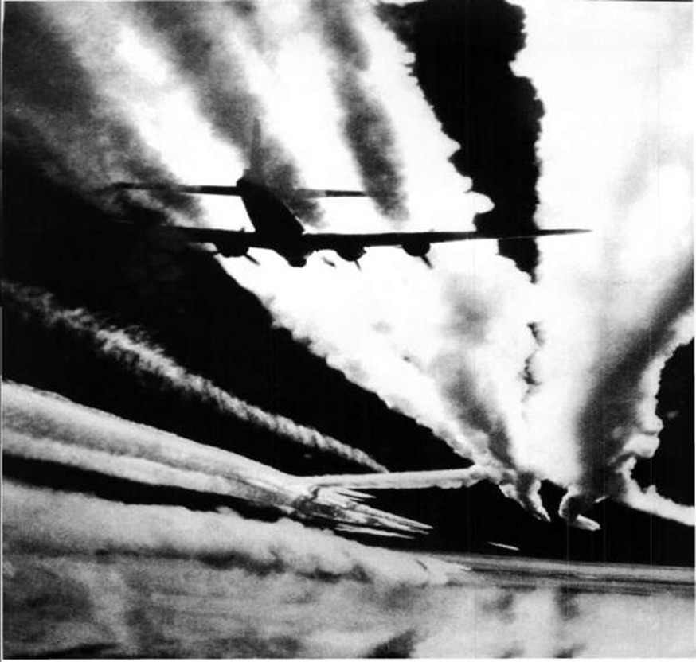
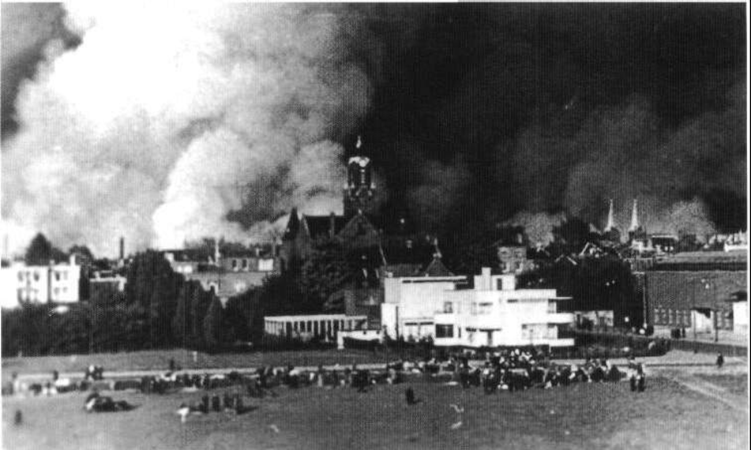
• OPERATION BARBAROSSA:
A PART OF THE GREAT PATRIOTIC WAR
Operation Barbarossa (German: "Unternehmen Barbarossa") was the codename for Nazi Germany's invasion of the Soviet Union during World War II that commenced on June 22, 1941. The operation was named after the Emperor Frederick Barbarossa of the Holy Roman Empire, a leader of the Crusades in the 12th century: according to Nazi ideology the conquest of 'inferior races' was similarly righteous.
It is not to be confused with the war on the Eastern Front in its entirety. Operation Barbarossa lasted from June 1941 to December 1941, while the war on the Eastern Front – called by the Russian people The Great Patriotic War – lasted from June 1941 to May 1945 when the Germans surrendered.

Slide 5
Где бы ни находился советский человек - на фронте, в тылу страны, в тылу врага, в фашистских лагерях, - всюду и везде он делал всё от него зависящее, чтобы приблизить час победы. Г. Н. Жуков

Slide 6
A PARADE OF GRIM DETERMINATION In the louring morning of 7th November 1941, with the enemy having already approached Moscow at a distance of only 15 miles, nevertheless, Stalin did intrepidly take a military parade in the Red Square as usual to celebrate the 24th anniversary of the Great Revolution. Having learnt of Stalin's speech broadcast during the parade, Hitler was infuriated with Russia's sturdy defiance. Evidently, the Führer and his hangmen did not realize that nothing on earth could daunt Russians. (M. Kuznetsov)

Slide 7
Stalingrad remembered Few battles on the Eastern front in World War II are remembered by people in the West. Ask anyone about the battles around Kharkov, or the perfect breakthrough of Operation Bagration, and you’re unlucky to get an answer. But mention Stalingrad, and most people will know that a titanic battle happened there, even if they couldn’t tell you where it is. The Battle of Stalingrad was a major battle of World War II in which Nazi Germany and its allies fought the Soviet Union for control of the city of Stalingrad (now Volgograd) in southwestern Russia. It took place between 17 July 1942 and 2 February 1943, and is often cited as one of the turning points of the war. Stalingrad is probably best remembered as the place where the Nazi expansion into Europe came up against Russian heroic defence. For Russian people, it is one of their proudest episodes, one of their best military operations of the war. The open plains of Russia were good country for the mobile German tanks supported by air-attacks: Blitzkrieg, literally, ‘lightning war”. However, the block-by-block, house-by-house and room-by-room fighting that happened in the city of Stalingrad didn’t suit the German method of war. Heroic Russian defence made the Germans pay for every yard of ground. On the 31 January 1943 the German Sixth Army surrendered to the Russians. Almost 65,000 Germans were prisoners.

Slide 8
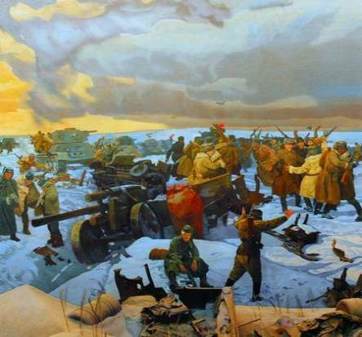
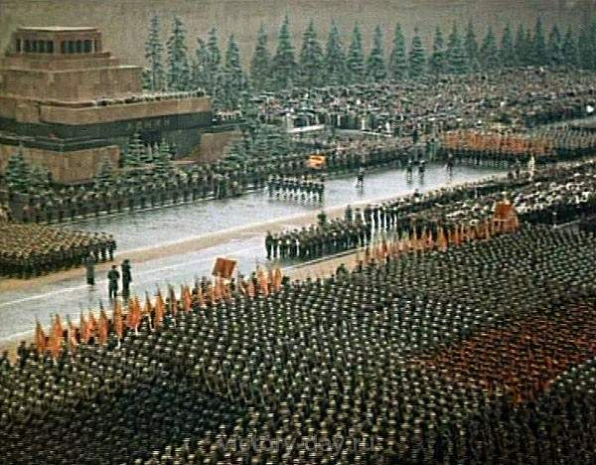
The Battle for Stalingrad

Slide 9
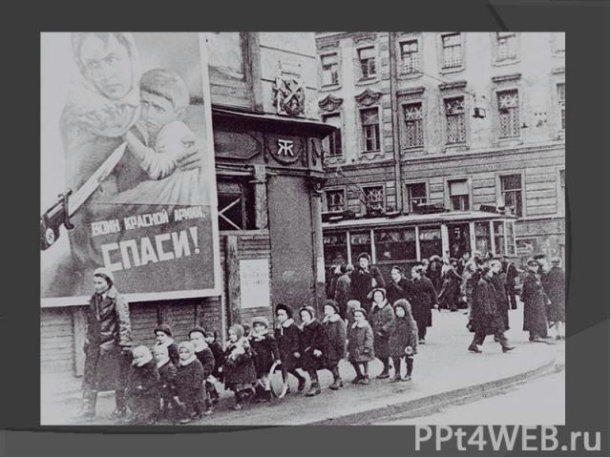
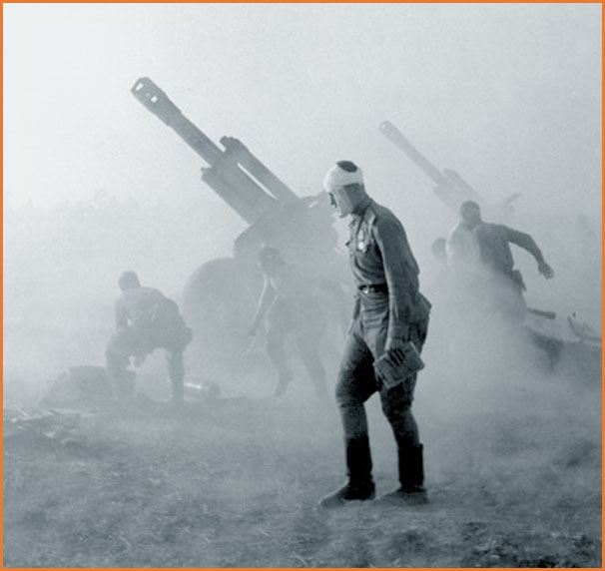
Many children find stories about the war interesting and very exciting. But because the war happened almost 70 years ago most elementary school children today have no direct personal connection to these events. Pupils are often able to form their own opinions about the war after learning the historical facts. Indeed ‘The war’ is a concept they understand but they are often unable to name specific events or people. They don’t have an overview or see connections between the events.

Slide 10
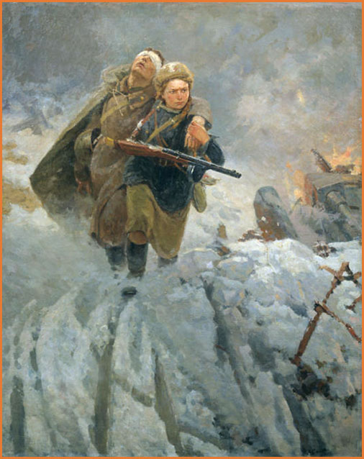
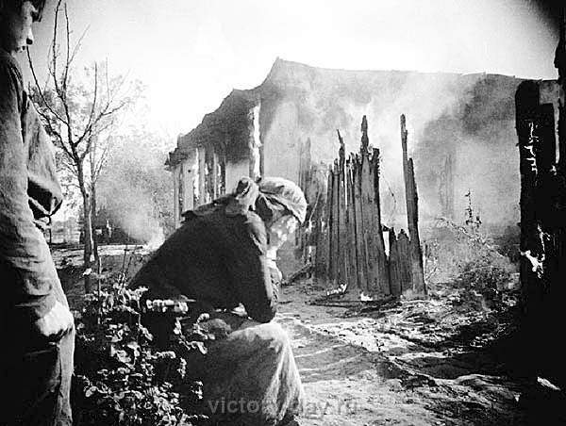
My grandmother was a military medical officer. She used to treat not only Russian wounded soldiers, but also German prisoners of war. Out of my grandmother's five brothers, three gave their lives in the sacred fighting for the independence and liberty of our Motherland, and only two of them returned home heroes. Or rather they returned to the ruins that had remained of the once thriving town where their home used to be before the war. (M. Kuznetsov)

Slide 11
ОГОНЬ! FIRE! My grandfather was an artilleryman. He beat Germans bravely in 1914 – 1918, and then he beat them again even more bravely and fiercely in 1941 – 1945. All of my grandparents, as well as their siblings and children, defended our Motherland with the utmost self-sacrifice and velour. I am very proud of my ancestors. They were true heroes. (M. Kuznetsov) STALIN'S ARTILLERY WAS THE BEST IN THE WORLD

Slide 12
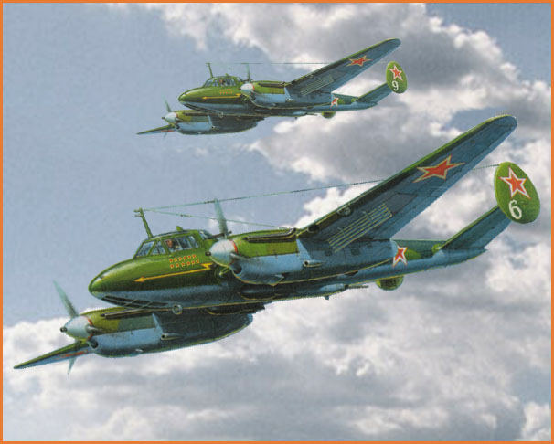
WESTWARD!
My father was a bomber pilot. He had been bombing the German invaders from the outbreak of the Great Patriotic War in June 1941 through to the hard-won Great and Glorious Victory over Nazi Germany in May 1945. He proved to be a real hero. I am very proud of him. Every member of my family – men and women, and even teenagers who could bear arms – fought the damned Nazis fiercely defending our Motherland. I am very proud of my dauntless forebears. Two thirds of them fell in action and never saw the Victory Day. (M. Kuznetsov)

Slide 13
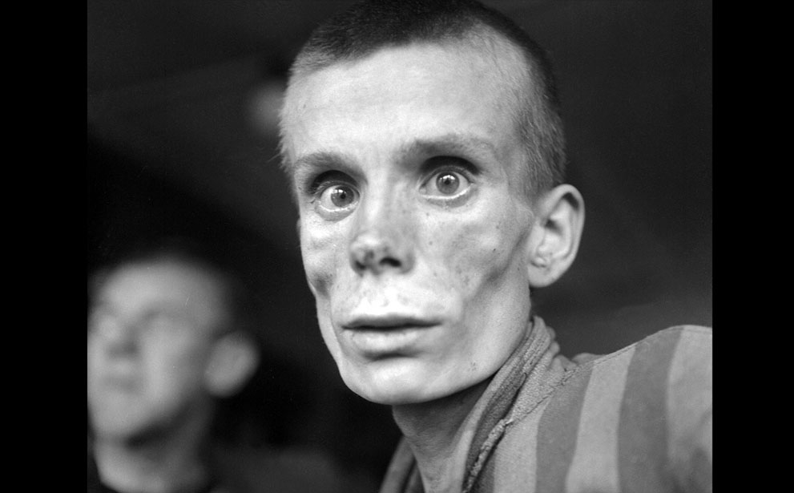
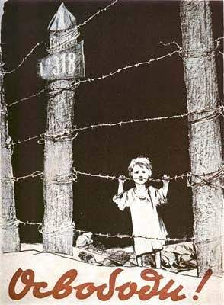
An emaciated 18-year-old Russian girl looks into the camera lens during the liberation of Dachau concentration camp in 1945. Dachau was the first German concentration camp, opened in 1933. More than 200,000 people were detained between 1933 and 1945, and 31,591 deaths were declared, most from disease, malnutrition and suicide. Unlike Auschwitz, Dachau was not explicitly an extermination camp, but conditions were so horrific that hundreds died every week.

Slide 14
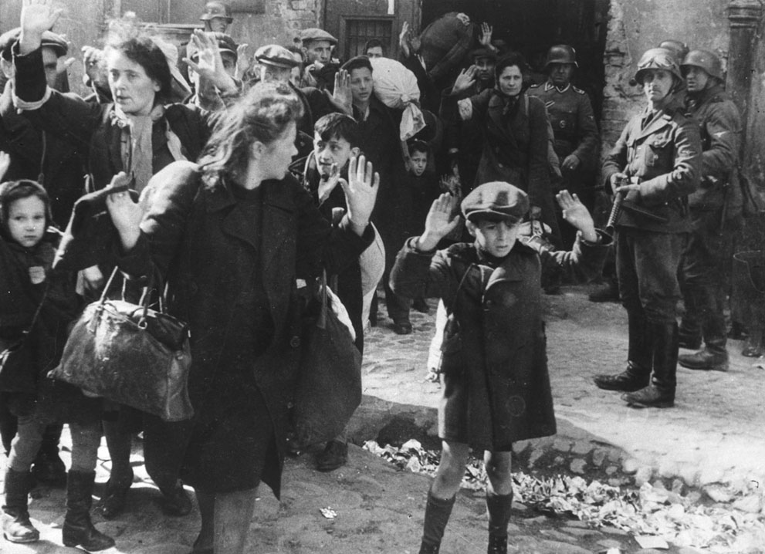
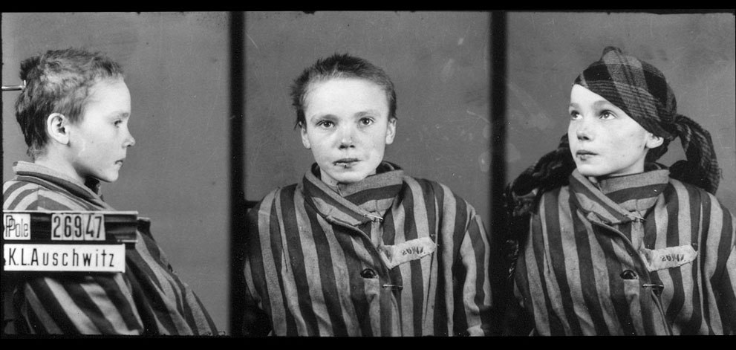
A group of Jews, including a small boy, is escorted from the Warsaw Ghetto by German soldiers in this April 19, 1943 photo. The picture formed part of a report from SS Gen. Stroop to his Commanding Officer, and was introduced as evidence to the War Crimes trials in Nuremberg in 1945.

Slide 15
THE DAILY TELEGRAPH
Letters to the Editor Re: Lies and Insinuations
Date: 25 January 2002 SIR – As a citizen and Ambassador of Russia to Britain, I refuse to believe that the article headlined "Red Army troops even raped Russian women as they freed them from camps" (report, Jan. 24) could be authorised by any of your responsible colleagues with a minimal knowledge of the history of the Second World War. I have absolutely no intention of taking part in any debate on these obvious lies and insinuations. It is a disgrace to have anything to do with this clear case of slander against the people who saved the world from Nazism. The article appeared on the eve of Holocaust Memorial Day, which transforms its publication into an act of blasphemy, not only against Russia and my people, but also against all countries and the millions of people who suffered from Nazism. I think that millions of those who were saved by the Russian army and the heroism of Russian soldiers will undoubtedly agree with me. Grigory Karasin Ambassador of the Russian Federation London W8, UK The Daily Telegraph, 25 January 2002, From Grigory Karasin, Ambassador of the Russian Federation, London W8 Original SOURCE

Slide 16
The 900-day Siege of Leningrad This was undoubtedly the most tragic period in the history of the city, a period full of suffering and heroism. For everyone who lives in St. Petersburg the Blokada (the Siege) of Leningrad is an important part of the city's heritage and a painful memory for the population's older generations. Less than two and a half months after the Soviet Union was attacked by Nazi Germany, German troops were already approaching Leningrad. The Red Army was outflanked and on September 8 1941 the Germans had fully encircled Leningrad and the siege began. The siege lasted for a total of 900 days, from September 8 1941 until January 27 1944. The city's almost 3 million civilians (including about 400,000 children) refused to surrender and endured rapidly increasing hardships in the encircled city.

Slide 17
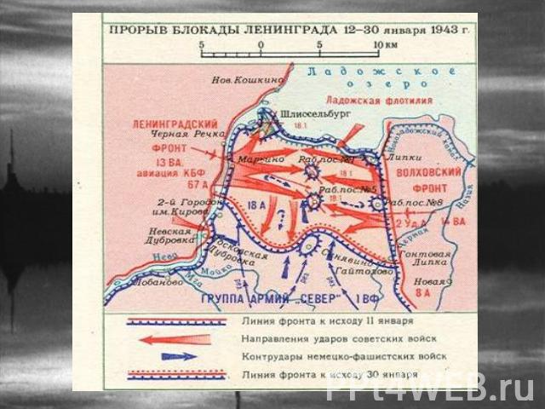

Slide 18
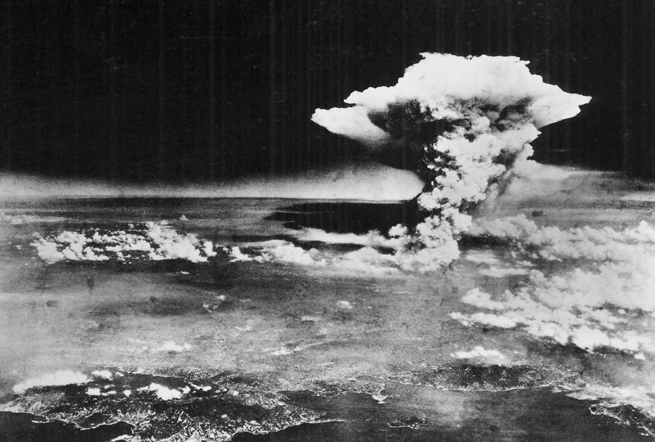
On Monday, August 6, 1945, a mushroom cloud billows into the sky about one hour after an atomic bomb was dropped by American B-29 bomber, the Enola Gay, detonating above Hiroshima, Japan. Nearly 80,000 people are believed to have been killed immediately, with possibly another 60,000 survivors dying of injuries and radiation exposure by 1950. (AP Photo/U.S. Army via Hiroshima Peace Memorial Museum)

Slide 19
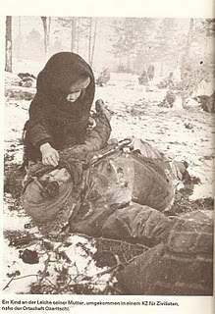
A poem “My thoughts on war”
after Khabipova Rusanna.
War is awful; it’s so bad for all countries on the map
For the mankind and for kids,
Why can’t people live in peace?
War is tears everywhere, blood and shooting, it’s not fair!
All around is death and killed, lying miserably on the fields…
Poor childhood and orphans, have they served this humble offend?
What are famine and sufferings for?
Ruining houses is out of law!
Could you tell me for God’s name?
For this madness who’s to blame?

Slide 20
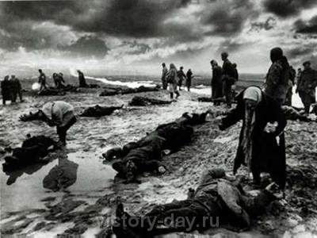
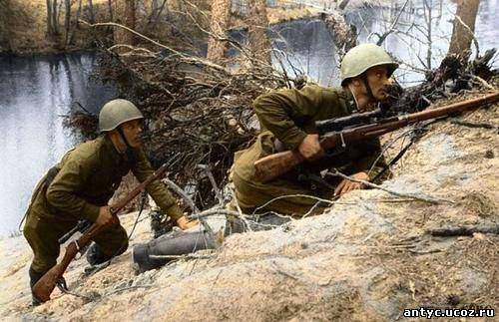

Slide 21
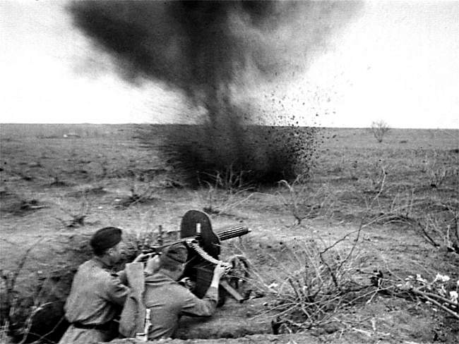

Slide 22
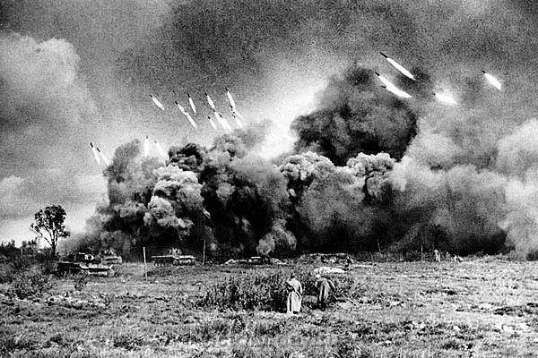
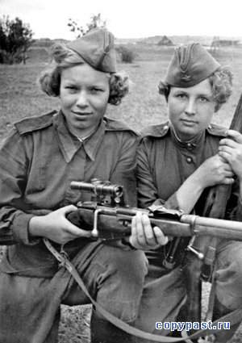

Slide 23
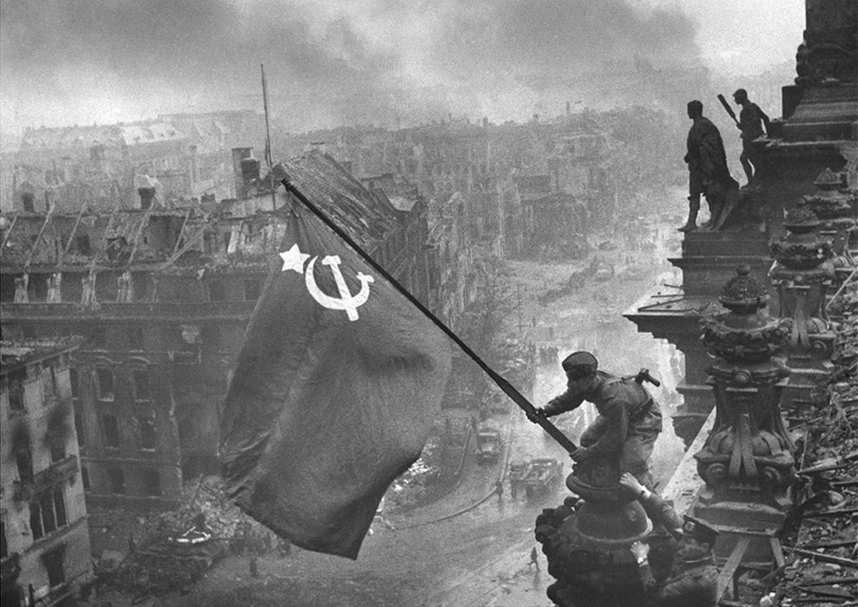
“Raising a flag over the Reichstag” the famous photograph by Yevgeny Khaldei, taken on May 2, 1945. The photo shows Soviet soldiers raising the flag of the Soviet Union on top of the German Reichstag building following the Battle of Berlin. The moment was actually a re-enactment of an earlier flag-raising, and the photo was embroiled in controversy over the identities of the soldiers, the photographer, and some significant photo editing.

Slide 24
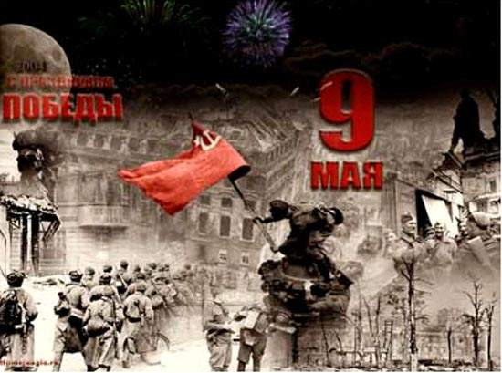
Victory! God is with us! Berlin in May 1945: The Reichstag captured Nazist Germany is prostrated Holy Russia has proved invincible!
MARSHAL STALIN'S ORDER OF THE DAY Moscow, May 1, 1945

Slide 25
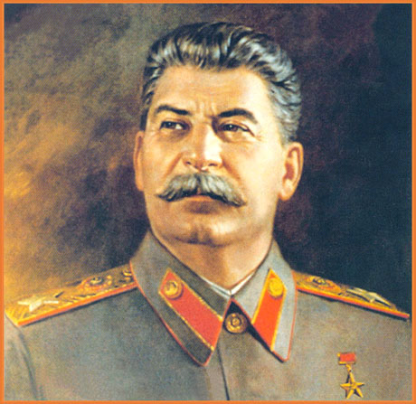
Head of the Soviet State Generalissimo Joseph V. Stalin
It was Marshal Joseph Vissarionovich Stalin (Generalissimo since June 27, 1945), the Supreme Commander-in-Chief of the Red Army, who led the Soviet Union through the Great Patriotic War (1941 - 1945) to the hard-won Victory. The Great Victory in May 1945 was achieved in glorious military alliance with the United Kingdom of Great Britain and the United States of America, over the juggernaut of the so-called Axis: Nazi Germany, Fascist Italy, Militarist Japan, and their satellites: Slovakia, Hungary, Romania, Finland, and Bulgaria. The Axis states were supported by all the manpower, industry and resources of almost all Continental Europe, North Africa, and South-East Asia under their control. But it was we who won with God's help!
OUR CAUSE IS RIGHT THE ENEMY IS SMASHED VICTORY IS OURS!

Slide 26
Comrades Red Armymen and Red Navymen! Sergeants and Non-commissioned Officers, Officers of the Army and Navy! Generals and Admirals! Working people of the Soviet Union! Today our country is celebrating May First – the international holiday of the working people. This year the peoples of our Motherland are celebrating May Day in the conditions of the victorious termination of the Great Patriotic War. The hard times, when the Red Army fought back the enemy troops at Moscow and Leningrad, at Grozny and Stalingrad, are gone, never to return. Now our victorious troops are battering the enemy's armed forces in the center of Germany, far beyond Berlin, on the Elbe River. Within a short time Poland, Hungary, the greater part of Czechoslovakia, a considerable part of Austria and her capital, Vienna, have been liberated. At the same time the Red Army has captured East Prussia – spearhead of German imperialism, Pomerania, the greater part of Brandenburg, and the main districts of Germany's capital, Berlin, having hoisted the banner of victory over Berlin. As a result of these offensive battles fought by the Red Army, within three or four months the Germans lost over 800,000 officers and men in prisoners and about one million killed. During the same period, Red Army troops captured or destroyed up to 6,000 enemy airplanes, up to 12,000 tanks and self-propelled guns, over 23,000 field guns, and enormous quantities of other armaments and equipment.

Slide 28
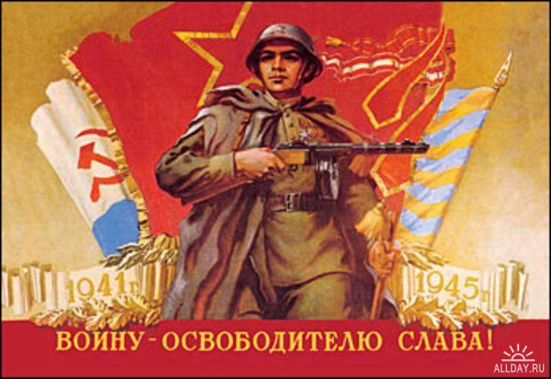
STALIN'S ADDRESS TO THE PEOPLE Moscow, May 9, 1945 Comrades! Fellow countrymen and countrywomen! The great day of victory over Germany has arrived. Fascist Germany, forced to her knees by the Red Army and the troops of our Allies, has admitted defeat and has announced her unconditional surrender. On May 7 a preliminary act of surrender was signed in Rheims. On May 8, in Berlin, representatives of the German High Command, in the presence of representatives of the Supreme Command of the Allied troops and of the Supreme Command of the Soviet troops, signed the final act of surrender, which came into effect at 24 hours on May 8. ……

Slide 29
Two hundred captive German military banners and standards were chosen out of many, and prepared to be flung down at the Victors' feet during the Great Victory Parade in the sacred Red Square in Moscow on the 24th of June 1945

Slide 30
The triumph of good over evil. 200 captured Nazi banners were tilted down in dishonour in the Red Square, Moscow

Slide 31
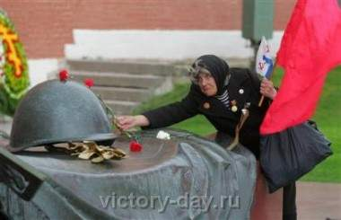
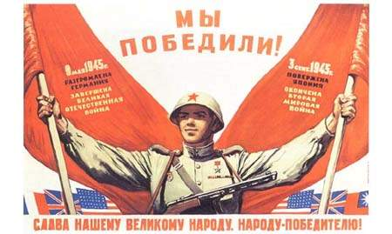
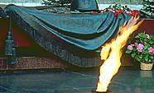
Вспомним всех поименно, Горем вспомним своим… Это нужно – не мертвым! Это надо – живым! (Р. Рождественский)

Slide 32
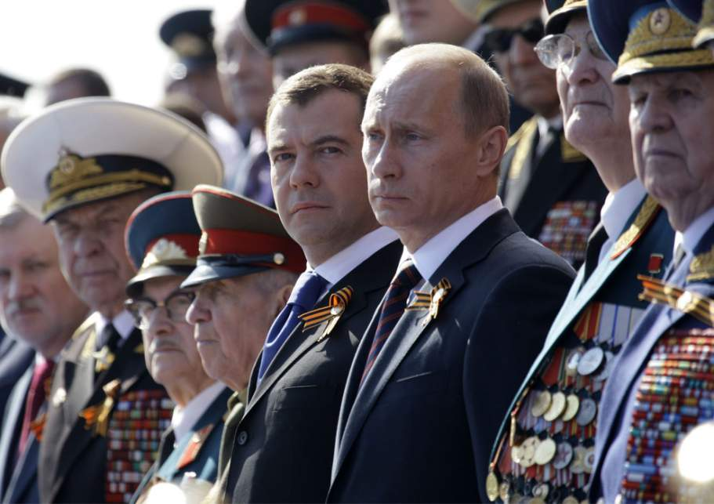

Slide 33
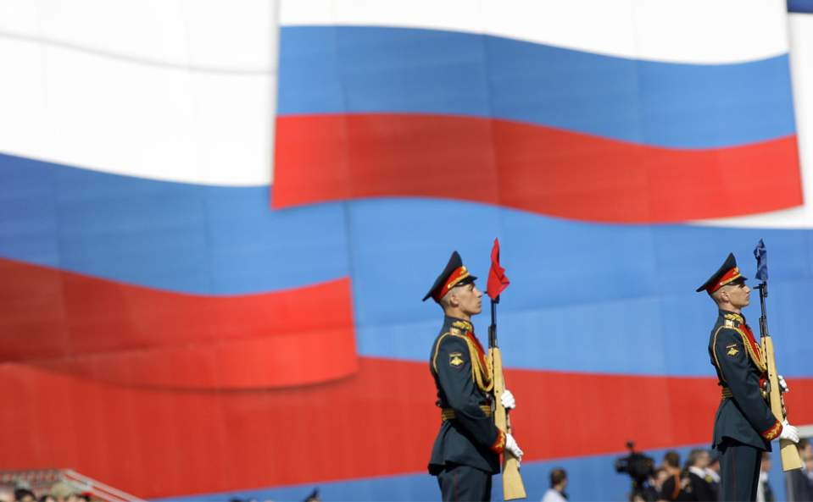

Slide 34
HITLER APPEARED TO BE THE GREATEST LOSER OF THE TWENTIETH CENTURY WHILE STALIN BECAME THE GREATEST VICTOR
Out of all Adolf Hitler's promises, prophecies and pledges only three were fulfilled ever. Although, those three were fulfilled in quite a bizarre manner. First, in 1935 Adolf Hitler solemnly declared: "In 10 years from now you will not recognize the city of Berlin!" Yes, indeed, just in ten years, by May 1945, Berlin had become utterly unrecognizable. Now the once great and beautiful city was completely in ruins. Second, in the autumn of 1941 Hitler told his soldiers that soon they would be marching along the streets of Moscow. Yes, indeed, after a short while, a huge number of infinite columns of German prisoners-of-war were driven – or "marching" under convoy of the Red Army guards – along the ancient majestic Moscow streets, boulevards and avenues. Third, during the great Stalingrad Battle Hitler announced this: "From where once the German soldier plants his foot, he never withdraws!" Yes, indeed, millions of killed German invaders left forever to lie dead in the boundless Russian lands whither they dared once put their foot. None of all the other Adolf Hitler's numerous prophecies, promises and pledges were fulfilled ever. Not one more. At the same time, out of all what Marshal Joseph Stalin had ever pledged and promised – everything was entirely fulfilled in the long run.

Slide 35
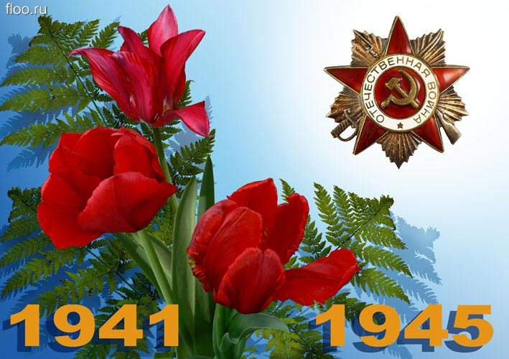
1. When did Adolf Hitler come to power? a) in 1923 b) in 1933 c) in 1938 2. When did the World War II start? a) in 1938 b) in 1939 c) in 1940 3. What two countries were Germany’s allies? a) Italy and Japan b) Italy and Spain c) Japan and China 4. Who was head of Germany’s Luftwaffe? a) Herman Goering b) Heinrich Himmler c) Martin Borman 5. What two countries declared war on Germany after the Nazi troops invaded Poland? a) Great Britain and the USA b) Norway and Denmark c) France and Great Britain 6. What was the only WWII battle that was fought solely in the air? a) the Battle of Britain b) the Battle of Stalingrad c) the Battle of Berlin 7. Who was Britain’s Prime Minister during the war? a) Harold Winston b) Winston Churchill c) Margaret Thatcher
The results
of the World War II Quiz
among the students of School №4 5-11 forms. There were 22 questions.

Slide 36
8. Which of the following death camps was the biggest? а) Dachau
b)Auschwitz
c)Buchenwald?
9. When did Japanese attack the American naval
base Pearl Harbour ? a) in 1939
b) in 1941
c) in 1943
10. What was the German code name for the
summer attack on the Soviet Union in 1941? a) Operation Barbarossa
b) Operation Dragon
c) Operation Bismar
11. Who said: “WE shall fight on the beaches.
WE shall fight on the landing grounds.
WE shall fight in the fields, and in the streets,
WE shall fight in the hills.
WE shall never surrender!” a) Winston Churchill
b) Josef Stalin
c) Franklin D. Roosevelt
12. The German invasion of the Soviet Union
began on the 22nd of June, 1941.
Who announced the news? a) Josef Stalin
b) Lavrentiy Beria
c) Vyacheslav Molotov
13. How long did the Siege of Leningrad last? a) 90 days
b) 300 days
c) 900 days
14. Who wrote the famous Leningrad symphony? a) Dmitri Shostackovich
b) Sergei Prokofiev
c) Alexander Alexandrov

Slide 37
15. What tank was considered to be the best tank in
World War II? a) T-42
b) T-72
c) T-34
16. What river does Stalingrad stand on? a) the Ural
b) the Volga
c) the Don
17. What was the biggest tank battle of WW II? a) The Battle of Stalingrad
b) The Battle of Kursk
c) The Battle of Leningrad
18. What Nazi party member saved 1100 Jewish
people giving them work in his factory? a) Rudolf Hess
b) Oscar Schindler
c) Josef Heinz
19. In 1943 Stalin, Roosevelt and Churchill met
at a conference. Where did it take place? a) In Cairo
b) In Teheran
c) In Yalta
20. Whose armed forces fought and won the
Battle of Berlin? a) Great Britain’s
b) The USA’s
c) The Soviet Union’s
21. What happened to Adolf Hitler? a) He committed suicide
b) He fled to Argentina
c) He was killed during an air raid
22. How many atomic bombs were dropped? a) 1 b)2
in Japan
23. Where were the war trials held after the war? a) in Berlin
b) in Nuremberg
c) in London
b) 3

Slide 44
Заключение
Годы Великой Отечественной войны были для нашей Родины годами тяжких испытаний и временем беспримерного героизма народа. Нет сомнений в том, что главную роль в победе сыграл советский народ. В этом подвиге, равного которому ещё не знала история, слились воедино и высокое мастерство военноначальников, и величайшее мужество воинов, партизан, участников подполья, и самоотверженность тружеников тыла.
Великая Отечественная Война показала всю глубину, передовой характер, духовную силу советского; показала решающую роль в исторической судьбе народа качества его духовности, значения духовной культуры и идеологии в ее подъеме, в мобилизации народа на борьбу за свое историческое существование.
Этот опыт войны чрезвычайно важен в наше время для приобретения народом веры в себя, в свою способность решить проблемы, кажущиеся непреодолимыми. Великая Победа советского народа над фашистской Германией обязывает и вдохновляет на решение таких проблем.
В годы войны были ситуации, когда у наших войск физических сил явно не хватало для остановки фашистских полчищ. Спасла сила духа, позволившая сделать перелом в ожесточенной борьбе. Духовная сила подняла на жертвенное служение Отечеству миллионы воинов на бескрайних фронтах великой войны и на бескрайних просторах близкого и далекого тыла. Она соединила всех и сделала творцами Великой Победы. Это величайший пример для потомства на все времена.
Народ не забыл и славит тех, кто храбро сражался и погиб смертью героя, приблизив час нашей победы, прославляет оставшихся в живых, сумевших победить врага. Герои не умирают, их слава бессмертна, их имена навечно занесены не только в списки личного состава Вооружённых Сил, но и в память народную. О героях народ слагает легенды, ставит им прекрасные памятники, их именами называет лучшие улицы своих городов и сёл.

Slide 45
Conclusion: There is nothing horrible and awful than war. In comparison we’ve taken three different articles. They are very different. History can’t be rewritten. Monuments and memorials erected in honor of dead shouldn’t be ruined. Sufferings, famine, death of innocent children mustn’t be forgotten. Never. New lie bear new lie. People must live in peace, not in lie. During preparation for our project we intently surf the net in searching for useful information about WW2 in the English language. Unfortunately, we didn’t find any truthful material in foreign mass media. We faced to misunderstanding and a strong wish of the abroad historians to rewrite the history of Russia. Our generation will never betray our ancestors’ glorious victory on fascism. We’ll always remember their immortal deeds for the benefit of the good fortune and happy life and cloudless sky over our heads. We won’t allow to pagan the history of Russia and dear veterans. They are the only witnesses and they are still alive. That is why it was necessary to do this project on the 70th anniversary eve. We made a survey among the students of 5-11 forms of our school (approximately 35%) to consider what they know about WW2. They were given questions in English. Now you are able to see the results. Naturally, the students of the upper grades showed the best results. Others show good knowledge of WW2 events. Also we organized “The best poem about war” contest and “The best booklet“.

Slide 46
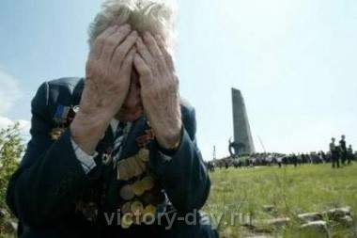
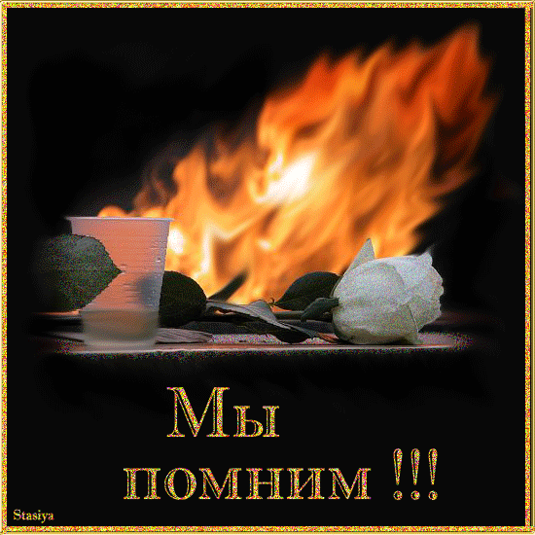
Our generation will never betray our ancestors’ glorious victory on fascism. We’ll always remember their immortal deeds for the benefit of the good fortune and happy life and cloudless sky over our heads.
http://paulcraigroberts.org
WE REMEMBER

Slide 47
Список использованной литературы 1. Аксел А. Герои России. 1941-1945 / А. Аксел. – М.: Интерстамо, 2002. 2. Баграмян И.Х. Так мы шли к победе. Военные мемуары / И.Х.Баграмян. – М.: Воениздат, 1990. 3. Дмитриенко В.П. История Отечества. XX век.: Пособие для учащихся / В.П. Дмитриенко, В.Д. Есаков, В.А. Шестаков. – М.: Дрофа, 2002. 4. Краткая всемирная история. В 2 книгах / Под ред. А.З. Манфреда. – М.: Изд-во Наука, 1996. 5. Падерин А.А. Война и мир: роль духовной культуры в воспитании патриотического сознания / А.А. Падерин // Материалы научно-практической конференции. – Москва: Изд-во Серебряные нити, 2005. 6. Википедиа (интернет) 7. Articles by: Dr. Paul Craig Roberts http://paulcraigroberts.org

