Slide 1
Now I know

Slide 2
g
a
k
e
b
d
i
h
c
f

Slide 4
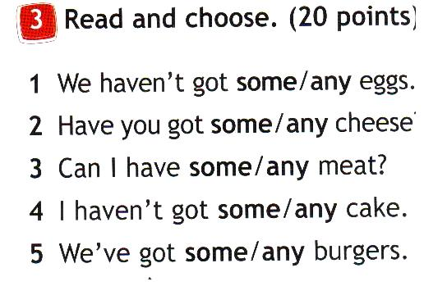
)
?

Slide 5
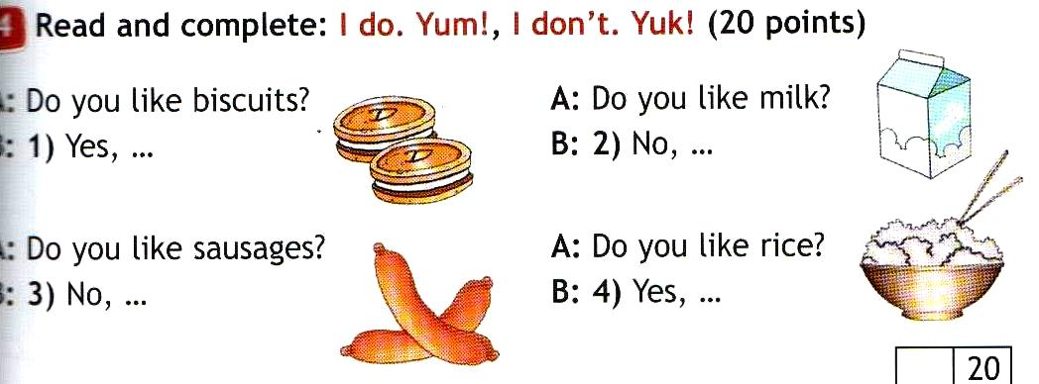
Communication
4
A: B:
I do. Yum!
I don’t. Yuk!
A: B:
I don’t. Yuk!
I do. Yum!

Slide 6
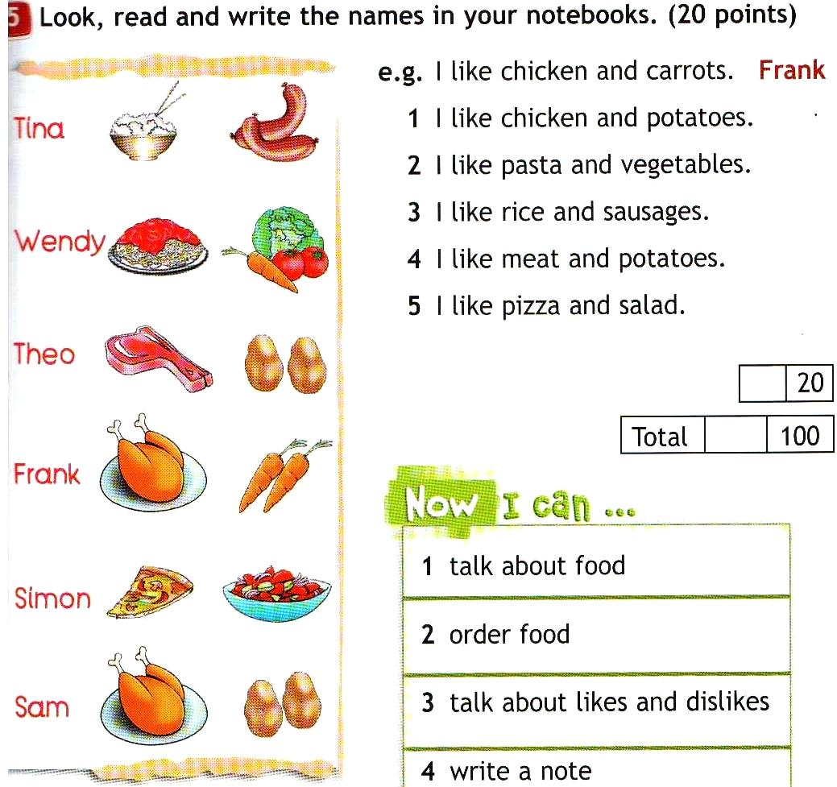
Reading and Writing
5
Sam
Wendy
Tina
Theo
Simon

