Slide 1
My house
Рукавишникова Ольга Анатольевна,
учитель английского языка
ГБОУ СОШ № 383.
Преподаватель Н.А.Карпова.

Slide 2
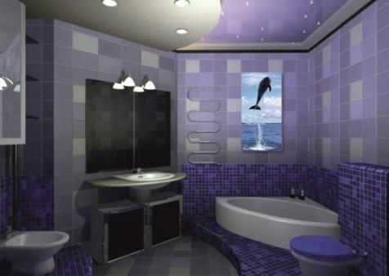
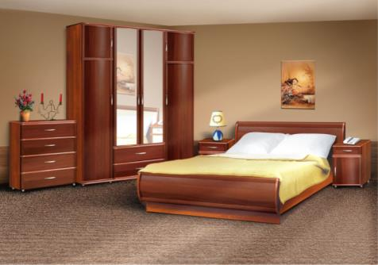
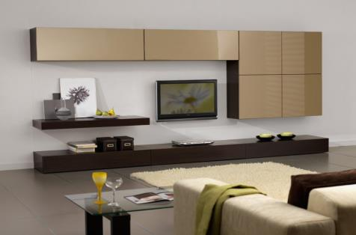
Match words and pictures
Bedroom
Bathroom
Living room

Slide 3
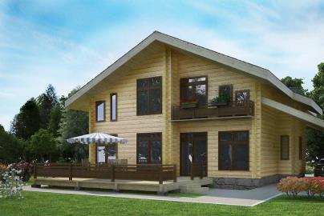
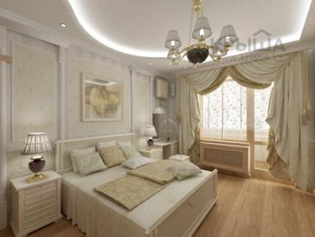
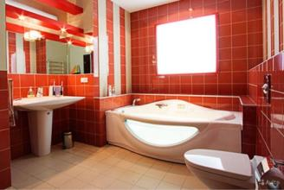
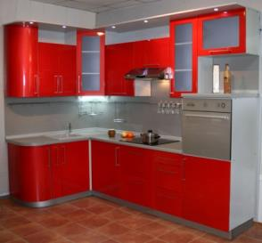
This is my
house
It’s number two.
There is a
bedroom,
a bathroom and a
a kitchen too.

Slide 4
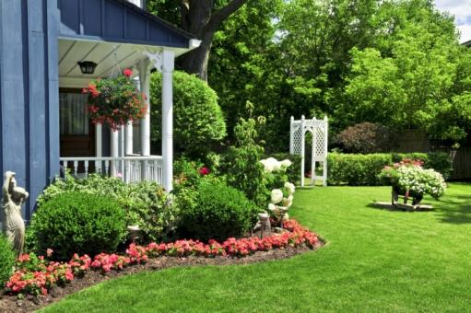
In my house there is
A living room
And in the
garden
All the flowers bloom!

Slide 5
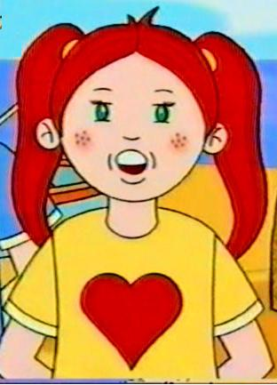
Is Lulu in the garden?
No, she is in the bathroom.

Slide 6
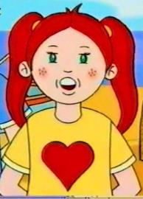
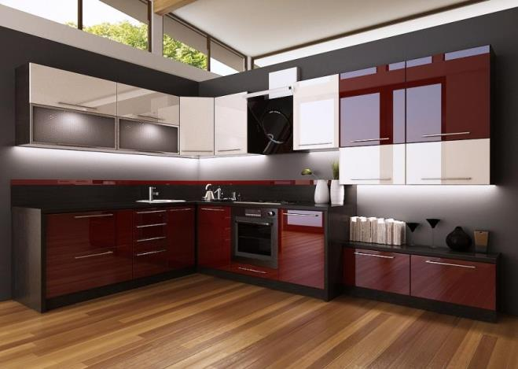
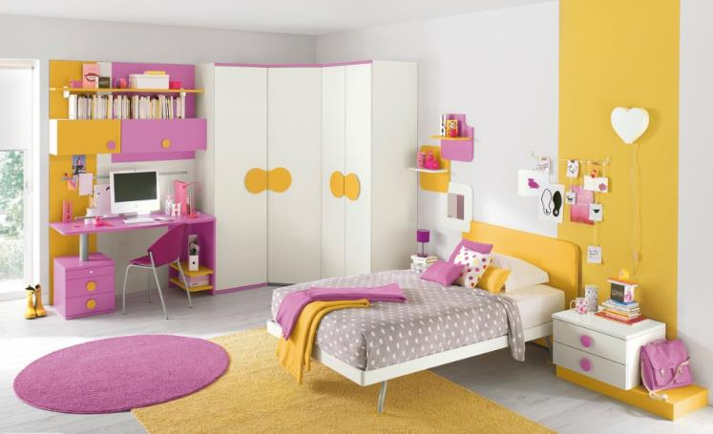
Is Lulu in the kitchen?
No, she isn’t. She is in the bedroom.

Slide 7
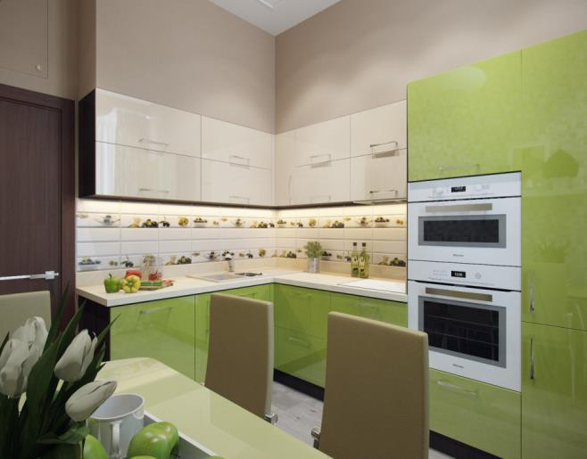
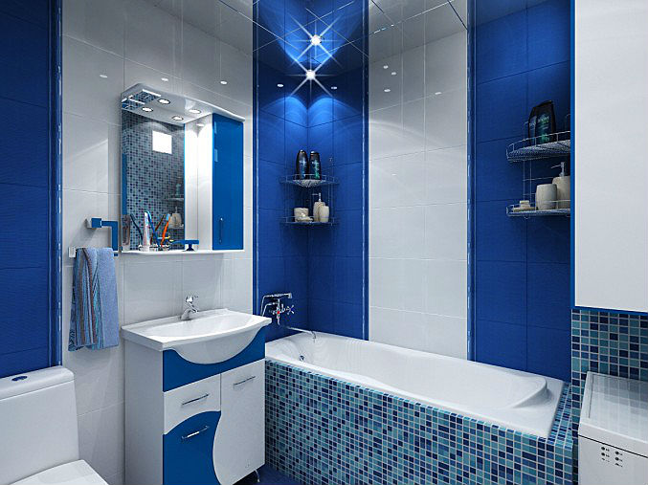
Is Lulu in the bathroom?
No, She isn’t. She is in the kitchen.

Slide 8
Выполните задания на повторение темы «My house»

Slide 9
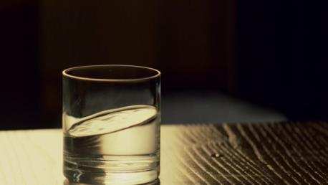
Complete the sentences
There ? a ? on the table
Is … glass
Are …glasses
There IS a glass on the table

