Slide 1







How are you today?

Slide 2
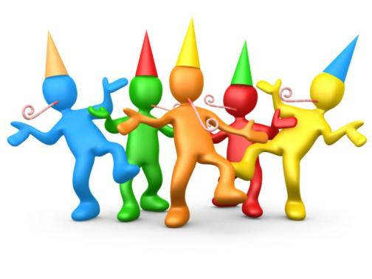
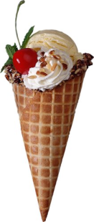
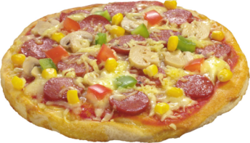
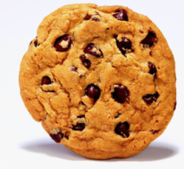
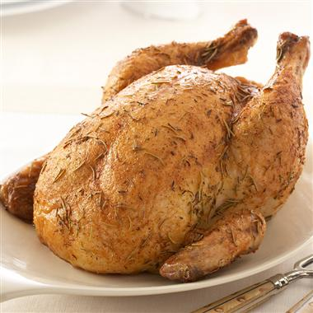
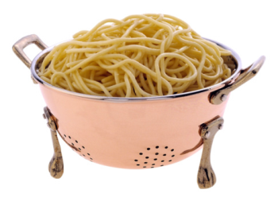
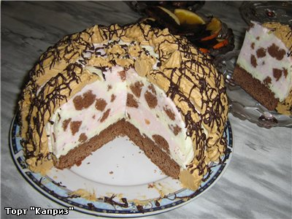
I like She likes

Slide 3


Slide 4
Мы научимся:
говорить о предпочтениях в еде, используя Present Simple.

Slide 5
[ei] [i]
Cake -milk
Bake -chips
-chicken
[ai]
Like
rice

Slide 6
biscuit
pizza
ice-cream
What’s this?
It’s … .
spaghetti
chicken

Slide 7
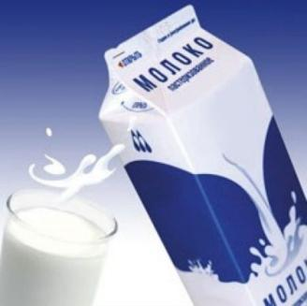
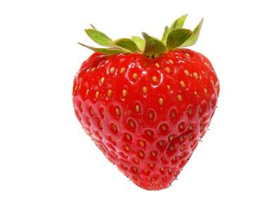
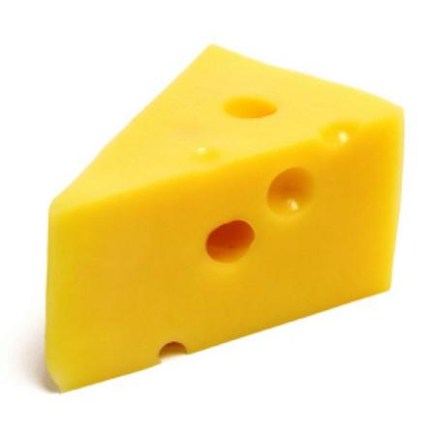
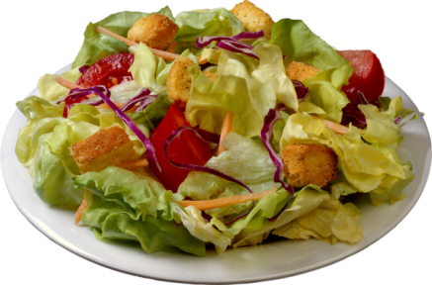
strawberry
cake
milk
What’s this?
It’s … .
cheese
salad

Slide 8
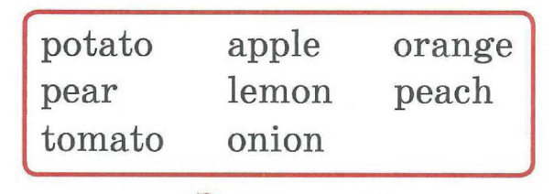
What’s this?
It’s …

Slide 9


Slide 10
Present Simple
утвердительная форма
like
likes
отрицательная форма
don’t like
doesn’t like
вопросительная форма
Do/Does … like…?
I / You / We / They
He / She / It
I / You / We / They
He / She / It

Slide 11
Выбери подходящее слово.
1. My friend like/likes chips.
2. I like/likes ice-cream.
3. She like/likes dancing.
4. They like/likes spaghetti.
5. We like/likes cheese.

Slide 12
Найди ошибки и исправь
I don’t likes bananas
You doesn’t like apples
We are don’t like
They doesn’t like
He is doesn’t like
She doesn’t likes
It don’t like

Slide 13
I don’t likes bananas
You doesn’t like apples
We are don’t like
They doesn’t like
He is doesn’t like
She doesn’t likes
It do_____n’t like

Slide 14
An ice-cram – stand up
A biscuit-run
A pizza-swim
A party-jump
A chicken-sit down
Spaghetti—clap your hands

Slide 15
What does Gogo like?
Onions
Tomatoes
Potatoes
Carrots
Beans
strawberries

Slide 16
Food | I | Sasha | …
Milk
…
…
…
Do you like … ?
Yes,I do
No, I don’t

Slide 17
I like … and … but I don’t like milk and … .
Sasha likes milk and … but he doesn’t like … and … .

Slide 18

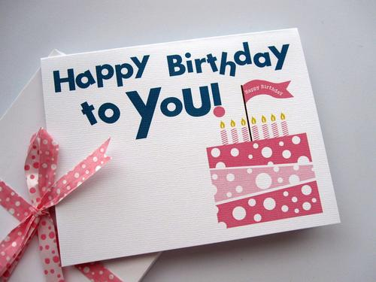



Slide 19



Slide 20
РТ с.48-49

Slide 21



