Slide 1
Сценарий внеклассного мероприятия по английскому языку на тему: «Easter»

Slide 2
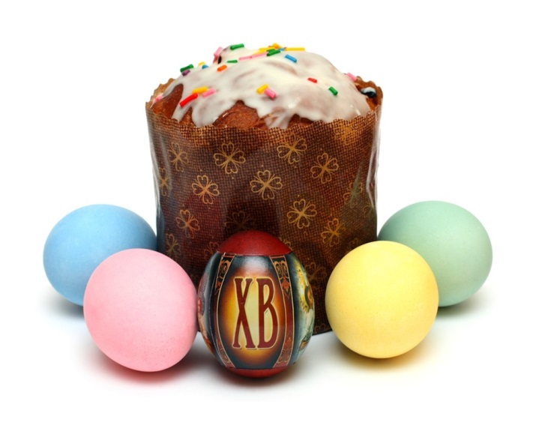
Russian Easter

Slide 3
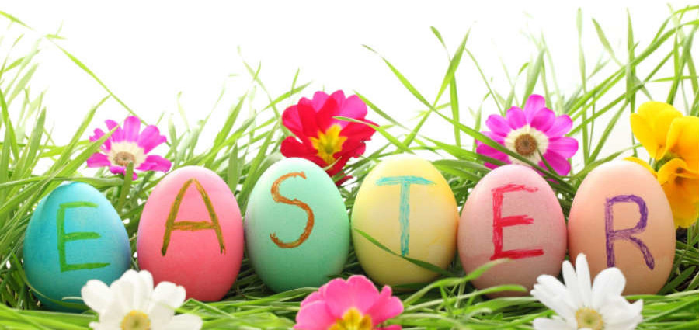

Slide 4
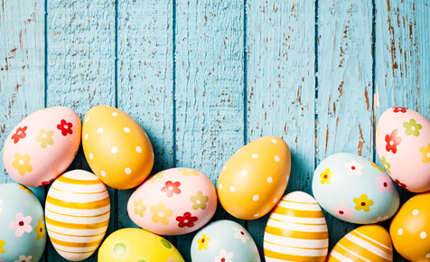

Slide 5
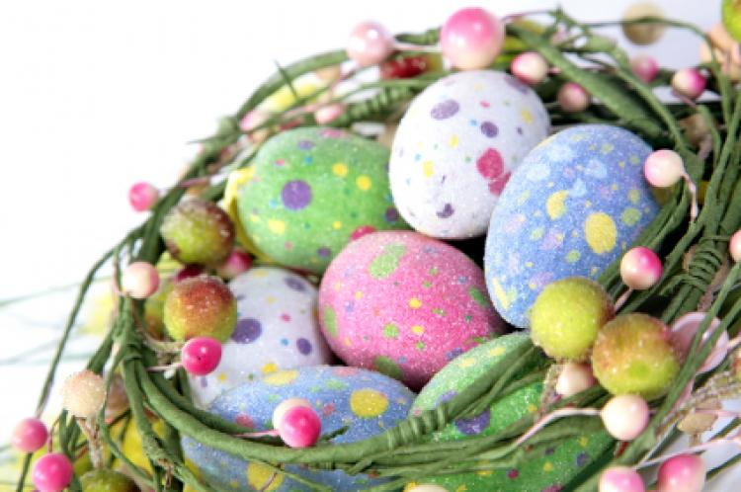

Slide 6
Cross buns

Slide 7
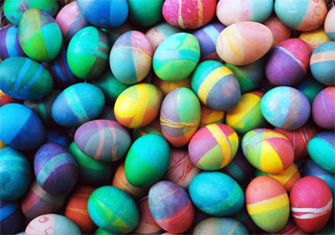

Slide 8
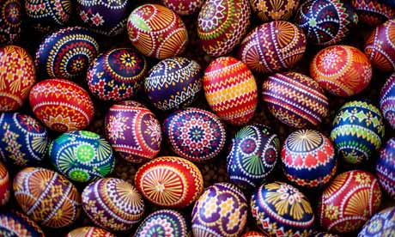

Slide 9
Easter Bunny

Slide 10
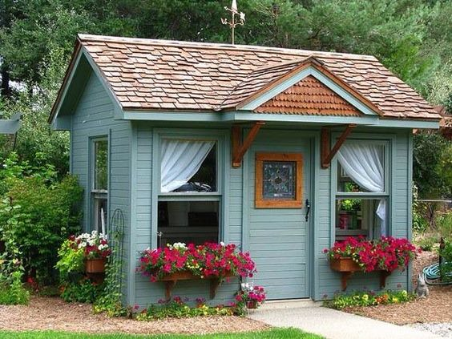

Slide 12
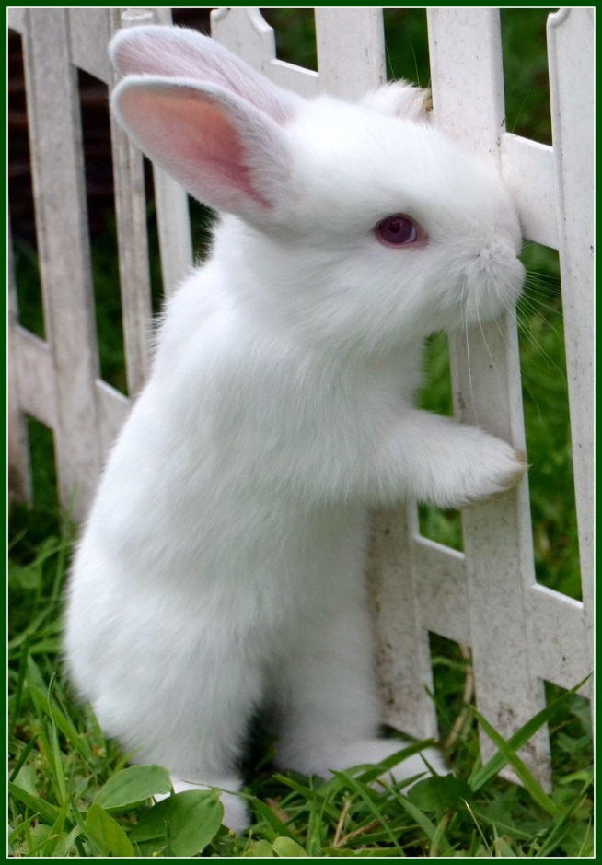

Slide 14
Chocolate Easter eggs

Slide 15
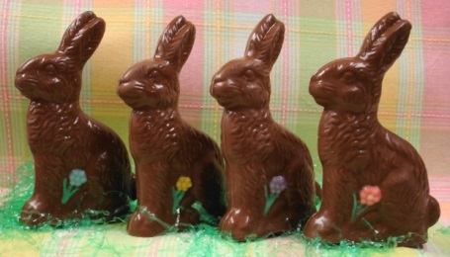

Slide 16
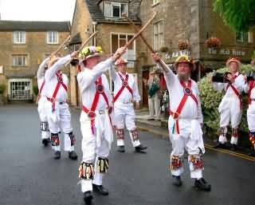

Slide 17
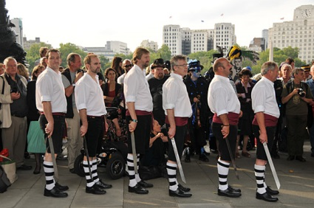

Slide 18
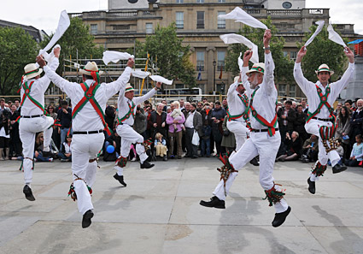

Slide 19
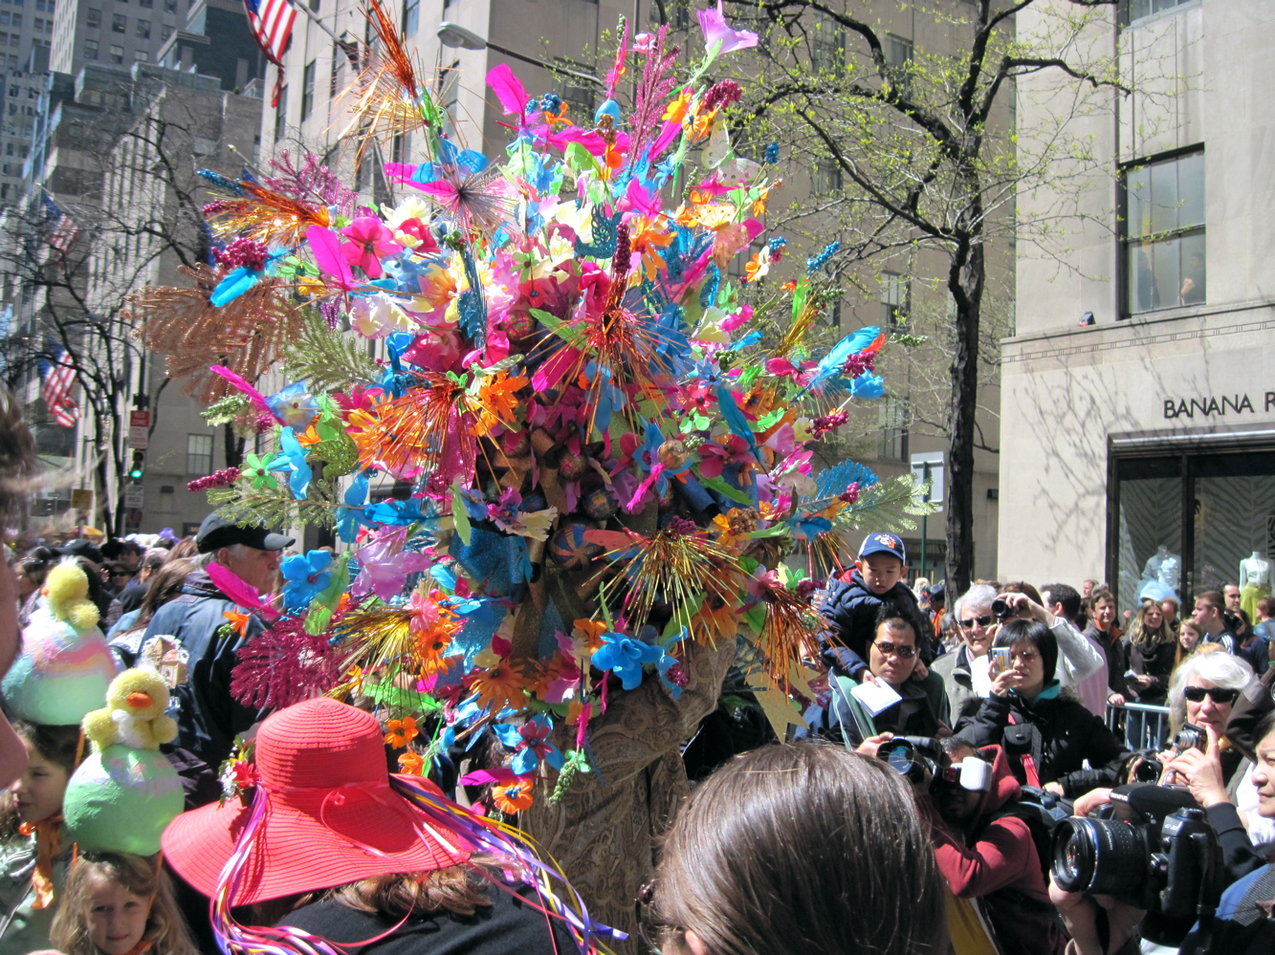

Slide 21
Использованные материалы:
http://russianfoods.com/wp-content/uploads/2013/03/russian-easter-kulich.jpg
http://blog.thetrainline.com/wp-content/uploads/2016/03/Easter-e1427190346683.jpg
http://trefzgerbakery.com/media/Easter-eggs-476x290.jpg
http://c.tadst.com/gfx/750w/easter-monday.jpg?1
http://www.thefreshloaf.com/files/u7270/3%3A4%3A2009%20Hot%20Cross%20Buns%205.jpg
http://s3-ap-southeast-2.amazonaws.com/asset.winning.com.au/bhc/uploads/2013/03/Traditional-Easter-eggs-make-at-home.jpg
http://static.guim.co.uk/sys-images/Guardian/About/General/2012/4/5/1333622377194/Traditional-Easter-eggs-008.jpg
http://cmrrevents.com/wordpress/wp-content/uploads/2015/03/easter-bunny.jpg
https://s-media-cache-ak0.pinimg.com/236x/53/ae/b3/53aeb3144be5aff7ba84ecfb51f4e5d1.jpg
http://feelgrafix.com/data_images/out/15/893699-spring-forest-wallpapers.jpg

Slide 22
11. https://s-media-cache-ak0.pinimg.com/236x/a1/60/30/a16030a1b8e72dc60e20f443252858fc.jpg
12. http://blog.pruhealth.co.uk/wp-content/uploads/Chocolate-eggs-Sister72-on-Flickr.jpg
13. http://1.bp.blogspot.com/-Zjb7NFBa_mQ/T3B1RWPYa0I/AAAAAAAAKVA/UkBlg3Ya_H8/s1600/chocolatehen.jpg
14. http://bhrabbitrescue.org/wp-content/uploads/2013/02/chocolate-classic-bunny-with-flower-620x355.jpg
15. http://www.cotswolds.info/images/ralph/morris_dancers.jpg
16. http://www.urban75.org/london/images/morris-dancers-southbank-076.jpg
17. https://23thorns.files.wordpress.com/2013/10/morris-dancers-01.jpg
18. http://1.bp.blogspot.com/-VA47K5OCkuA/T4IyL4deY6I/AAAAAAAAAkg/K1x_0pwpDOI/s1600/Easter+Parade+Heavy+Hat.jpg
19. http://i0.wp.com/www.jacquelyng.me/wp-content/uploads/2015/11/thank-you-clothesline-752x483.jpg?fit=945%2C9999

