Slide 1
My future profession
Automation fitter
Group 042

Slide 2
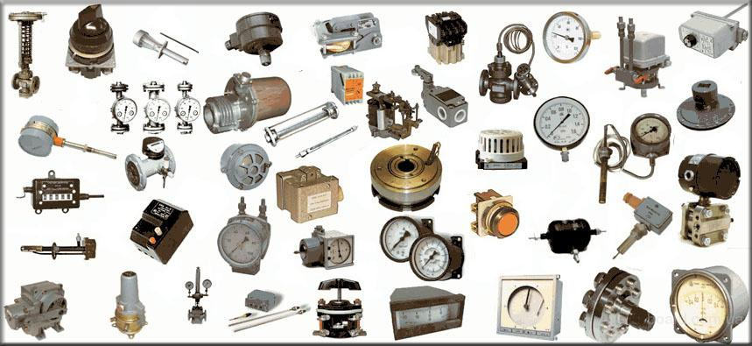
Why I have chosen this profession
Because it is easy to find a job in this specialty. My profession is demand always and everywhere. It is well-paid,if you know foreign languages .

Slide 3
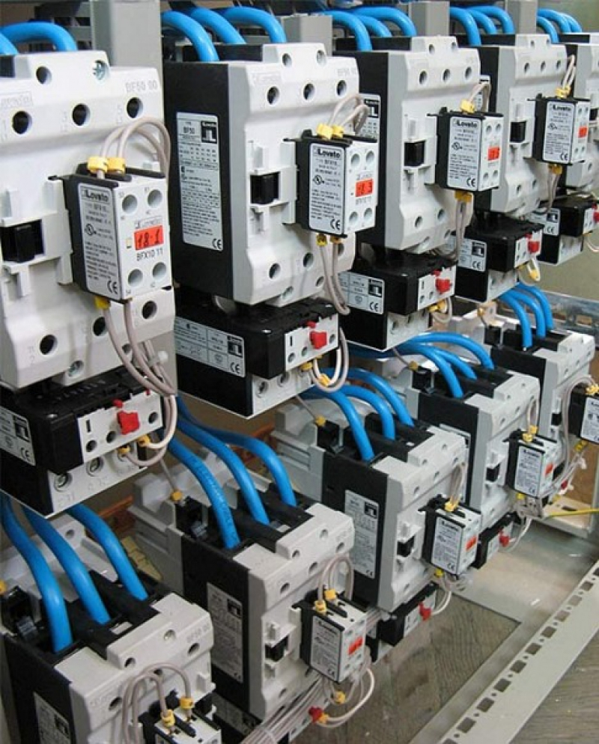
Who is automation fitter
is a versatile specialist working for the maintenance, repair and operation of various control equipment and automatic control systems.

Slide 4
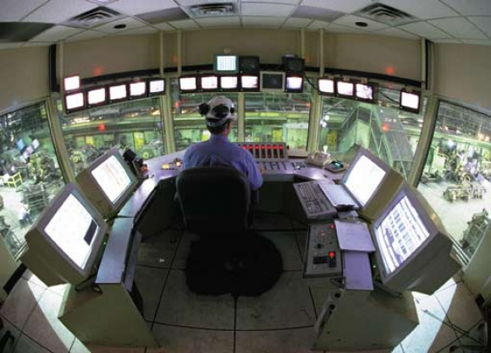
Duties in manufacturing :
- High-quality and timely execution of the duties
- Meet the requirements of technological regulations (flow charts and other normative - technical documentation), rules and regulations for safety in the work
- Execution of orders, orders for the company, instructions and orders of the section chief (deputy head of the department), master control equipment, LPA
- Compliance with labor and executive discipline, work rules
- Compliance with rules and regulations on safety, industrial sanitation, fire safety requirements for environmental protection

Slide 5
Duties in manufacturing :
- Compliance with labor and executive discipline, work rules
- Compliance with rules and regulations on safety, industrial sanitation, fire safety requirements for environmental protection

Slide 6
Professional holidays
professional holiday for representatives of this profession is Energy and World Metrology Day.
Energy Day is celebrated in Russia each year on December 22. Interestingly, this festival falls on the shortest daylight of the year - the winter solstice.
World Metrology Day is celebrated every year on May 20 - the day of the signing of the Metre Convention, which became the basis of an intergovernmental international organization of weights and measures.

Slide 7
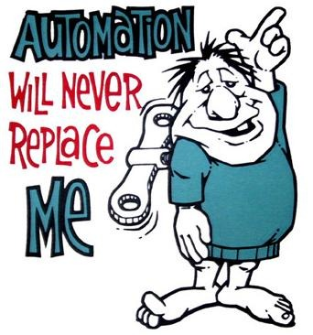
We are
the best automation fitters

