Slide 1
Professional and Residential Purposes of English
Popkova Valery,
Khusainova Alfiya,
Group 143-1

Slide 2
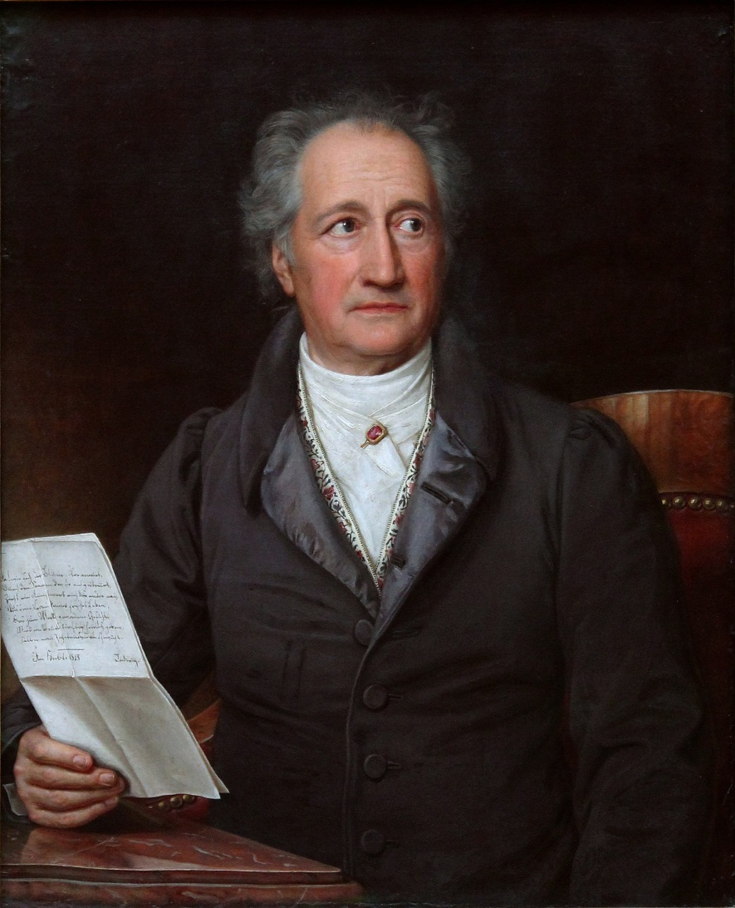
“He, who knows no foreign language, doesn’t know his own one”
Johann Wolfgang von Goethe

Slide 3
The English language
Nowadays it’s especially important to know foreign languages. Some people learn languages because they need them for their work, others for travelling abroad, for the third - studying foreign languages is a hobby. Everyone, who knows foreign languages can speak to people from other countries, read foreign authors in the original, which makes their outlook wider.
Knowledge of foreign languages helps us to develop friendship and people understanding.

Slide 4
English as a World Language
Now in the world there are about 1.5 billion English-speaking people!
In 54 countries English is the official language. Great Britain, the USA, Canada, Ireland, Malta, some states of Asia and Oceania, Africa treat them.
Also English is one of the official languages of many international organizations.
English is very popular now. It’s the language of computers, science, business, sport and politics.

Slide 5
English in My Profession
Half of the world’s scientific literature is in English. It’s the language of computer technology.
Our profession is the programmer. Without knowledge of English it is impossible to comprehend it. Almost all terms, definitions are borrowed from English. All programs also are written in English. Therefore to become the best in the profession for us is the necessity of English.

Slide 6
English in Our Life
English is very popular now.
English is the language of great literature.
It is the language of sports and glamour: the official language of the Olympics and the Miss Universe Competition.
The largest broadcasting companies in the world (CBS, NBS, ABC, BBC) transmit in English for audience.

Slide 7
Knowing a foreign language (English) you can read international papers, magazines and books in the original of great writers, watch satellite TV programs. If you like travelling you can go anywhere abroad.

Slide 8
We think that knowing of English today is absolutely necessary for every educated man, for every good specialist.

Slide 9
Thanks for attention!

