Slide 1
MY FUTURE PROFESSION
Suslov Maxim gr.141

Slide 2
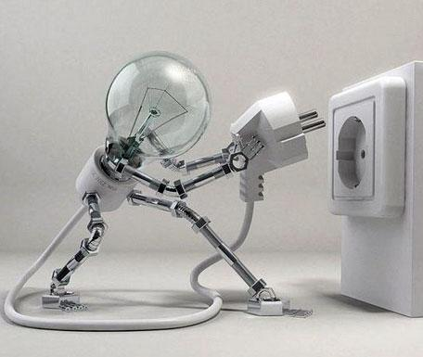
Advantages
Today, about a man "who invented the XX Century",people remember not very often. But the fruits of Nikola Tesla’s works lived till to this day, giving us the opportunity to enjoy all the benefits of progress.

Slide 3
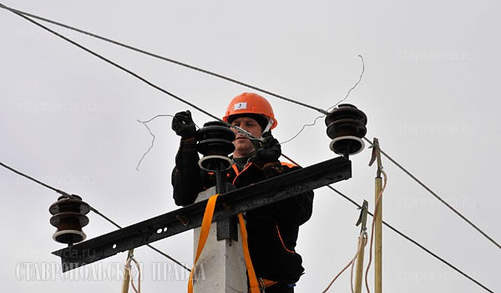
Every year the profession of electrician becomes more popular in modern society.

Slide 4
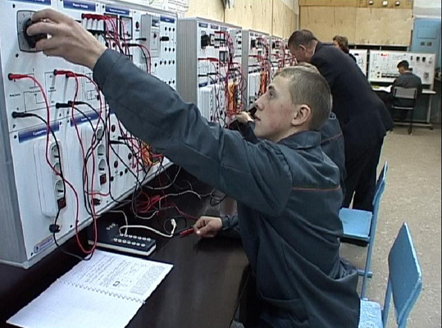
electrician profession remains popular, respected and well-paid

Slide 5
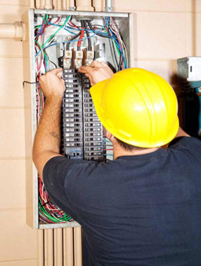
Qualitative performance of their tasks depend uninterrupted operation of any enterprise.

Slide 6
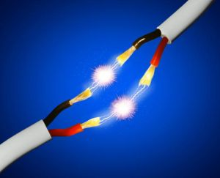
Disadvantages
No one is safe from electric shock

Slide 7
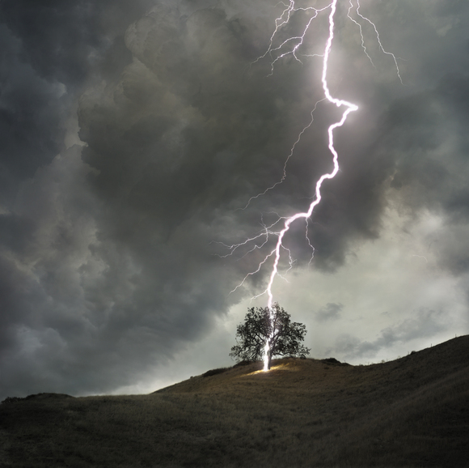
in the open field lightning can strike the human

Slide 8
Don’t forget that high voltage is dangerous for people

