Slide 1
My future profession
Dmitry Lebedev,
group 015

Slide 2
My future profession is a computer programmer.
I get this profession in Polytechnic Department of our college. The studing here gives me the opportunity to get new skills, knowledge and at last a diploma.
Who is a programmer ?
Programmer is a specialist who deals with the design, development and maintenance of computer programs.

Slide 3
Programmers may be
a computer system architect
a computer analyst

Slide 4
A computer system architect
A computer system architect creates programs for users.
They work with games, multimedia and Web-pages.

Slide 5
A computer analyst
A computer analyst is called the person, whose programs are designed to provide the computer and used by other computer professionals.

Slide 6
Programming languages
For programmers there are many programming languages.
The most common programming languages ​​are C++, Delphi, Pascal, Visual Basic, HTML, PHP, Oracle.

Slide 7
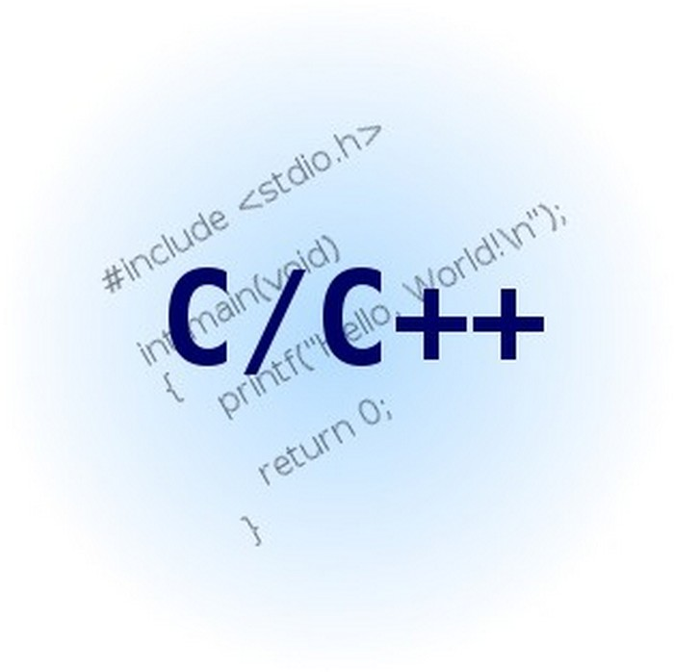

Slide 8
Advantages of my profession
Advantages of my profession are
good wages and working conditions demand;
programmers have the ability to work at home.

Slide 9
Disadvantages of my profession
Disadvantages of profession are
the loss of vision,
the job requires a lot of time,
a large mental load.

Slide 10
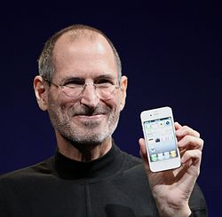
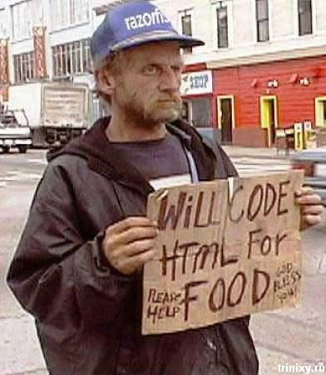
Successful
Unsuccessful
As you can see, the knowledge of foreign languages is necessary for our great success in the future.

