Slide 1
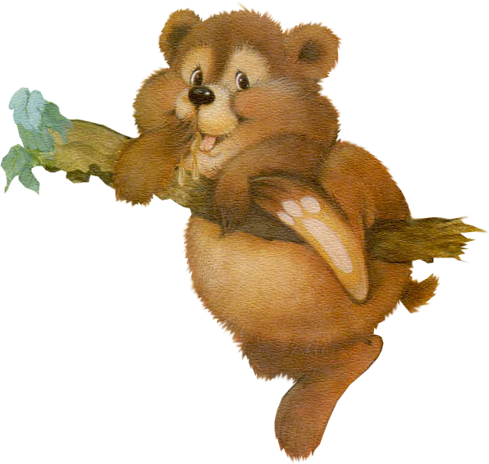
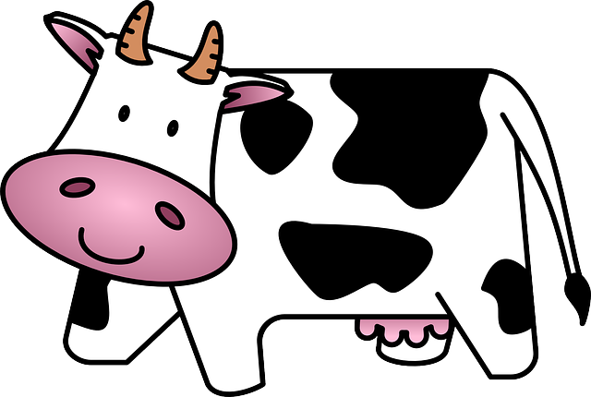
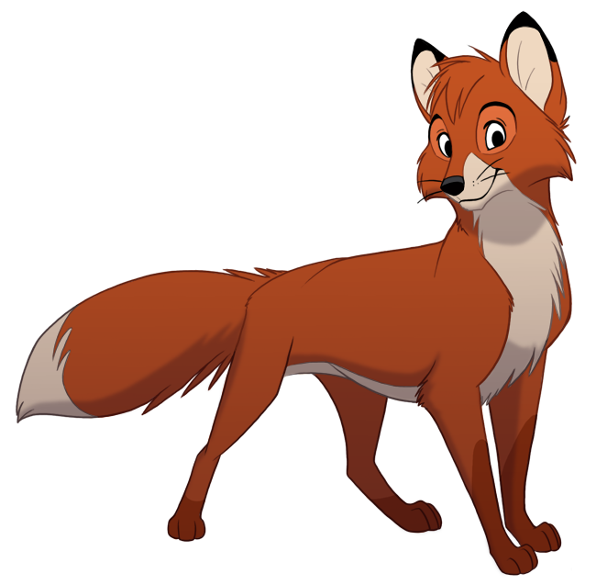
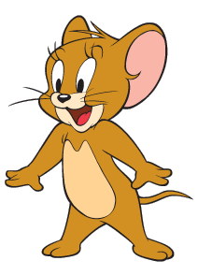
Wild and domestic animals.

Slide 2
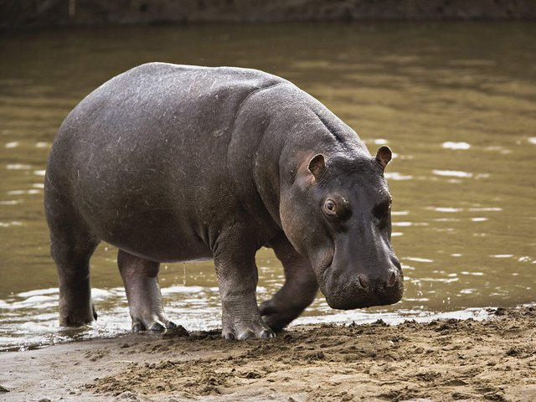
A HIPPO [‘hɪpəʊ] has got a fat body.
It lives in Africa.

Slide 3
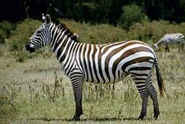
A ZEBRA [‘zebrə] is black and white.
It lives in Africa.

Slide 4
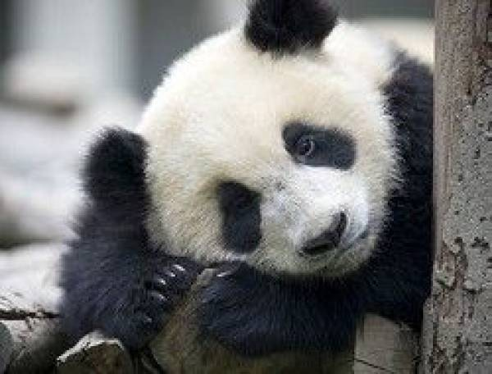
A PANDA [‘pændə]has got
two black
spots around its eyes.
It lives in Asia.

Slide 5
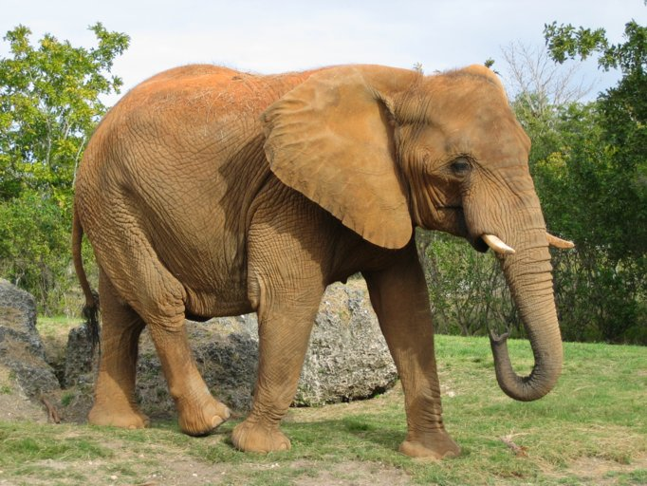
An elephant has got a very
long nose (TRUNK [trʌŋk]).
It lives in Asia and Africa.

Slide 6
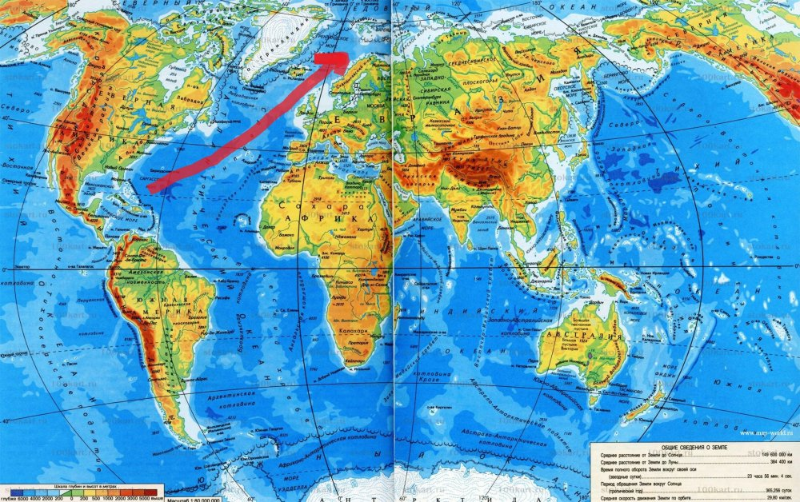

Slide 7
Task:
Say where these animals live and what we must give them to eat and to drink.

Slide 8
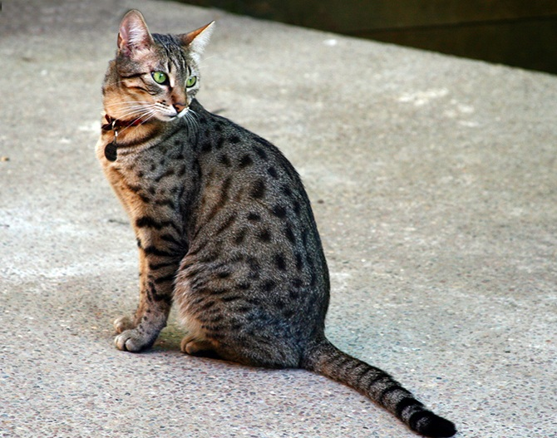
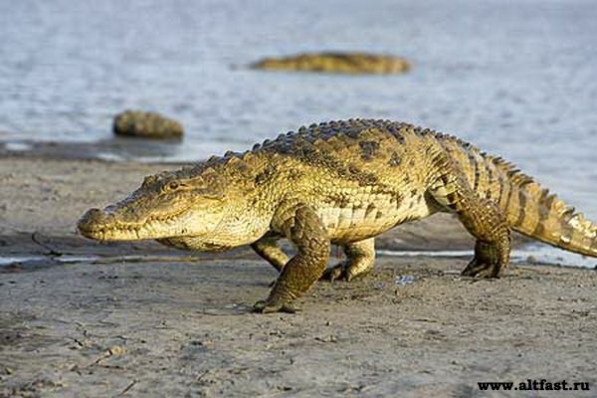
A cat lives …………………………………………………………….
We must……………………………………………………………….
A crocodile lives………………………………………………
We must…………………………………………………………

Slide 9
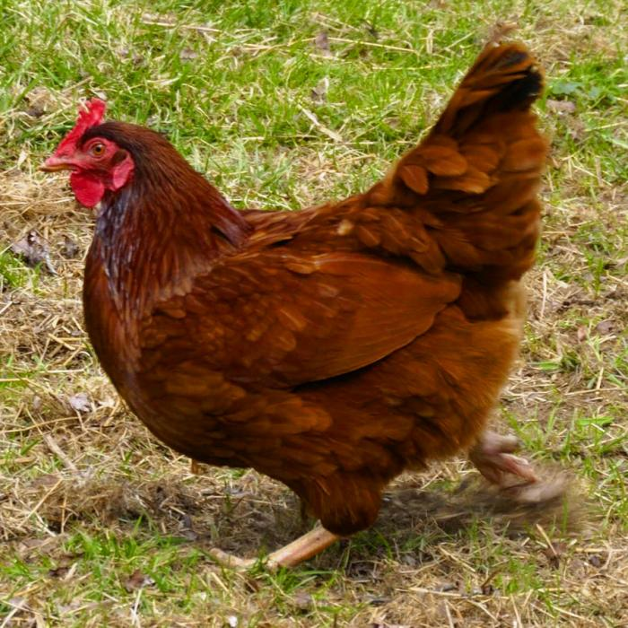
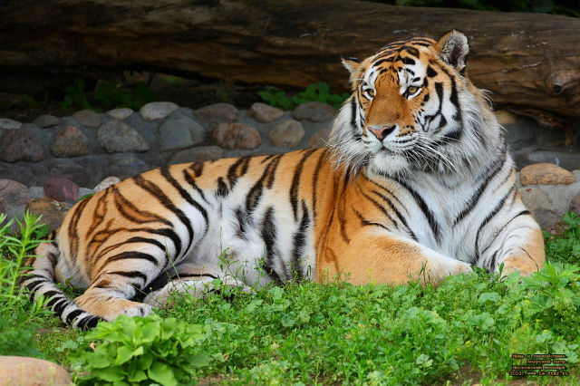
A hen lives……………………………………………………………
We must……………………………………………………………….
A tiger lives……………………………………………………
We must………………………………………………………..

Slide 10
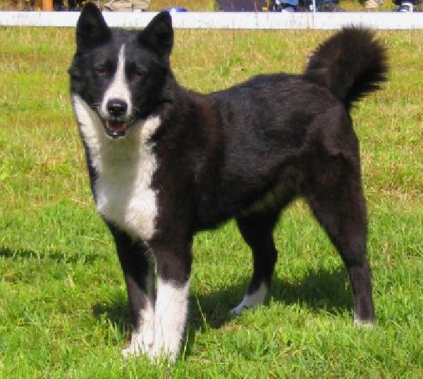
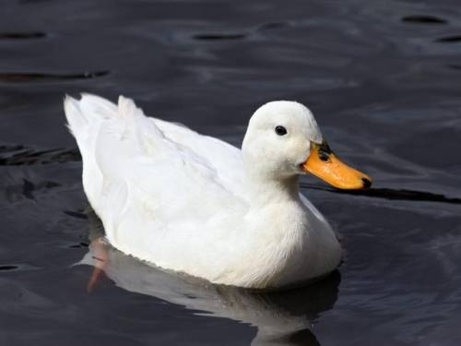
A dog lives……………………………………………………..
We must………………………………………………………..
A duck lives……………………………………………………….
We must………………………………………………..

Slide 11
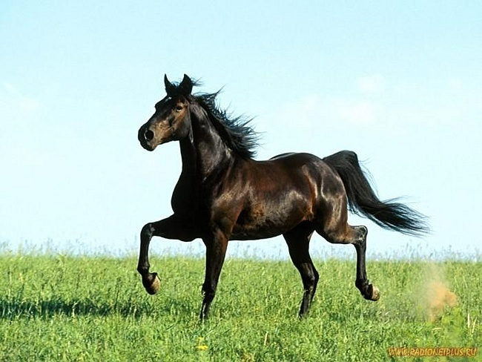
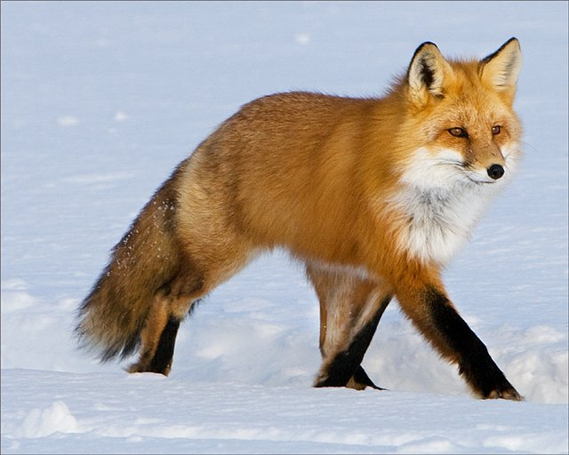
A horse lives……………………………………………………..
We must……………………………………………………………….
A fox lives………………………………………………………….
We must……………………………………………………………….

Slide 12
A panda lives……………………………………………………..
We must……………………………………………………………….
A zebra lives……………………………………………………..
We must……………………………………………………………….

Slide 13
A hippo lives……………………………………………………..
We must……………………………………………………………….
A hippo lives……………………………………………………..
We must……………………………………………………………….

Slide 14
Is it a domestic or a wild animal?
Where does it live?
What is it like?

