Slide 1
Развитие логических УУД на уроках английского языка в 3 классе (УМК И.Н. Верещагиной, Т.А. Притыкиной)
Яковлева С.Н.
учитель английского языка
НОУ «ООЦ «Школа»

Slide 2
Логические универсальные действия: - анализ объектов с целью выделения существенных и несущественных признаков; - синтез – составление целого из частей; - выбор оснований и критериев для сравнения, сериации, классификации объектов; - установление причинно-следственных связей; - построение логической цепи рассуждений; - доказательство; - построение гипотез и их обоснование.

Slide 3
Классификация по тематическому принципу:
Group the words:
ski, sister, uncle, blue, hockey, basketball, black, father, aunt, white, badminton, green, brown, skate, football, yellow, brother, daughter
SPORT
COLOURS
FAMILY

Slide 4
Классификация по видовому принципу:

Slide 5
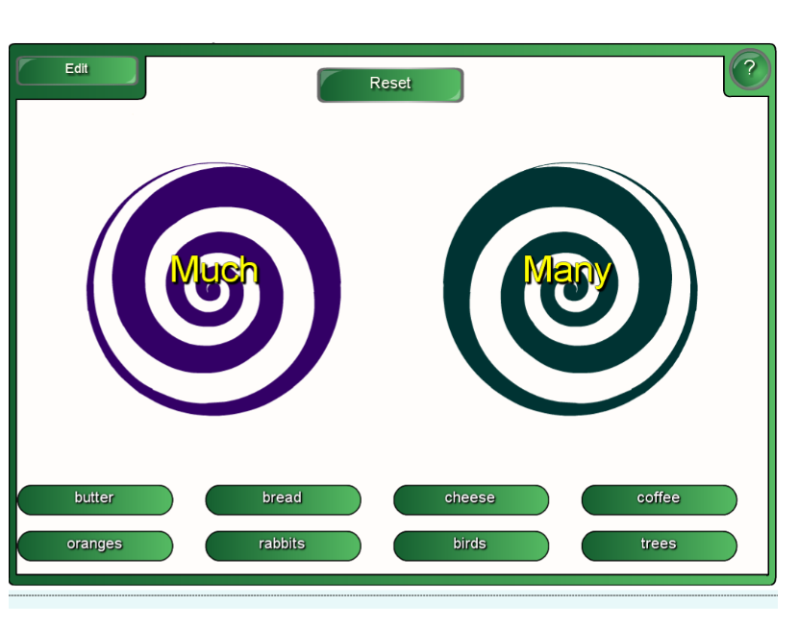
Классификация по грамматическому принципу:

Slide 6
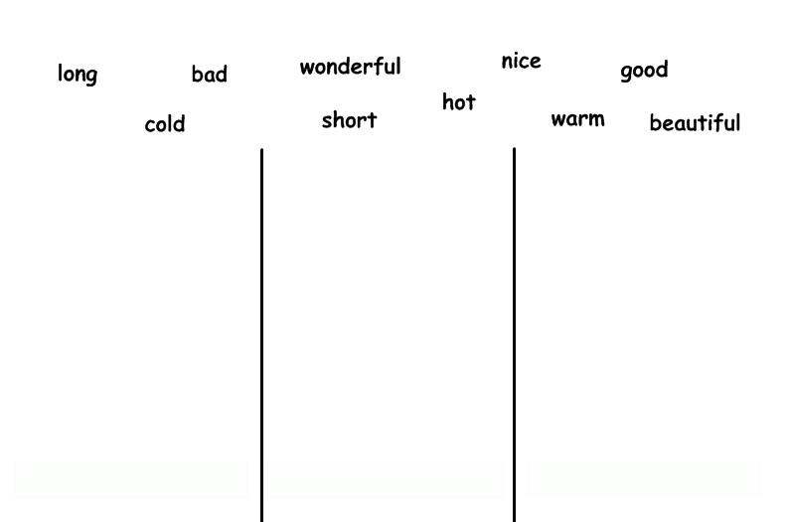
Классификация по грамматическому принципу:
Одно-
двусложные
Многосложные
Исключения

Slide 7
Классификация по грамматическому принципу:

Slide 8
Сравнение
have 4 meals a day: breakfast, lunch, tea, dinner or supper
English people’s last meal is dinner
or supper
eat porridge for breakfast
drink a lot of tea
don’t eat much bread

Slide 9
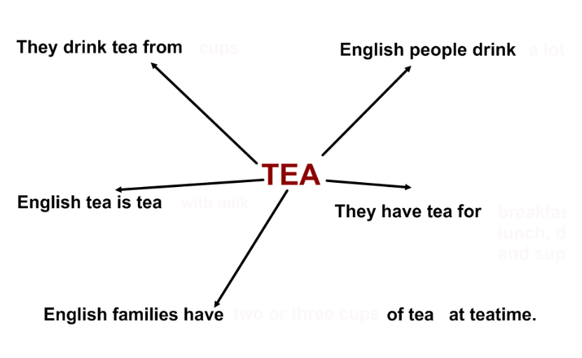
Анализ
cups
a lot of tea
breakfast
lunch,
dinner
and supper
with milk
2 or 3 cups

Slide 10
Синтез
The English Year
1. In great Britain summer...
2. May, June and August ...
3. The weather is...
4. The days are long, and ...
5. People wear light clothes...
6. On the 1st Monday of May English people ...
7. In June the English people ...
8. On that day children send...
9. In July and August British people can...
10. If the weather is fine,...
a) usually warm, it is often changeable.
b) celebrate the May day holiday.
c) cards and give presents to their fathers.
d) go to the parks, to the swimming pools, to the stadiums.
e) are four summer months.
f) there are a lot of people on the beaches.
g) celebrate Father's Day.
h) the nights are short.
i) cotton shirts, jeans, skirts, T-shirts and light shoes.
j) begins in May.

Slide 11
Синтез
Complete the dialogue and role-play it.
Good afternoon.
Good afternoon.
I’d like a pair of jeans, please.
…
Blue.
…
25. Can I try them on?
…
Sorry, could you change these jeans, please.
…
It’s the wrong size.
…
They’re too big for me.
…
Thanks a lot. They are so nice!
…
Why? What’s wrong with them?
I’m sure this pair of jeans will be the right size for you.
And what size do you want?
Of course.
They suit you so well! You’ll look great!
What colour would you like?
Are they too big or too small?

Slide 12
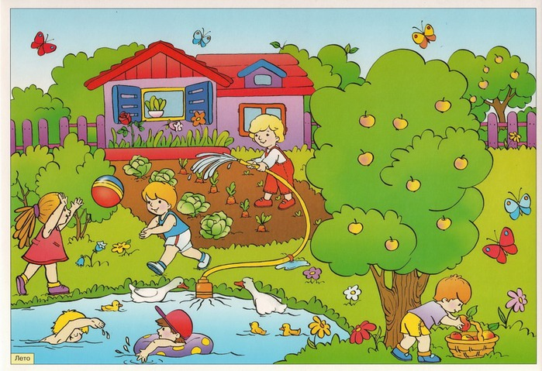
Доказательство
What season is it?
How can you prove it?
It is .... because...
- How is the weather?
- What are the children doing?
- What are the children wearing?
- What colour are the leaves?
- What colour is the grass?

