Slide 1
Present Continuous
Настоящее продолженное

Slide 2
Difference between Present Simple and Continuous
Present Simple
I go to school. – Я хожу в школу.
Present Continuous
I am going to school now. – Я иду в школу сейчас.

Slide 3
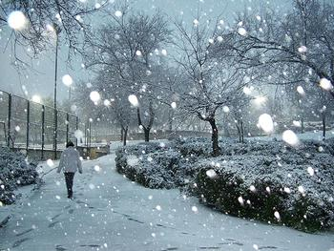
It’s snowing
s
ing
Идет снег

Slide 4
to be
Present Continuous образуется с помощью:
am
V
is
ing
are

Slide 5
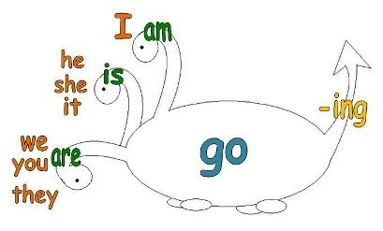

Slide 6
am
playing
is
watching
are
reading
He
now.

Slide 7
am
playing
is
watching
are
reading
They
now.

Slide 8
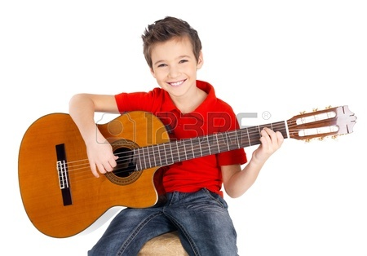
am
playing
is
watching
are
reading
I
the
guitar now.

Slide 9
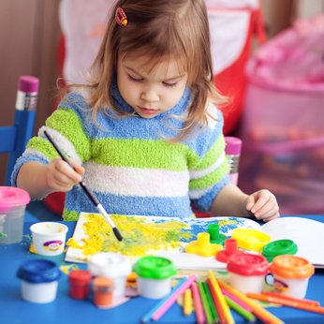
What is she doing at the moment?
She’s drawing a picture at the moment.

Slide 10
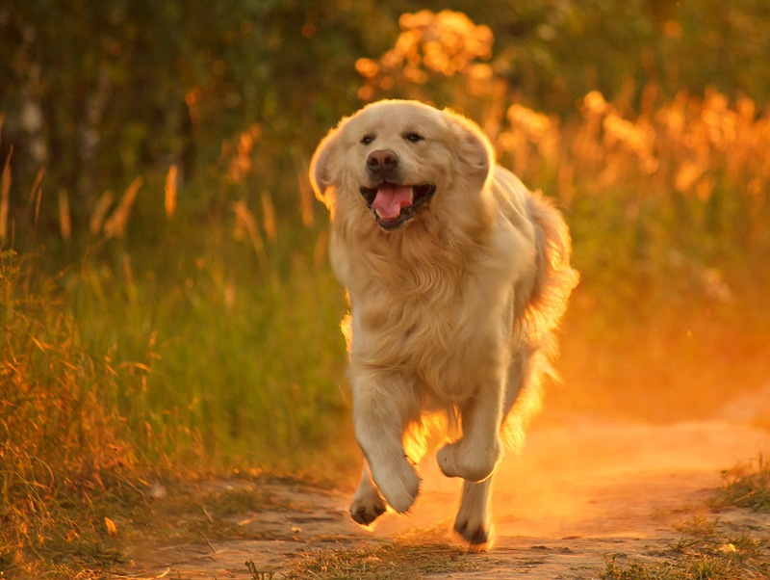
What is it doing now?
It’s running now.

Slide 11
When we speak, we usually use short form of the verb to be
I am reading.
I’m reading.
She is reading.
She’s reading.
You are reading.
You’re reading.

Slide 12
Помни, что при добавлении окончания -ing
jump
ing
jumping
make
ing
making

Slide 13
run
ing
running
sit
ing
sitting

Slide 14
Negative
Отрицание

Slide 15
to be
Отрицательные предложения в Present Continuous образуется с помощью:
am
V
not
is
ing
are

Slide 16
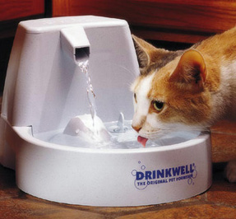
Cat is not eating.
- Кот не кушает.

Slide 17
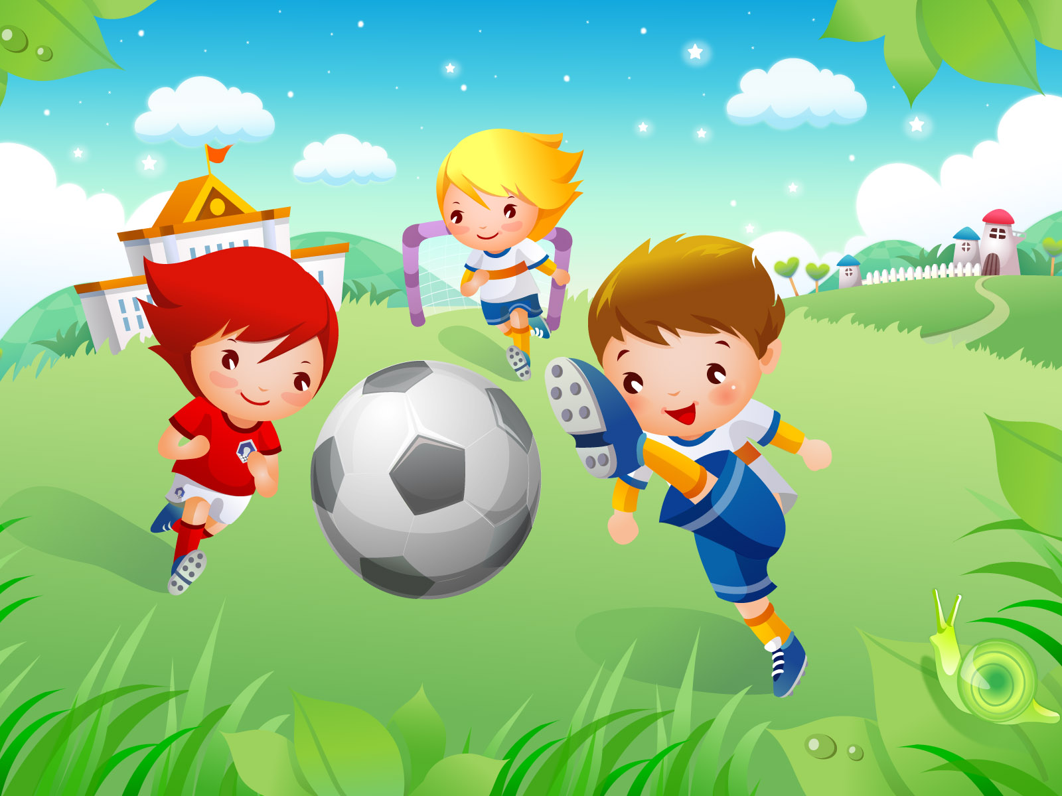
We are not sleeping.
- Мы не спим.

Slide 18
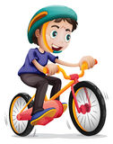
Short form
You are not swimming.
You aren’t swimming.

Slide 19
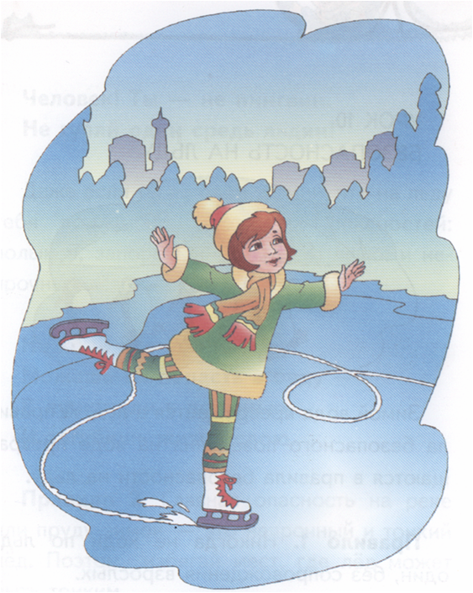
Choose the right sentence
She isn’t skating.
She’s skating.

Slide 20
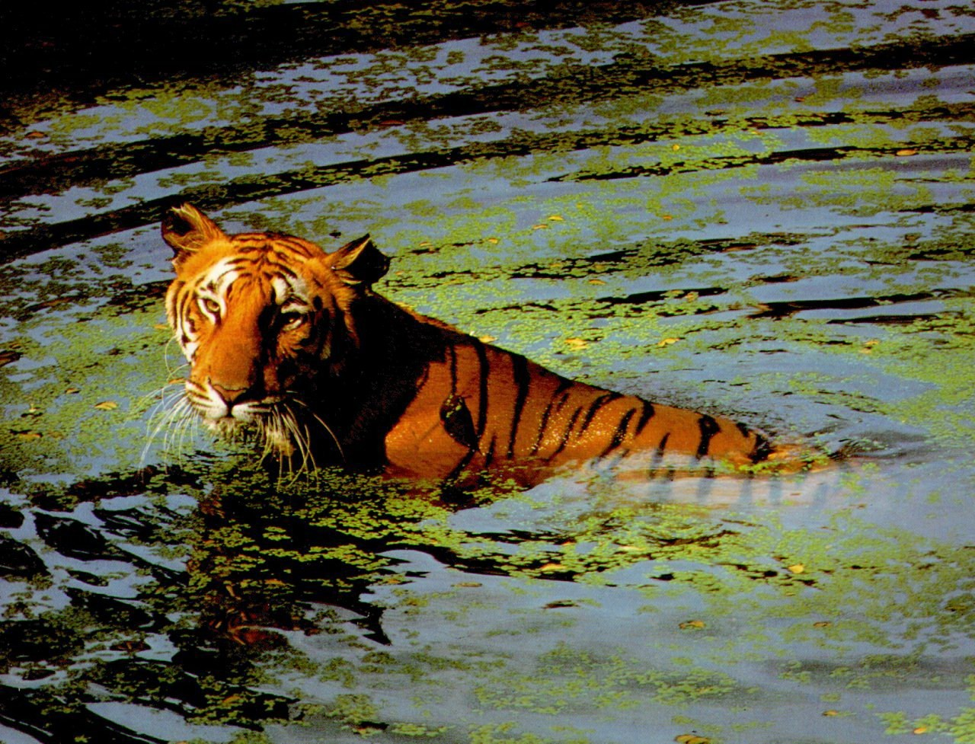
The tiger’s jumping.
The tiger isn’t jumping.

Slide 23
Thank you
For your
attention

