Slide 1
Information Technology
in my life
SPK – 4 Golomazov Artem

Slide 2
Hello! My name is Artem
and I’d like to tell you
about Information Technology
by using Information Technology!
Yes, this presentation is rather strange
but significant way of communicating with a computer.
It shows how differently we can use
Information Technology in our lives.

Slide 3
What is Information Technology:?

Slide 4
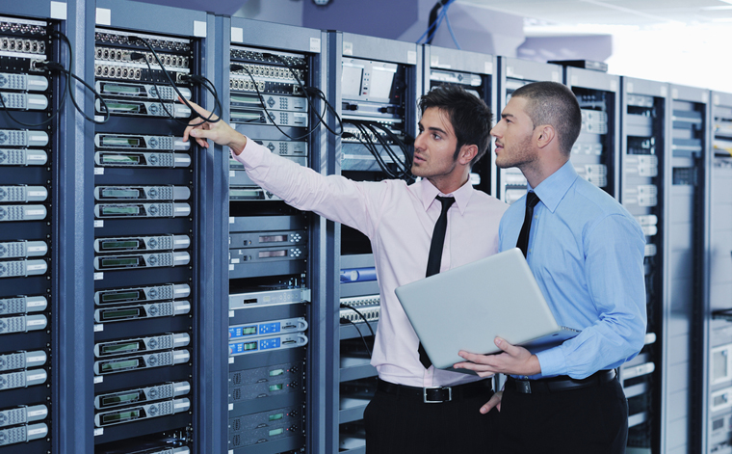
Information technology (IT) is the application
of computers and telecommunications equipment
to store, retrieve, transmit and manipulate data.
The term is commonly used as a synonym for computers and computer networks, but it also encompasses other information distribution technologies such as television and telephones. Several industries are associated with information technology, including computer hardware, software, electronics, semiconductors, internet, telecom equipment, engineering, healthcare, e-commerce and computer services.

Slide 5
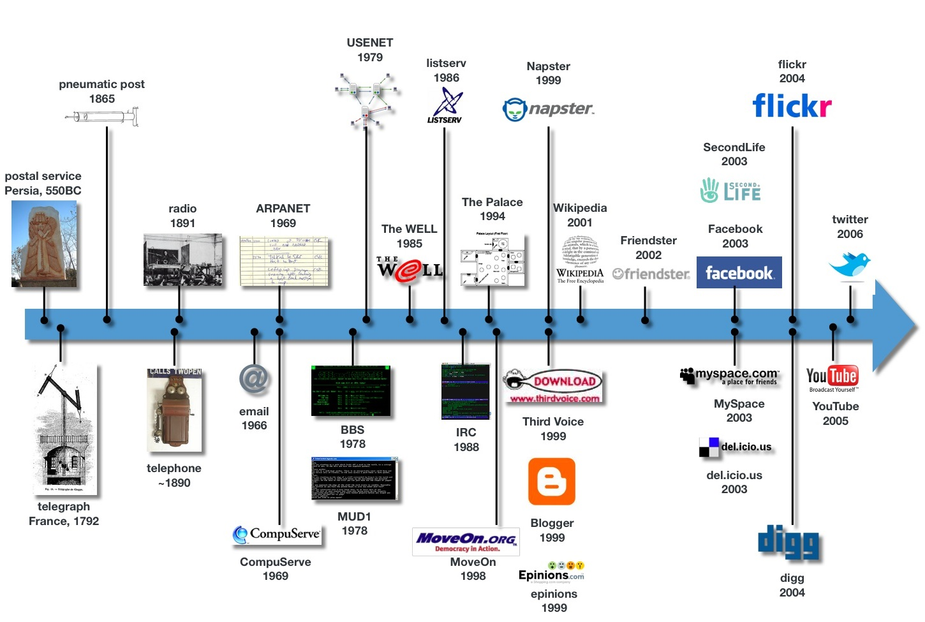
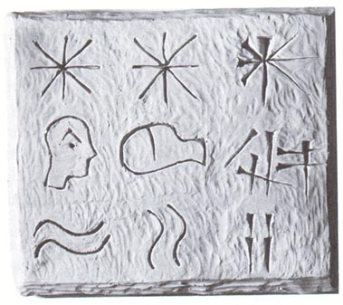
History of Information Technology takes its origin long before the modern discipline of computer science, which appeared in the 20th century. Information technology related to the study of methods and means of collection, processing and transmission in order to obtain information about the quality of the new state of the object, process or phenomenon.
In view of increasing needs of mankind
in the processing of all the large amounts
of data, improved means of obtaining
information from the earliest mechanical
inventions to modern computers.
Also as part of the development
of information technology there is
a concomitant of mathematical
theories, who now form
the modern concept

Slide 6
IT Technologies
Information technology includes all the resources needed to manage information, especially computers, software, and network necessary for the creation, storage, management, sharing and retrieval of information.
Network
Terminals
Services

Slide 7
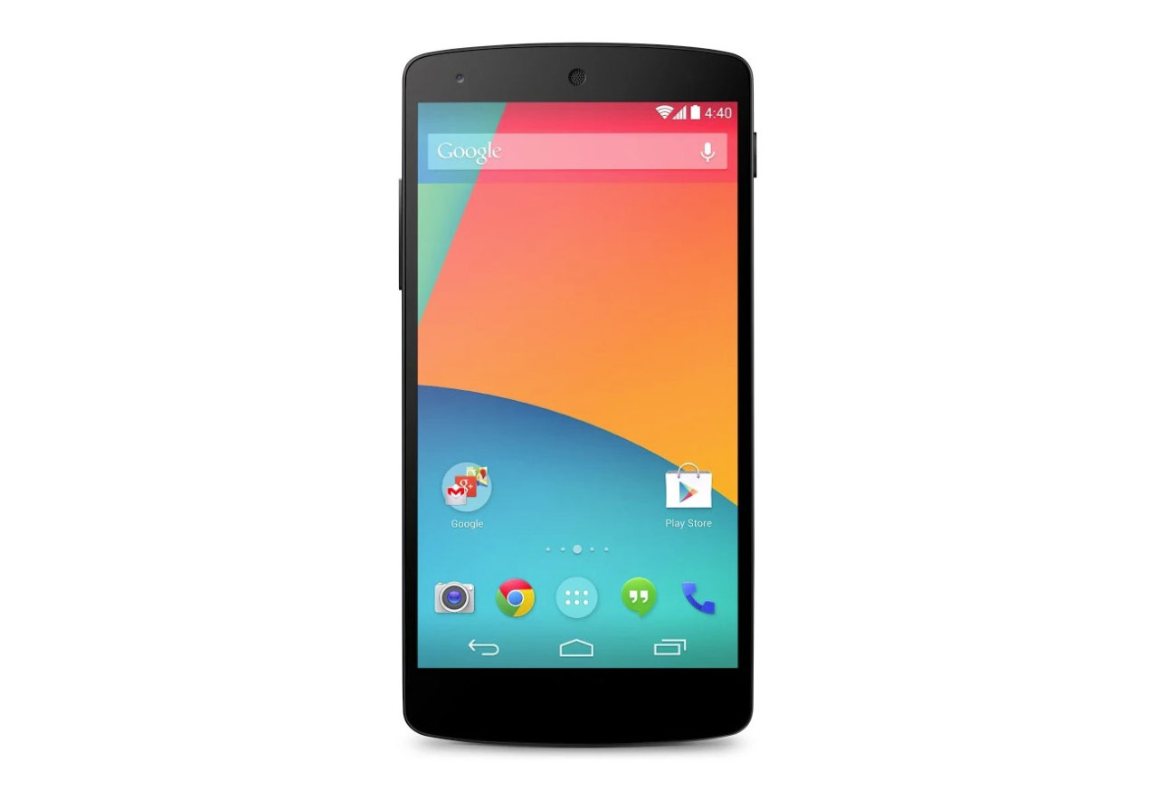
Every day new IT technologies and trends
that are currently on the wave of popularity of smartphones,
replacing the life of a lot of things and
take place in the Internet space, come out
A smartphone is a mobile phone with an advanced mobile operating system which combines features of a personal computer operating system with other features useful for mobile or handheld use. They typically combine the features of a cell phone with those of other popular mobile devices, such as personal digital assistant (PDA), media player and GPS navigation unit.

Slide 8
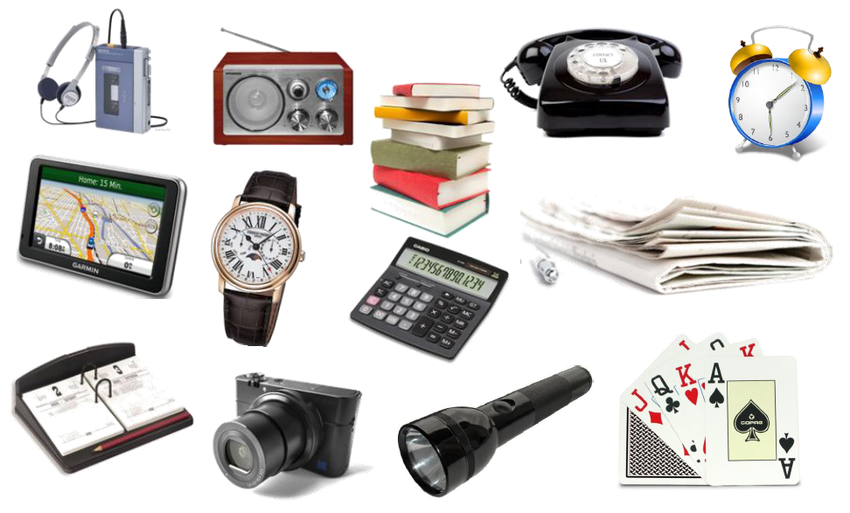
Almost everyone already has a smartphone and use it for various purposes

Slide 9
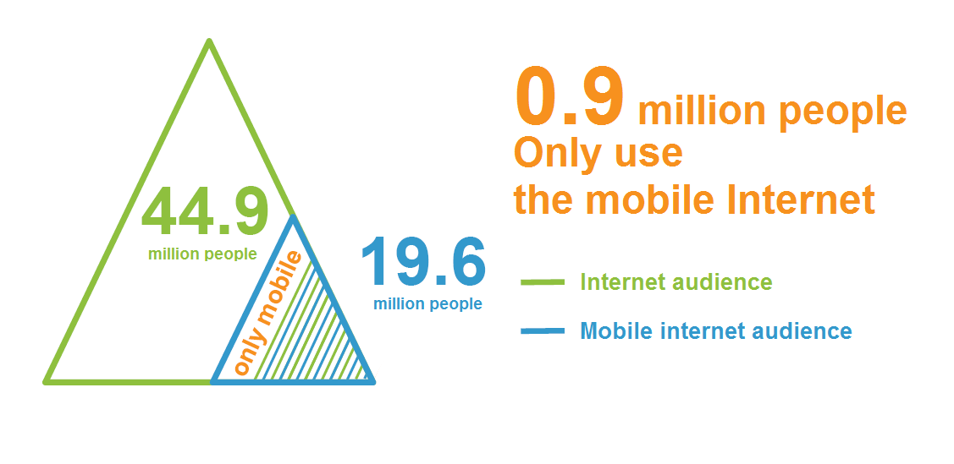
Smartphones have all the opportunities that the computer, and now occupy an important place in the Internet space

Slide 10
And now… try imagining your life without information technology.
Without TV, computers, telephones and so on.
It would be very different from what we are accustomed to today.
The truth is, all of us rely on technology a great deal to get through the day.
Whether it's at work, at home, or at college, I know you depends greatly on technology as well as I.
Try imagining the life without information technologies.
And you understand how much space is occupied in our lives.

Slide 11
Thank you for attention!

Slide 12
IT Technologies
Telephone networks
Networks that simple signal converters are the endpoints between the electric and visible / audible.
Computer networks
Networks, terminals which are computers.
Network
Currently, there are various data networks - combined endpoints (terminals) communications, united by data channels and switching devices (network nodes) that provide messaging between all terminals.
Telephone networks
Computer networks

Slide 13
IT Technologies
Computer
Electronic apparatus for using by a single user, that is, for personal using. Computer was created as calculating machine, PC as it is usually used for other purposes - as a means of access to information networks and as a platform for video games, and to work with graphic interfaces.
Mobile phone
Designed to work in cellular networks. It uses a radio transceiver and a traditional telephone switching for telephone services in the territory of the network coverage area.
TV
Modern electronic device for receiving and displaying the image and sound transmitted wirelessly or cable.
Game console
Specialized electronic device, designed and developed for video games. The most commonly used device is a television display or, at least, a computer monitor - and therefore such devices are called consoles, since they put to an independent display device.
Terminals
The terminals are user access point to the information space
Computer
Mobile phone
TV
Game console

Slide 14
IT Technologies
Email
Technology and its services for sending and receiving electronic messages (called "emails") as a distributed computer network. E-mail on the composition of the elements and the principle of operation is virtually identical to the system of normal (paper) mail, to borrow a term (e-mail, letter, envelope, attachment, box, delivery, etc.), and special features - ease of use, messaging delays, sufficient reliability and at the same time, there is no guarantee of delivery.
Web search engine
Software and hardware system with a web interface that provides the ability to search for information on the Internet. Under the search engine usually refers to a site on which is placed an interface system. The software part of the search engine is a search engine (search engine) - a set of programs that provides the functionality of a search engine and is usually a trade secret of the company-developer of search engine.
Services
Email
Web search engine

