Slide 2
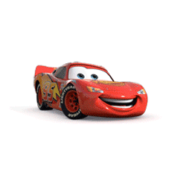
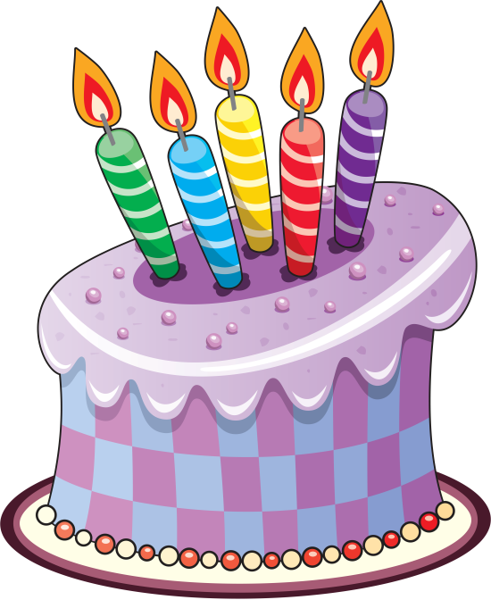
[ei] [ei] [ei]
[ ] [ ] [ ]
[t] [t] [t]
[w] [w] [w]

Slide 4
To: Maria Lavrentievna Mikhailova

Slide 6
Questions:
- About what we are going to speak today?
Who does usually organize your Birthday Party?
-

Slide 7
Can you plan your Birthday Party?

Slide 8
The aim:
Learn to organize Birthday Party

Slide 9
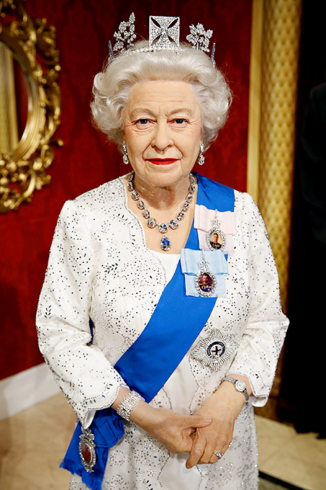
Queen Elizabeth II

Slide 10
Let’s have a rest!

Slide 11
Menu
Guests
Present
Decoration

Slide 12
Can we plan Birthday Party?

Slide 13
HAPPY BIRTHDAY!

