Slide 1
At school

Slide 2
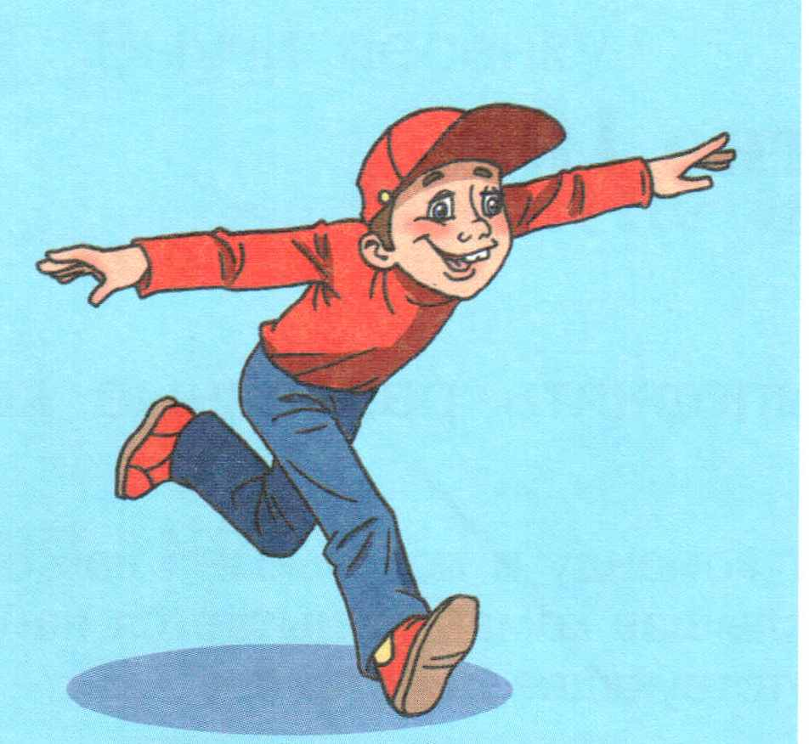
Warm up
Why, why, why
Can you tell me, why
I can run, I can jump,
But I cannot fly …

Slide 3
Let’s repeat

Slide 4
a book
[buk]

Slide 5
a copy- book
[‘kopi-buk]

Slide 6
a pencil
[pencl]

Slide 7
a pen
[pen]

Slide 8
a bag
[bæg]

Slide 9
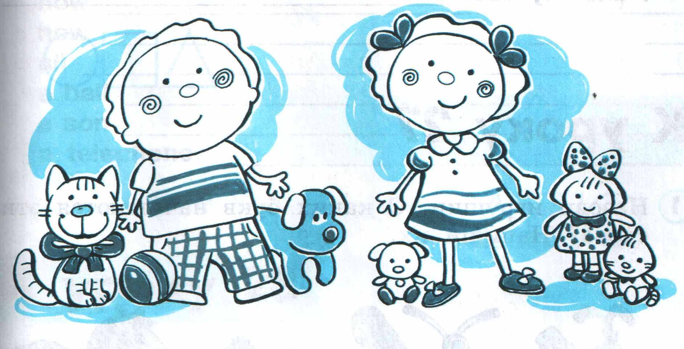
Let’s play!

Slide 10
Show me your book, please.

Slide 11
Show me your ruler, please

Slide 12
Show me your copy-book, please

Slide 13
Show me your bag, please

Slide 14
Show me your eraser, please

Slide 15
Show me your pencil-case, please

Slide 16
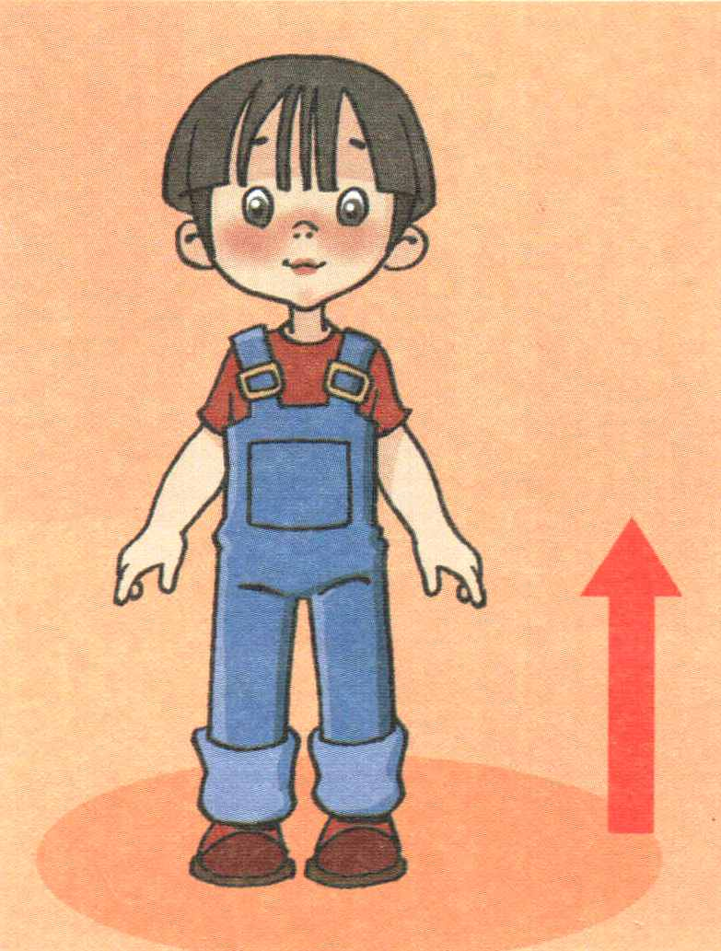
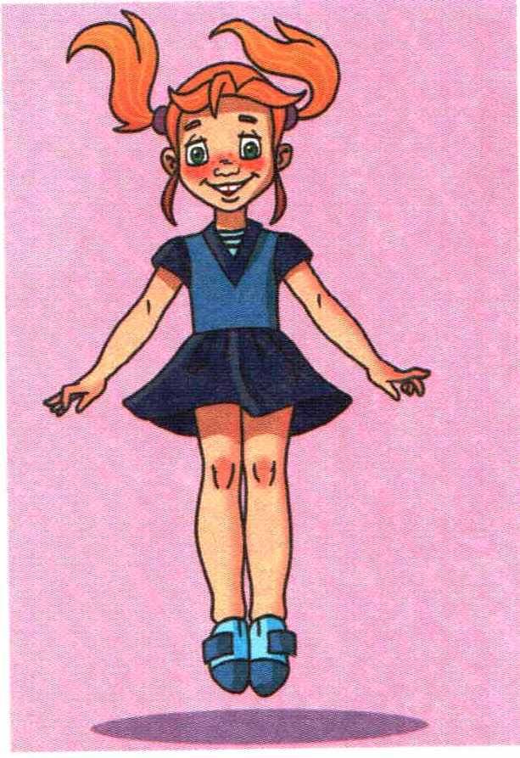
Let’s do exercise!

Slide 17
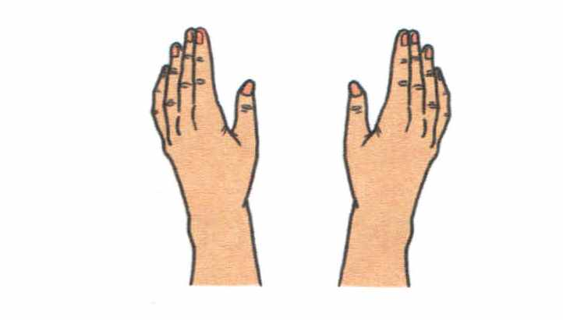
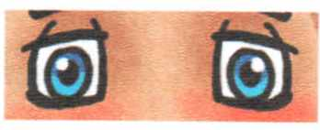
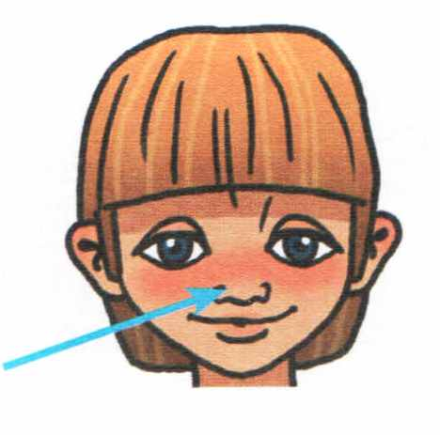
Sing with us!
I’ve got ten fingers,
I’ve got ten fingers,
I’ve got two ears,
Two eyes,
One nose.

Slide 18
Letters

Slide 19
Thank you for
the lesson!
Good bye, my dear friends!

