Slide 1
Урок в 3 классе по теме :
«Food»
УМК «Enjoy English»-1
Биболетова М.З.

Slide 2
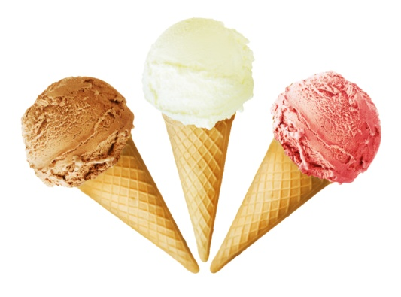
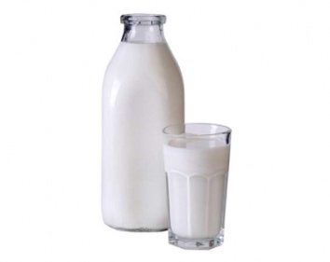
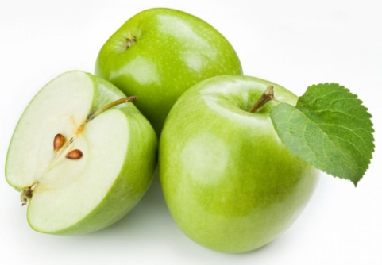
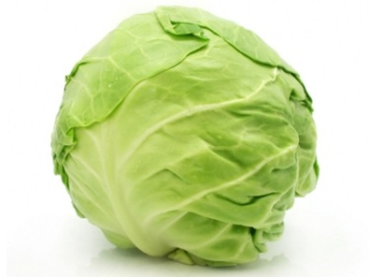
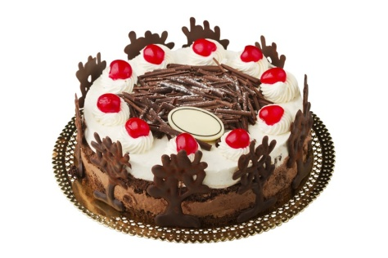
Прочитай слова вслух и переведи на русский язык
Apple
Cake
Milk
Cabbage
Ice-crime

Slide 3

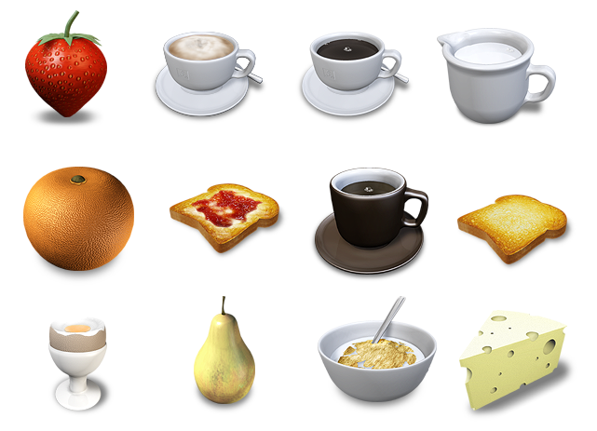
1.Посмотри на картинки и предложи котенку поесть
Would you like to…?
Would you like some…?

Slide 4
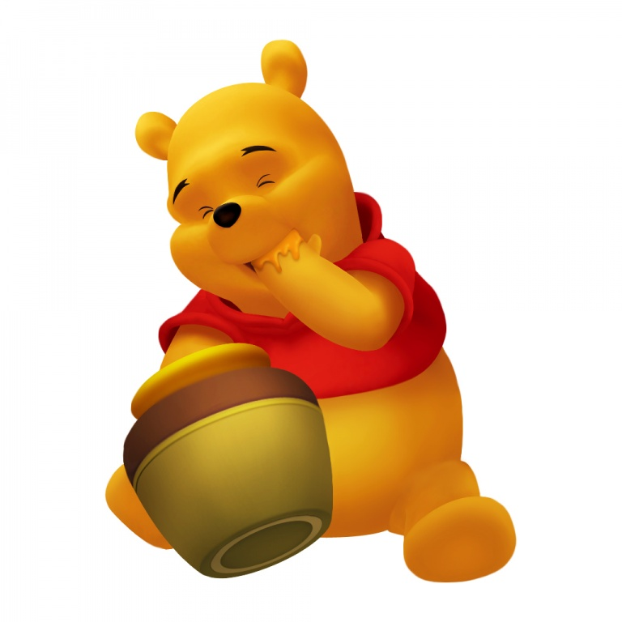
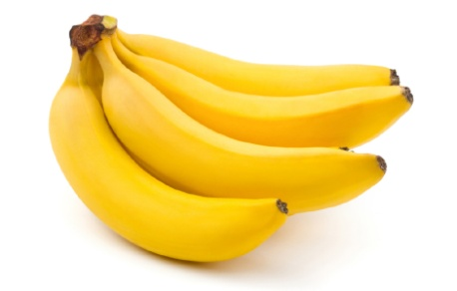
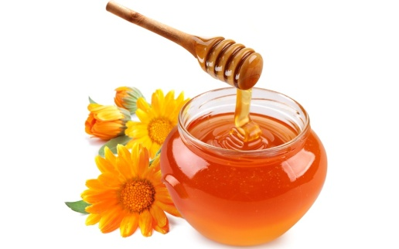
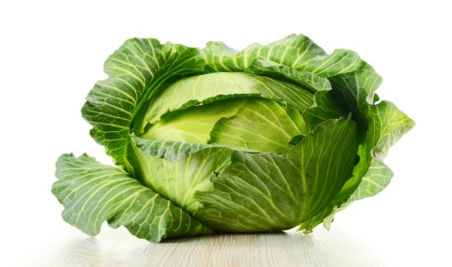
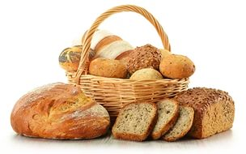
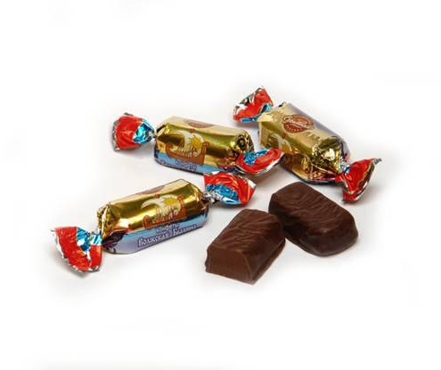
Выбери продукты, которые больше всего могут понравиться Винни. Назови их.
I think, Winnie likes..

Slide 5
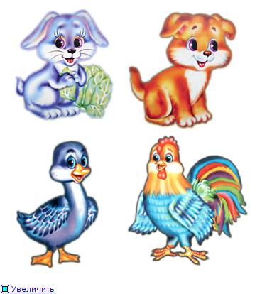
Угадай кто любит…
Who likes meat?
Who likes meat?
Who likes cabbage?
Проверь себя
Dog likes meat.
Rabbit likes cabbage.
Duck and cockerel like corn.

Slide 6


Угадай загадку
It is fruit. It is yellow. I drink tea with it. It is yuck.
It is white. I like to drink it. I drink it with cakes. It is yummy.
It is red. It is not a fruit. I like to eat it in salad.

Slide 7
THE END
THANK YOU!

