Slide 1
Game
Visiting Animals
Domestic
animals
Wild
animals

Slide 2
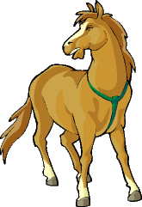
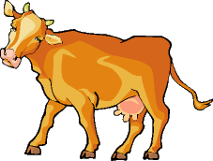
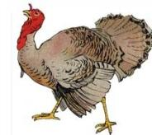
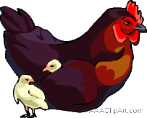
Конкурс №1 Do you know?
pig
sheep
horse
cow
turkey
rabbit
duck
dog
hen
cat
Domestic animals

Slide 3
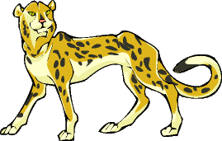
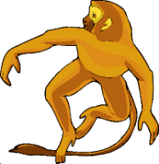
Wild animals
lion
elephant
tiger
cheetah
bear
rhino
wolf
monkey
fox
penguin

Slide 4
Конкурс №2 - Riddles
It is a domestic animal. It likes fish.
It is orange. It is not big. It can run. It is very cunning.
(a fox)
This animal lives at home or in the street. It is a man’s friend.
It is green. It can swim and run. It can’t climb and jump.
It big and strong. It’s grey. It likes to help his friends. It lives in Africa
It’s clever. It can jump and climb. It lives in a tree. It’s very funny.

Slide 5
Конкурс №3 - Crossword
e | s | g | s | a | a | s | c | a | t
r | m | i | a | p | i | g | s | s | r
h | o | r | s | e | d | e | s | c | d
u | u | a | a | d | g | l | i | o | n
o | s | f | t | i | g | e | r | c | d
o | e | f | r | o | g | p | y | k | s
y | h | e | n | o | o | h | r | u | r
w | f | i | s | h | g | a | y | i | z
d | o | g | q | m | o | n | k | e | y
c | f | e | e | u | y | t | h | m | n
c | c | r | o | c | o | d | i | l | e

Slide 6
Конкурс №3 - Crossword
e | s | g | s | a | a | s | c | a | t
r | m | i | a | p | i | g | s | s | r
h | o | r | s | e | d | e | s | c | d
u | u | a | a | d | g | l | i | o | n
o | s | f | t | i | g | e | r | c | d
o | e | f | r | o | g | p | y | k | s
y | h | e | n | o | o | h | r | u | r
w | f | i | s | h | g | a | y | i | z
d | o | g | q | m | o | n | k | e | y
c | f | e | e | u | y | t | h | m | n
c | c | r | o | c | o | d | i | l | e

Slide 7
Cat, pig, horse, lion, tiger, frog, hen, fish, dog, monkey, crocodile, mouse elephant, cock, giraffe.

Slide 8
Конкурс №4 Здесь зашифрованные названия животных. Надо угадать и перевести.
God ypon Mekyno ipg
Tac sohre
Ogrf lorcodeci
Omuse reha
Owc mecal

Slide 9
God-dog ypon-pony
Mekyno-monkey ipg-pig
Tac-cat sohre-horse
Ogrf-frog lorcodeci-crocodile
Omuse-mouse reha-hare
Owc-cow mecal-camel

Slide 10
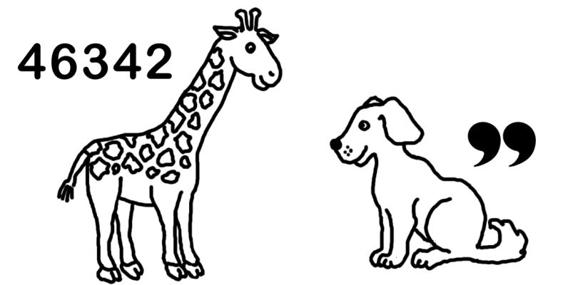
“Puzzles”
morning
afraid
monster

Slide 11
“Captain’s
competition’
Не is not big. He is small. He is brave and merry. He is not bad and ugly. He has big funny ears. He has a girlfriend. He likes her. He can run and jump but he саn`t swim. He lives in the house.
(Mickey Mouse)
Не is not big. He is slim. He is clever. He is not bad and stupid. He is good. He has big eyes. He can swim and fly but he can't run and jump. He is not clever, but funny. He lives in a big house.
(Donald Duck)
Не is not big. He is fat. He is not ugly. He is nice. He is kind and funny. He is curios and he is not cunning. He has many friends. He can sing. He likes honey. He lives in the forest.
(Winnie the Pooh)

Slide 12
I love all kinds of animals, Dogs and cats, and rabbits. I love all kinds of animals, Despite their little habits.

