Slide 1
Try to make your own congratulations!

Slide 2
My mother is …
Clever
Loving
Nice
The best
Friendly
Pretty
Beautiful
Merry
Kind
Good

Slide 3
My dear Mummy!
My dear ,dear mummy! I love you very much. I want you to be happy On the 8th of March.

Slide 4
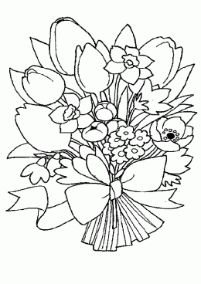
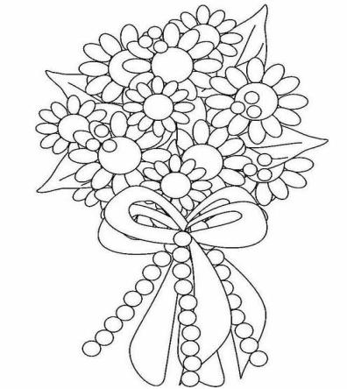
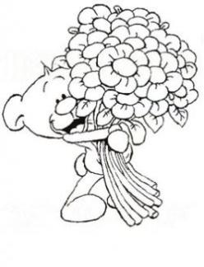
Let’s make a postcard!
Happy Women’s
Day!
To the Best Mum!
I love you, Mum
With lots of love,
…
Thank you Mum!

Slide 5
Good Bye!

