Slide 1
Для чего нам нужен английский язык?

Slide 3
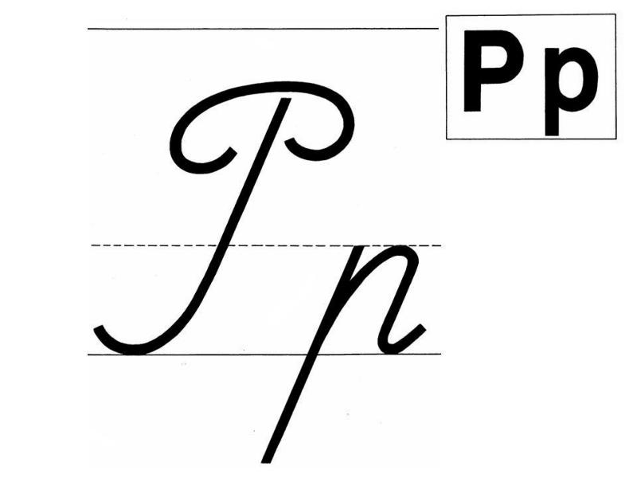

Slide 4
Прочитайте слова.
Rest, rock, risk, rat, parrot, strict, troop, tram, trap, crook, crispy.

Slide 5
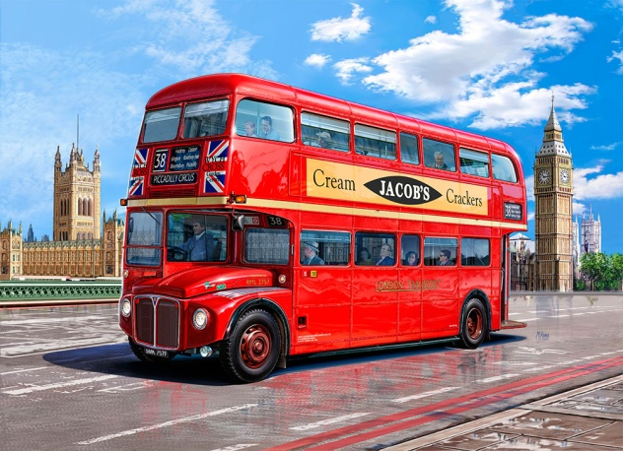
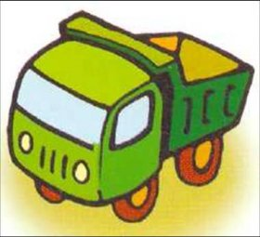
Игра «Кто с кем или что с чем дружит?»
This is … with a bus.

Slide 6
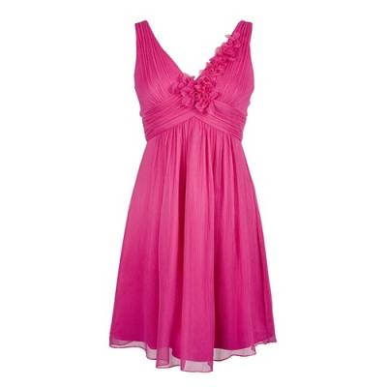
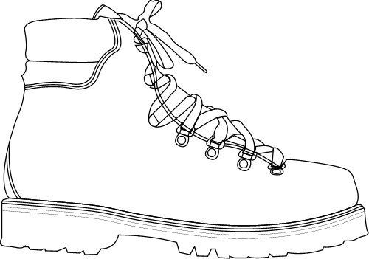
This is … with a boot.

Slide 7
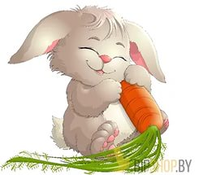
This is … with a carrot.

Slide 8
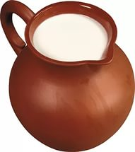
This is a jug with ….

Slide 9
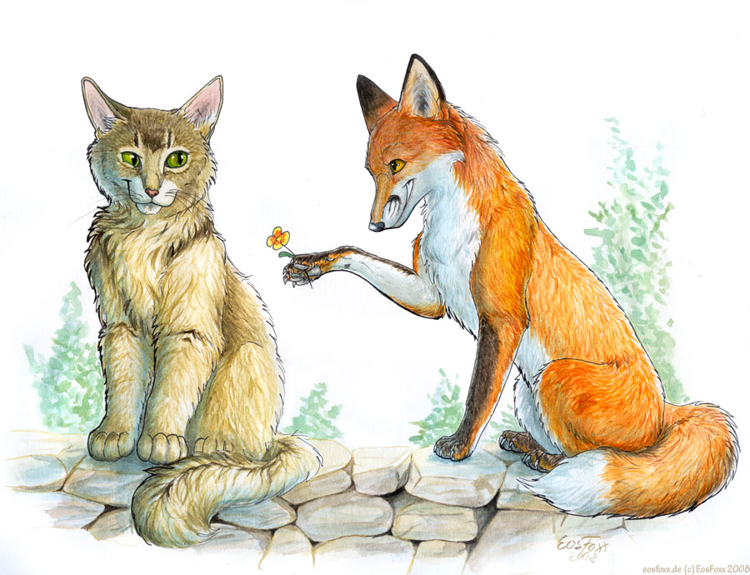
This is a cat with ….

Slide 10
Переведите предложения на русский язык.
This is a red bus.
This is a black cat.
This is a big truck.
This is a happy fox.
This is a rabbit with a carrot.

Slide 11
Exercise 10 p.9
It is in the room.
It is in the box.
It is with a carrot.
It is on the truck.
It is red.

Slide 12
Thank you for the lesson! ☺☺☺

