Slide 1
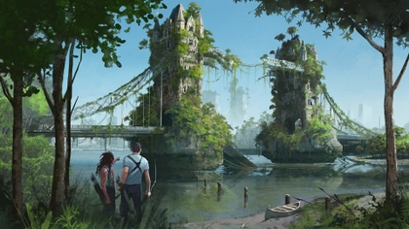
In the world of fantasy

Slide 2
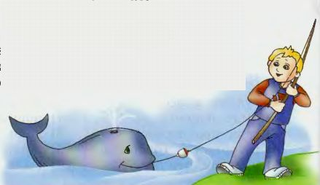
The Whale One, two, three, four, five, Last month I caught a whale alive. Six, seven, eight, nine, ten, Then I let it go again!

Slide 3
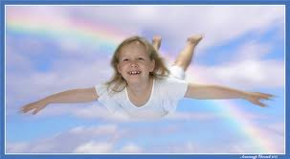
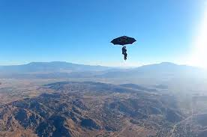
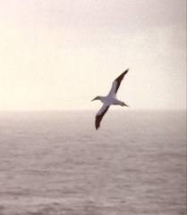
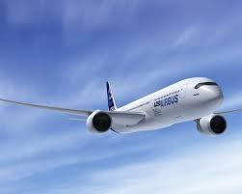

Slide 4
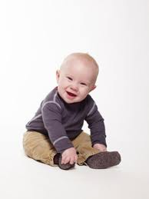

Slide 5
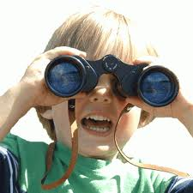
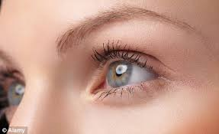

Slide 6
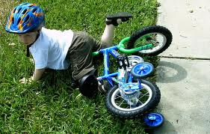
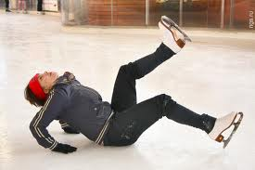

Slide 8
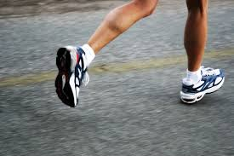
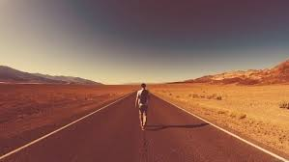

Slide 10
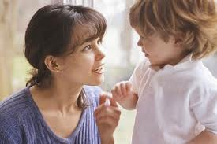
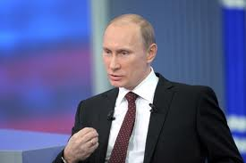

Slide 12
Слова-спутники прошедшего времени: yesterday - вчера the day before yesterday – позавчера ten days ago – десять дней тому назад a week ago – неделю назад a year ago – год назад last week – на прошлой неделе last month – в прошлом месяце last year – в прошлом году last summer - прошлым летом

Slide 13
Say what you did yesterday.
Example: Yesterday I walked in the park.

Slide 14
Глагол – связка to be
Present Simple Past Simple
am
are
is
are
are
are
I
you
he / she / it
we
you
they
was [wɒs] (был, была)
were [wɜ:] (были)
was
were
were
were
Example: The weather was fine last summer.

Slide 15
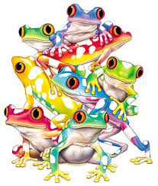
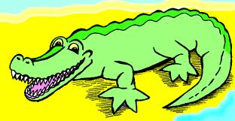
Example: The crocodile was green and strong.

Slide 16
Отрицательные формы
was not = wasn’t
were not = weren’t [wə:nt]

Slide 17
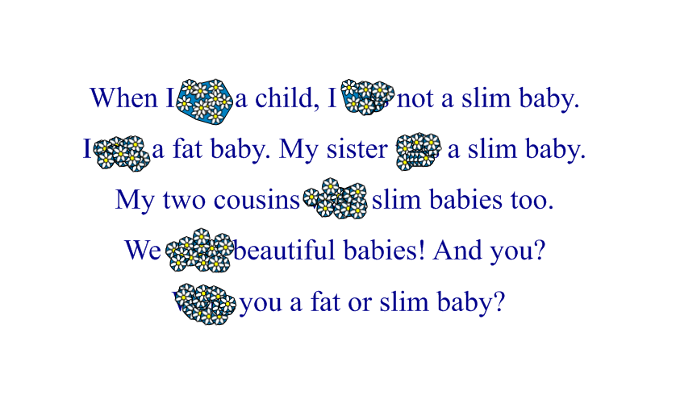
Complete the text. Fill in was or were.

Slide 18
Расставь слова в правильном порядке.
1.Were at they school yesterday?
2.summer mountains he last Was the in?
3.last the in month park Was he?
4.in Great Britain Were last they year?
5.you in Were Moscow ago a week?

