Slide 2
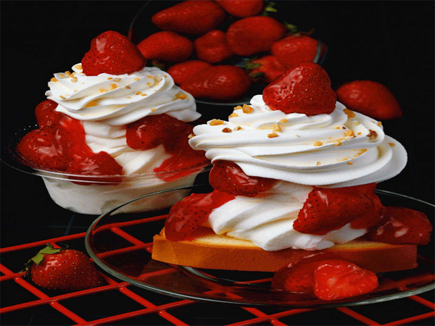
Ask questions about food to the
partner.
What do you like to eat?
What do you like to drink?
-What would you like to eat
for breakfast?
Do you like sweets?

Slide 3
What’s kind of sweet things do
you know?
-Is it healthy to eat much sweet
food?
Do you like sandwiches?
Do you usually have for
breakfast tea or coffee?
tea
coffee

Slide 4
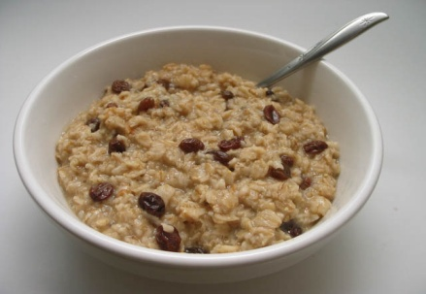
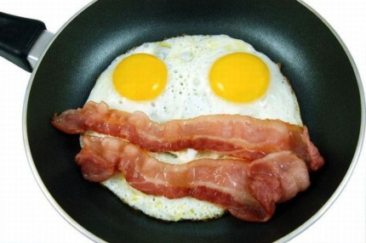
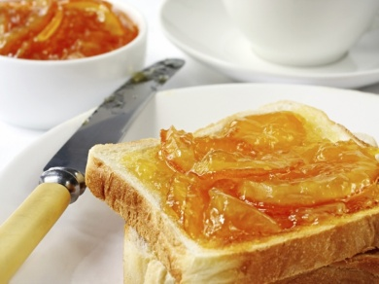
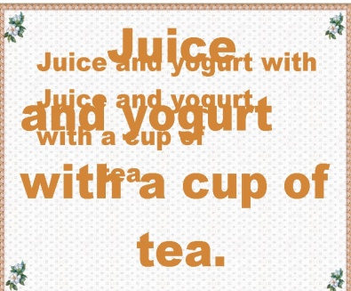
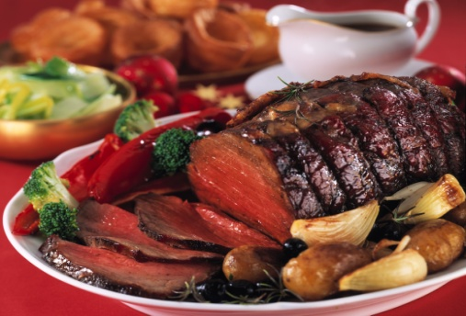
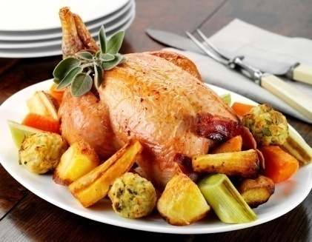
What the English eat nowadays ?
Traditional English Nowadays food
cereal
Toasts with marmalade
cereal
Eggs and bacon
Pork
(свинина)
Lamb
(баранина)
Roast beef
Chicken

Slide 5
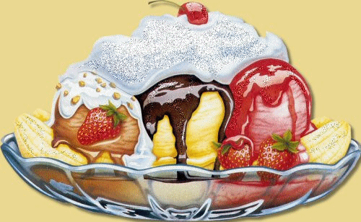
What do English people eat for breakfast?
Where do the English eat lunch?
What is the most important meal of the week?
Текст надписи

Slide 6
Compare
-to be made of
-to be made from

Slide 7
УПОТРЕБЛЕНИЕ
to be made of | to be made from
Продукт при обработке остаётся неизменным. A pizza is made of sausages, tomatoes, cheese. | Продукт при обработке полностью видоизменяется. Juice is made from apples, grapes.

Slide 8
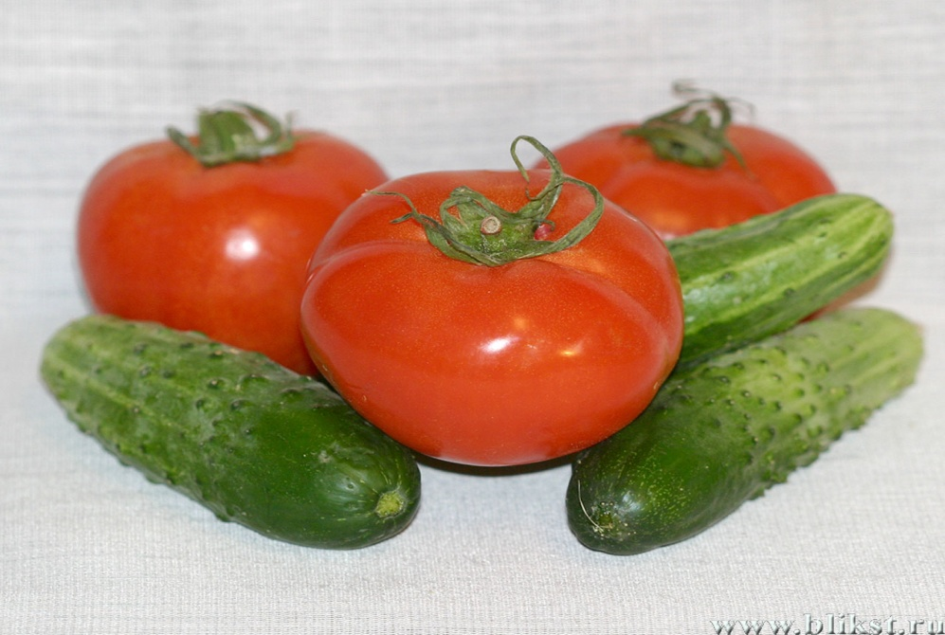
Choose the correct preposition
Salad is made
cucumbers, tomatoes.

Slide 9
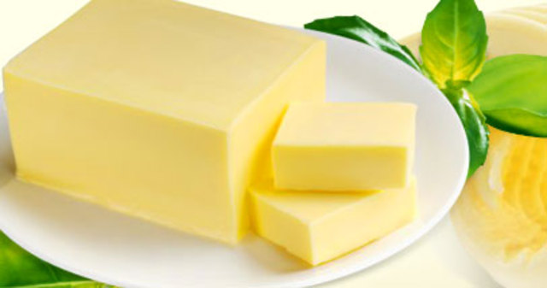
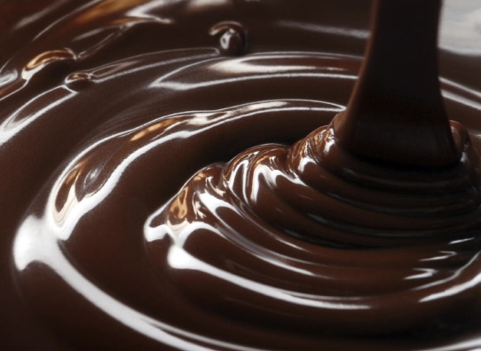
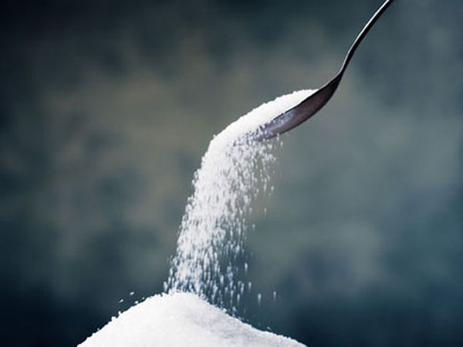
A cake is made
butter, chocolate ,sugar.

Slide 10
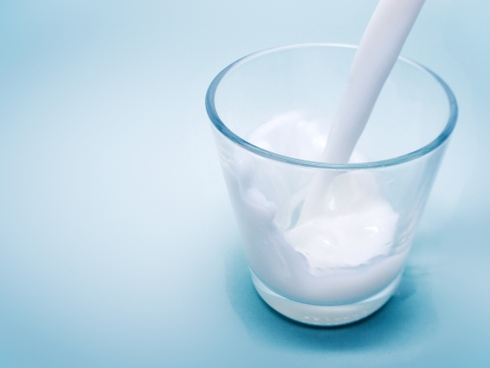
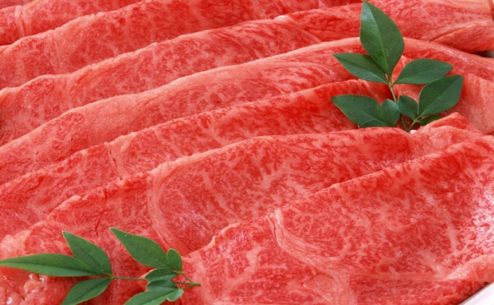
Cheese is made
milk.
Sausage is made
meat.

Slide 11
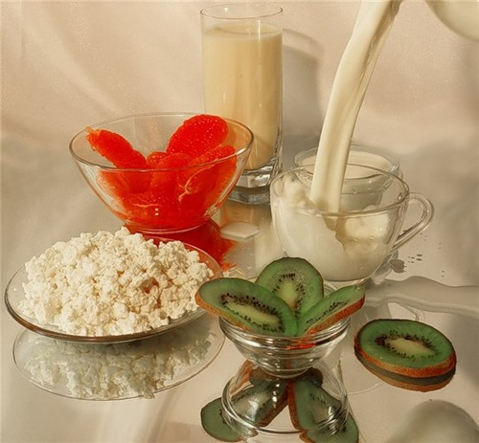
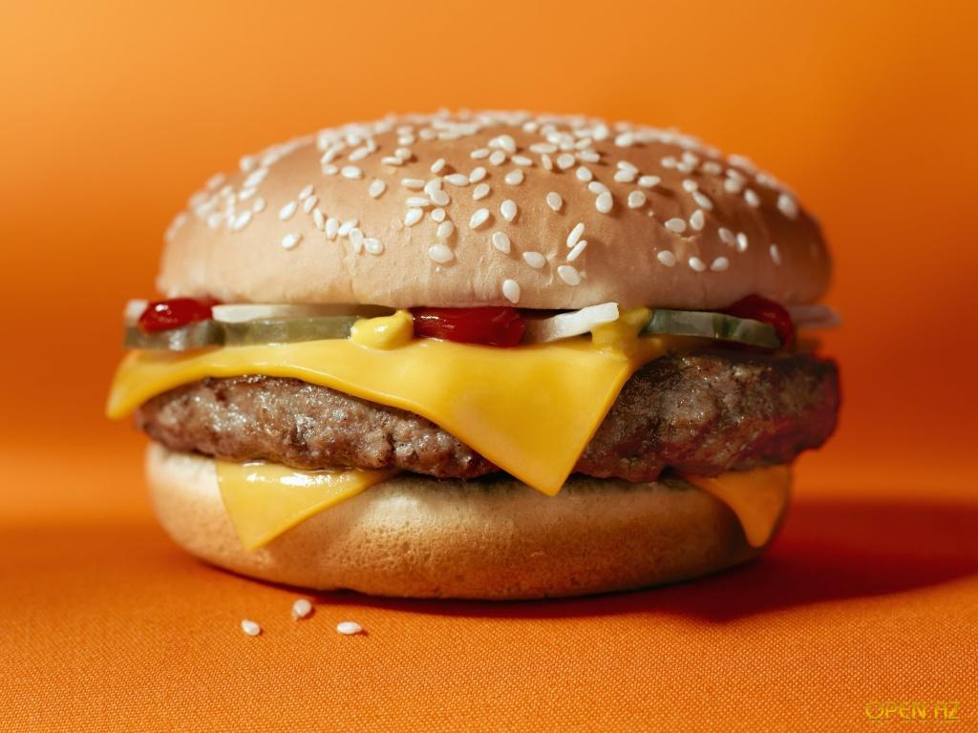
Yogurt is made
milk, fruits.
A hamburger is made
bread, cheese…

