Slide 1
Do you understand?
Yes, I do
No, I don’t

Slide 2
Very well!!!
Push

Slide 3
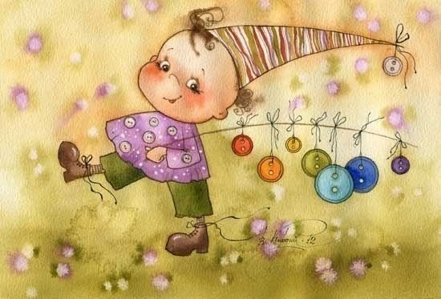
Push me
Really?
Wish you
good luck!!!!!

Slide 4
Push
Wrong answer
Try again!

