Slide 3
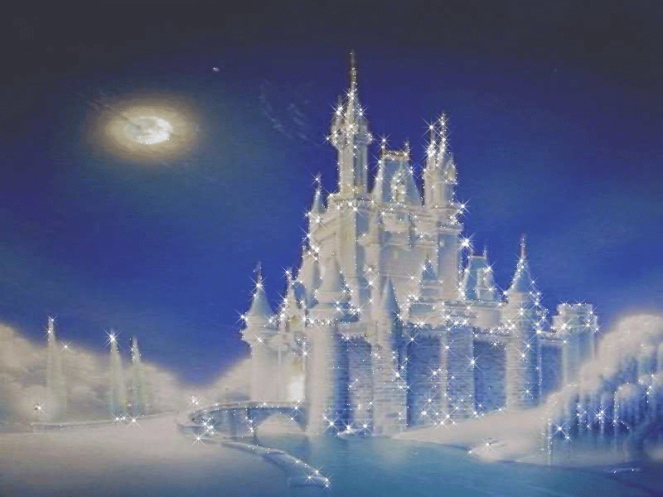
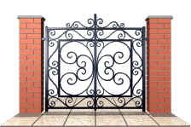

Slide 4
15
12
14
18
17
19
20
13
16
11

Slide 5
11
12
15
13
14
16
18
19
20
17

Slide 6
11
10
<

Slide 7
10
<
8

Slide 8
12
0
<

Slide 9
14
=
14

Slide 10
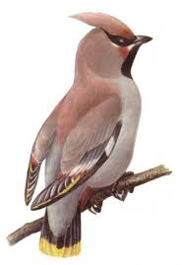
5
2
=
+
7

Slide 11
-
=
7
3
4

