Slide 1
ПРЕЗЕНТАЦИЯ ПО ТЕМЕ
“FOOD”
Выполнила: учитель английского языка
МБОУ СОШ №29
г. Самара
Телешевская Ольга Александровна

Slide 2
TRANSCRIPTION.
[mi:lk] [tʃi:z]
[kᴂrǝt] [mi:t]
[tʃikin] [ɔrindȝ]
[rais] [biskits]
[sɔsidȝ] [wɔtǝ]

Slide 3
LETTERS.
1) –Which food begins with letter C, P, S, I, M, E, V, A?
2) –Which drink begins with letter W, L, J, M?

Slide 4
QUESTIONS:
Look at the pictures and answer the questions:
What’s this?
Is it a drink, a fruit or a dessert?
Do you like …?
Does your mother like … ?
What’s your favourite food, drink?

Slide 5
PICTURES:
What’s this?

Slide 6
What’s this?

Slide 7
What are they?

Slide 8
What’s this?

Slide 9
What’s this?

Slide 10
What’s this?

Slide 11
What’s this?

Slide 12
What’s this?

Slide 13
What’s this?

Slide 14
What’s this?

Slide 15
What’s this?

Slide 16
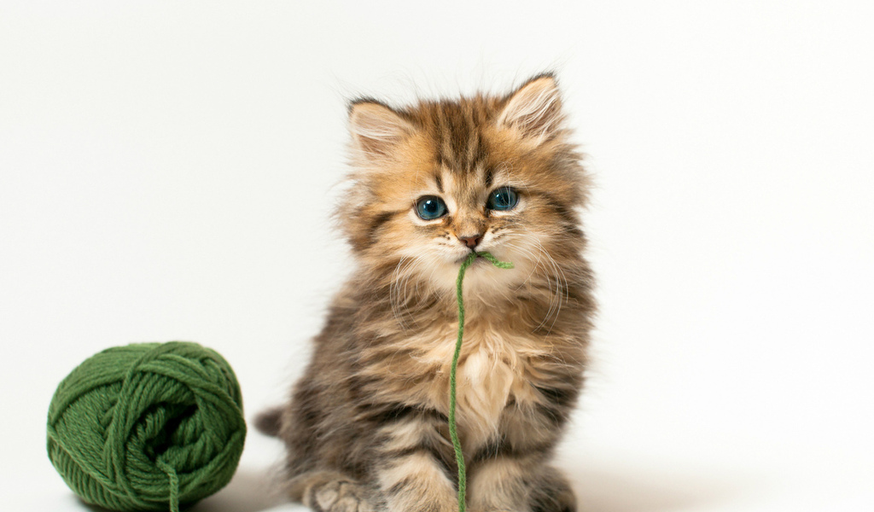
OUR PETS.
What does your cat eat? My cat eats …

Slide 17
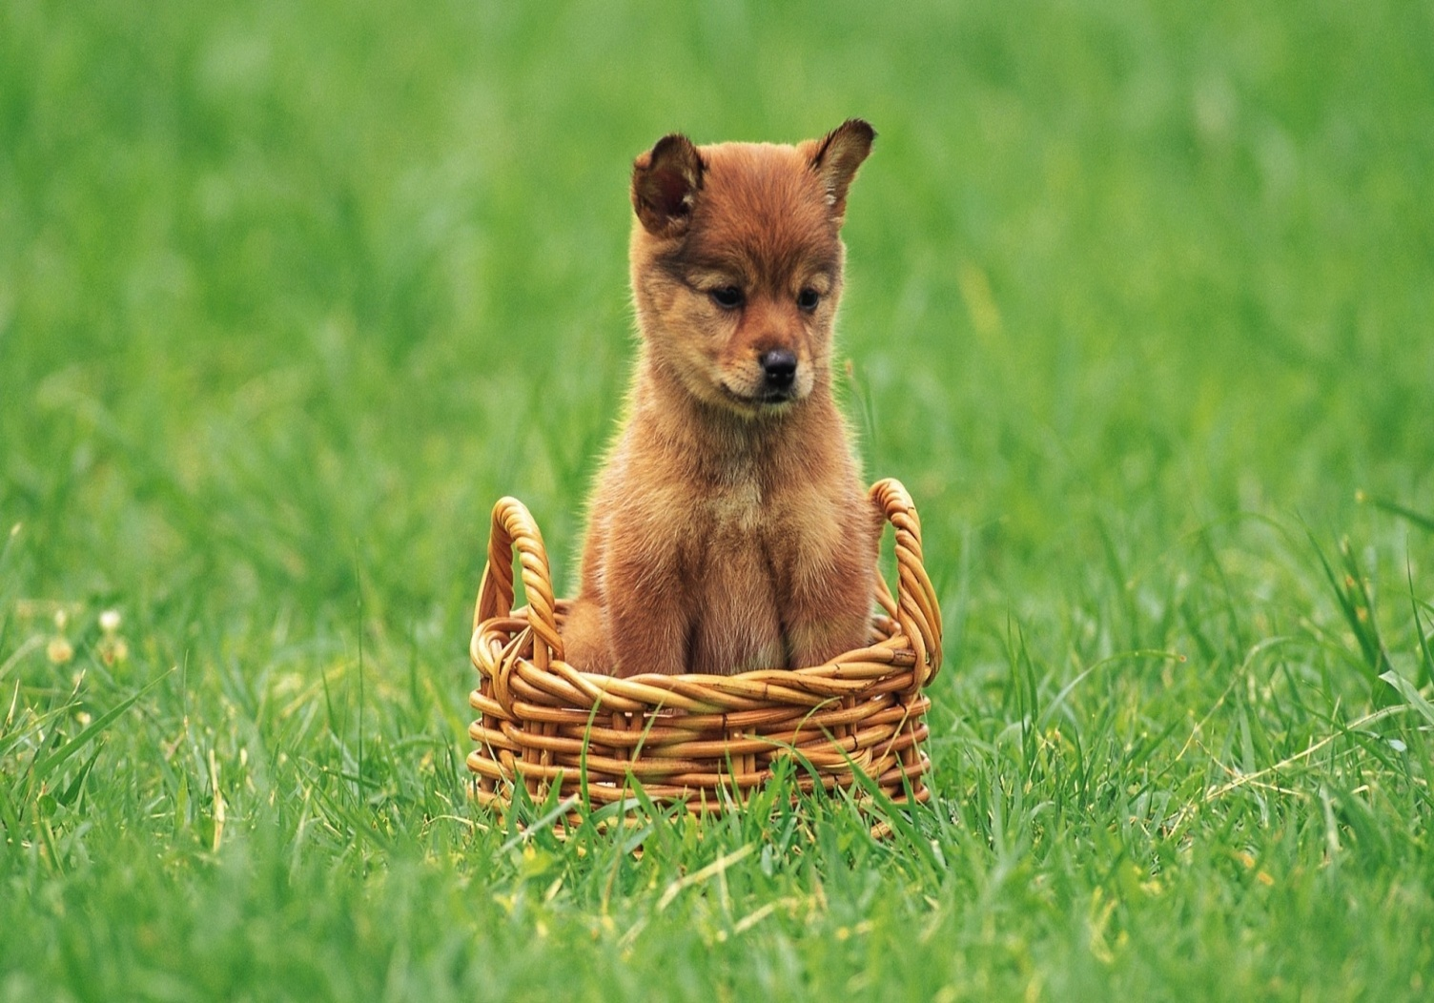
OUR PETS.
What does your dog eat? My dog eats …

Slide 18
THE MENU.

