Slide 2
blue [blu:]

Slide 3
red
[red]

Slide 4
brown [braʊn]

Slide 5
green [gri:n]

Slide 6
white
[waɪt]

Slide 7
black
[blæk]

Slide 8
yellow [‘jelәʊ]

Slide 9
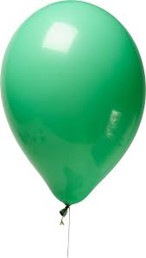
What is missing?

Slide 17
What colour is your …?
It’s……..

Slide 19
