Slide 1
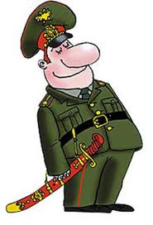
Модальный глагол
must

Slide 2
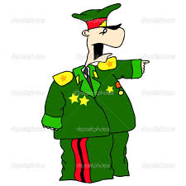
Модальный глагол must (должен, обязан)
Употребляется для выражения необходимости, обязанности совершить действие
Всегда сочетается с глаголом - действия

Slide 3
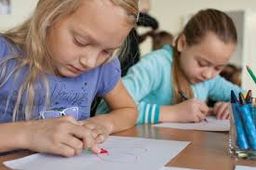
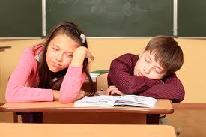
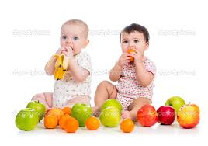
+
Children must do their
homework.
Children must not sleep at school.
Must children eat fruit?
+ Yes, they must.
- No, they mustn’t
-
?

Slide 4
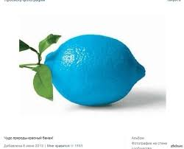
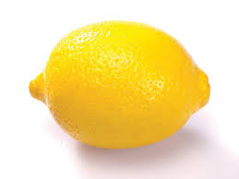
Must be…
Is it really?
No! The sun must be yellow.
Are they really?
No! The clouds
must be white
Is it really?
No! The lemon
must be yellow.

Slide 5
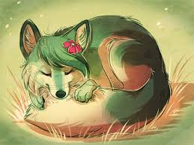
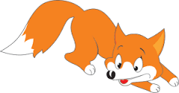
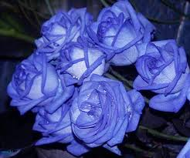
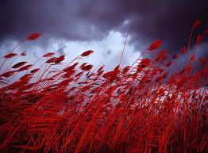
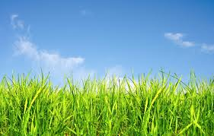
Is it really?
No! The fox
must be red.
Are they really?
No! The roses
must be red,
pink or white.
Is it really?
No! The grass
must be green.

Slide 6
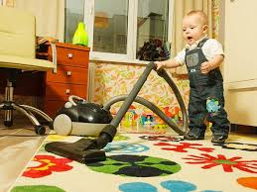
must/mustn’t
We _____________ wash our hands before lunch.
We_____________ come to school in time.
We _____________ swim in the lake in winter.
We _____________ eat soup every day.
We _____________ smoke.
We _____________ help mother about the house.
We _____________ go to the park at night.

Slide 7
must/mustn’t
We _____________ wash our hands before lunch.
We_____________ come to school in time.
We _____________ swim in the lake in winter.
We _____________ eat soup every day.
We _____________ smoke.
We _____________ help mother about the house.
We _____________ go to the park at night.
must
must
mustn’t
must
mustn’t
must
mustn’t

Slide 8
You must know English well!

