Slide 1
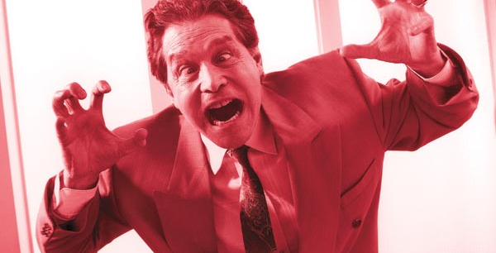
What feeling does the picture represent? A) puzzled b) unsure c) furious

Slide 2
Презентация для повторения лексического материала за 1 триместр (1-3 модуль)для учащихся 8 класса.
К УМК Spotlight
Составитель: учитель англ. языка
Шиндрова Анна Алексеевна

Slide 3
Fill missing adjectives. Ann’s… and … You can trust her and she always does what she says.
selfish/ shy
honest/ reliable
easy-going/ sociable

Slide 4
Name the idiom.

Slide 5
Choose the right preposition. You shouldn't be jealous … other people’s success.
Of
With
to

Slide 6
Who did discover penicillin?
Alexander Fleming
Joseph Montgolfier
Marie Curie

Slide 7
What does mean an «obento»? Use the words to explain.
Rise serve box small
portions pleasing to the eye

Slide 8
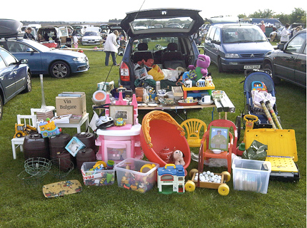
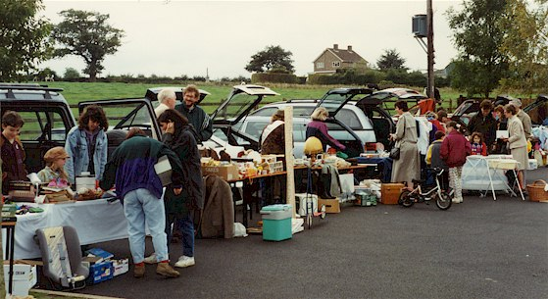
What’s this?
a) Bazaar b) flea market c) car boot sale

Slide 9
When did people start celebrating “By Nothing Day”?
In 1993
In 1994
In 1995

Slide 10
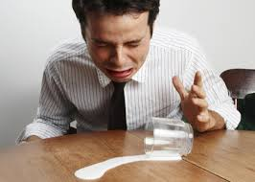
What does the picture mean? Remember the idiom.
Describe the situation when we can use it.

Slide 11
What does plastic come from?
pollution
electricity
oil

Slide 12
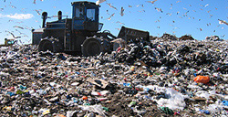
It’s…
The rubbish
The landfill site
The manufacturing of plastic bags

Slide 13
I prefer … of chocolate to the milk or white varieties.
A bar
Dark
Milk

Slide 14
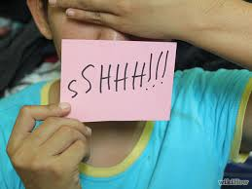
Remember the idiom.

Slide 15
Who was the first passengers of hot-air balloon?
sheep, duck and cockerel
Sheep, duck and chicken
Dog, duck and sheep

Slide 16
When did the Montgolfier brothers present their first hot-air balloon?
On 19th September 1783
On 1st September 1883
On 20th October 1783

Slide 17
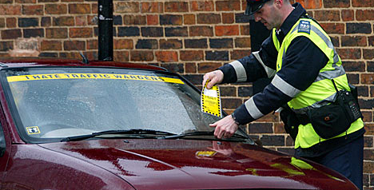
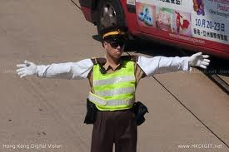
?
Police
Traffic warden
Air traffic controller

Slide 18
Alexander Fleming is a …
Polish scientist
British scientist
Scottish scientist

Slide 19
Been a very … scientist, he used to leave his culture plates all around his lab.
messy
sloppy
dirty

Slide 20
Marie Curie died …
from radiation poisoning
of radiation illness
of radiation poisoning

