Slide 1
KIREEVA E.V.
PRESENTS
LYCEUM 410
APRIL 2015

Slide 2
Ex. № 7, p. 75
Thousands of people were … homeless. Hundreds of sheep … in the flood and many other animals … their habitats.
Many roads … and a five-storey apartment building … like a house of cards. The people in the building are … to be dead.
Many people were … in and the roads were … with ice.
Many people were … in and the roads were … with ice.

Slide 3
Ex. № 7, p. 75
Thousands of people were left homeless. (tsunami/earthquake/flood)
Hundreds of sheep drowned in the flood and many other animals lost their habitats. (flood)
Many roads cracked and a five-storey apartment building collapsed like a house of cards. The people in the building are feared to be dead. (earthquake)
Many people were snowed in and the roads were covered with ice. (avalanche)

Slide 4
По словам и фразам определите тему
Global warming
Rescue team
Drown
Survivor, Suffer
Ruined
Shaking of the ground
Collapse like a house of cards
Be left homeless
Violent wind Storm
Large amount of water

Slide 5
cold
sleety
freezing
dull
frosty
chilly
gloomy
drizzly
WEATHER
rainy
windy
foggy
breezy
misty
warm
boiling hot
cool
sunny

Slide 6
IDIOMS

Slide 7

To feel under the weather

Slide 8

To save up for a rainy day

Slide 9

To be on cloud nine

Slide 10
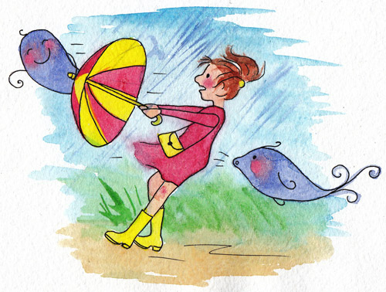
To see which way
the wind blows

Slide 11
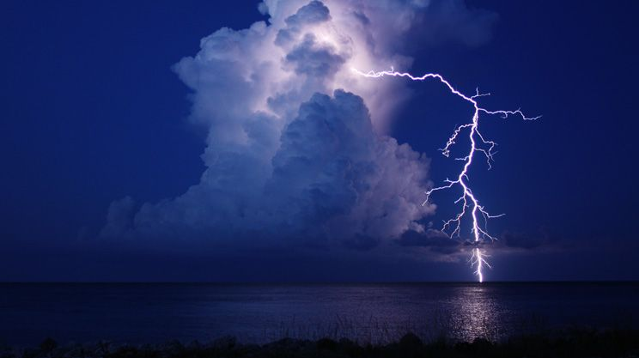
To be a bolt from the blue

Slide 12



Slide 13



Slide 14



Slide 15
Dynamic music pause
The English lyrics were first written as a poem by Jane Taylor (1783–1824)and published with the title "The Star" in Rhymes for the Nursery by Jane and her sister Ann Taylor
(1782-1866) in London in 1806.
"Twinkle, Twinkle, Little Star" is a popular English lullaby. The lyrics are from an early 19th-century English poem, "The Star" by Jane Taylor. The poem, which is in couplet form, was first published in 1806 in Rhymes for the Nursery, a collection of poems by Taylor and her sister Ann. It is sung to the tune of the French melody "Ah! vous dirais-je, Maman", which was published in 1761 and later arranged by Mozart for a famous set of variations. The English lyrics have six stanzas, although only the first is widely known.
It has a Roud Folk Song Index number of 7666.

Slide 16
Ex. 3 p. 80
Shepherd - пастух
Majority – большинство
To expect - ожидать
Meteorologist – метеоролог
Satellite – спутник
Weather forecast – прогноз погоды
Predict – предсказывать
To figure out – вычислить
Observing – наблюдение
Behaviour – поведение
Accurate - точный

Slide 17
DISASTERS
NATURAL
MANMADE
DROUGHT
WAR
FLOOD
POVERTY
TORNADO
FAMINE
TSUNAMI
GLOBAL WARMING
EARTHQUAKE
ENDANGERED SPECIES
CYCLONE
POLLUTION
AVALANCHE
HOMELESSNESS
HURRICANE
CHILD LABOUR

Slide 18
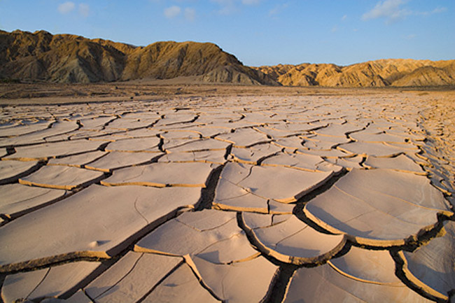
DROUGHT

Slide 19
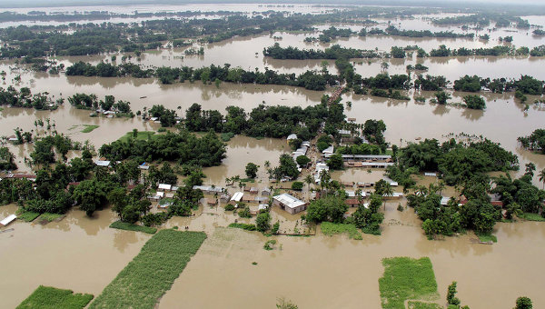
FLOOD

Slide 20
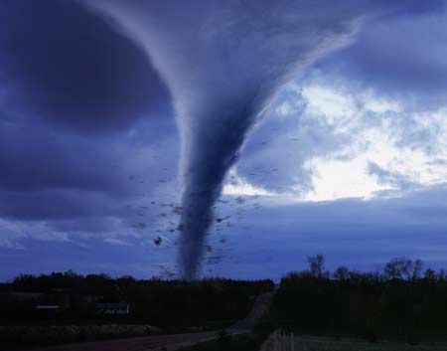
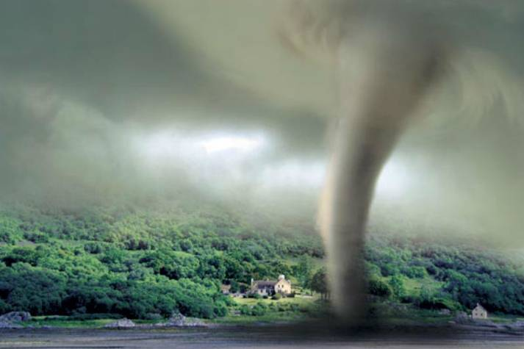
TORNADO

Slide 21
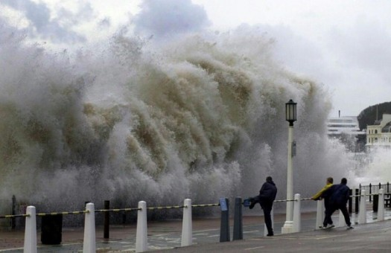
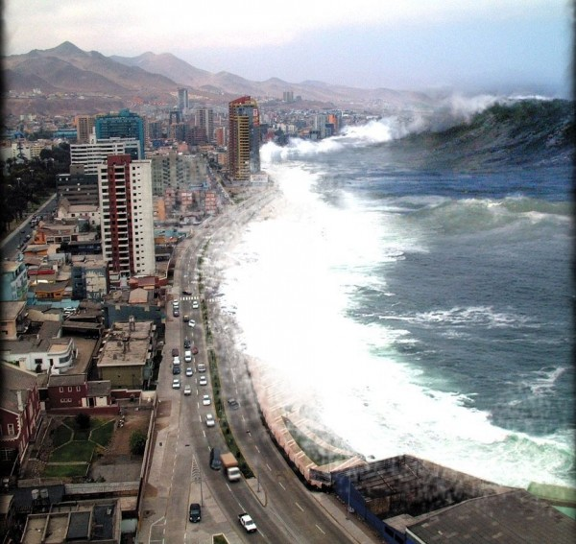
TSUNAMI

Slide 22
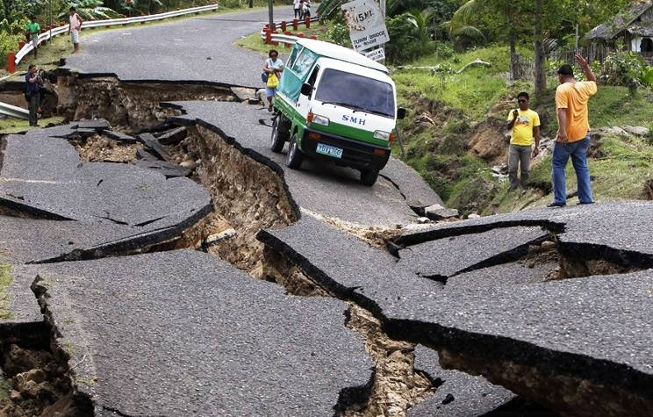
EARTHQUAKE

Slide 23
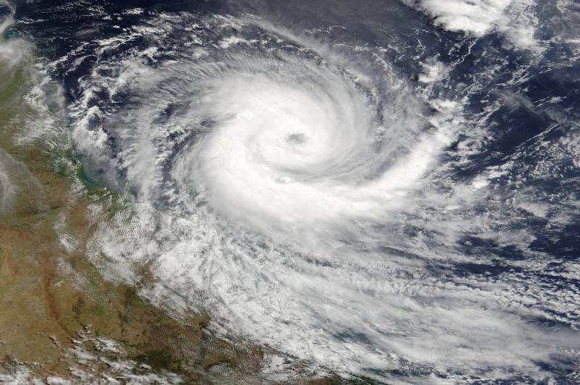
CYCLONE

Slide 24
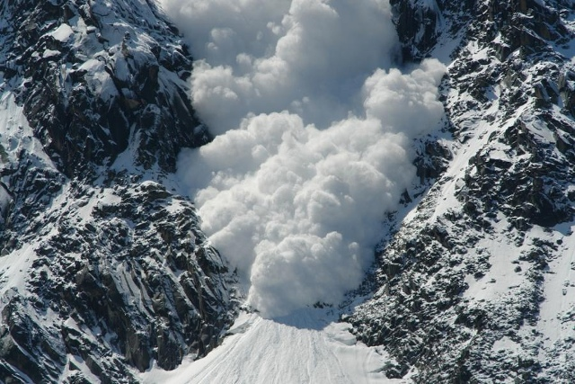
AVALANCHE

Slide 25
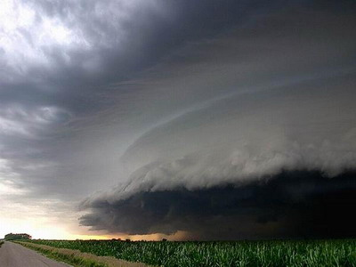
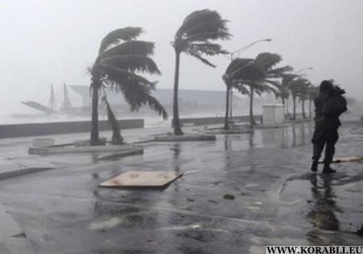
HURRICANE

Slide 26
HOME TASK
EX 4 P 80
EX 5,6 P 80,81
THANK YOU !

