Slide 1
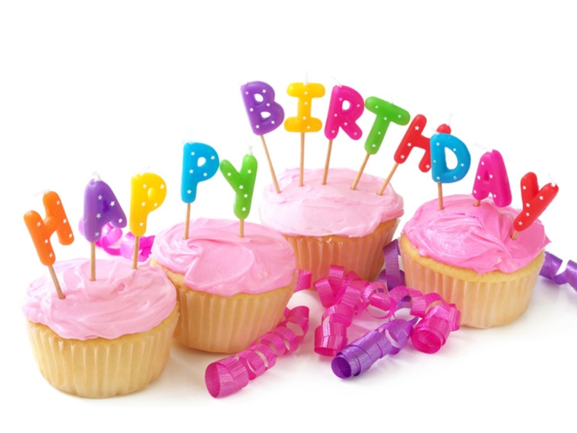
Jim’s birthday

Slide 2
Dear, friends!
Today I have got a birthday.
Would you like to visit me?
Please come and see me.
Your friend, Jim.

Slide 3
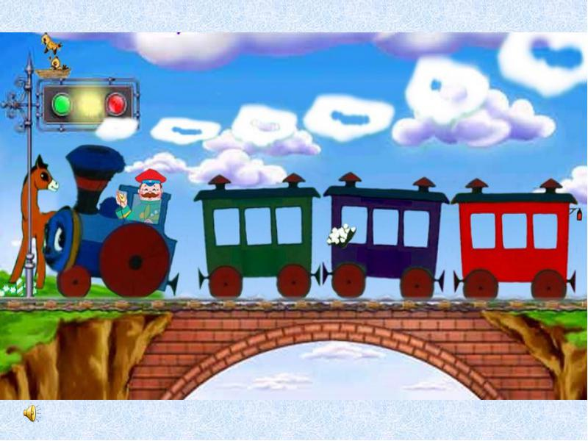

Slide 4
Phonetic exercises:
[ f ] fairy, friend, fine
[ t ,d ] tidy, teddy, date
[ʃ ] show, shop, shine
[ð, z ] is, this,
[ a: ] card, party, park
[ w ] why, what, when

Slide 5
Station 1
What can we do at the party?
We can…

Slide 6
Station 2
Choosing presents

Slide 7
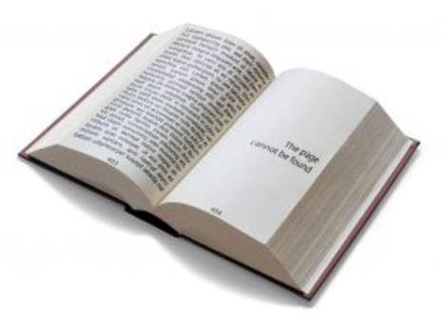
a book

Slide 8
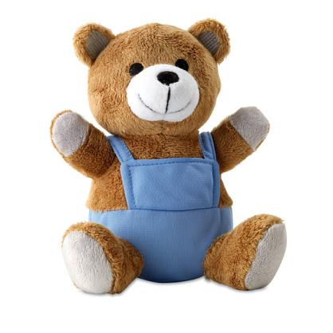
a teddy bear

Slide 9
a ball

Slide 10
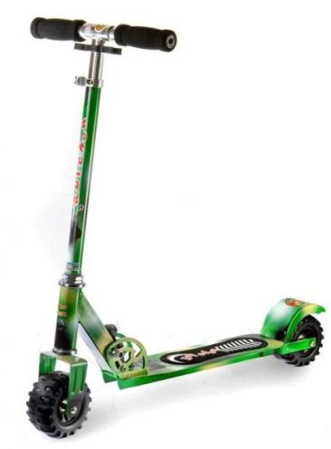
a scooter

Slide 11
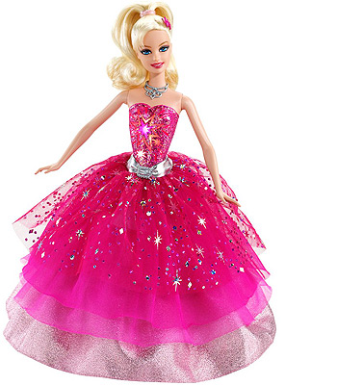
a doll

Slide 12
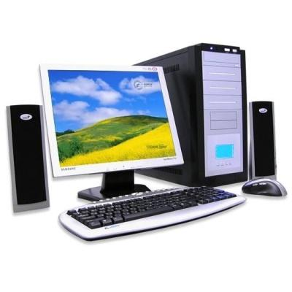
a computer

Slide 13
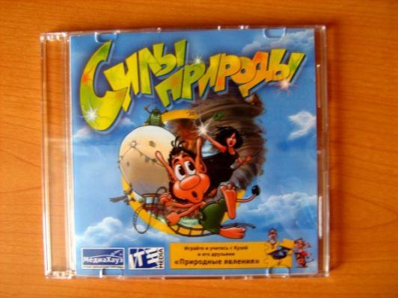
a computer
game

Slide 14
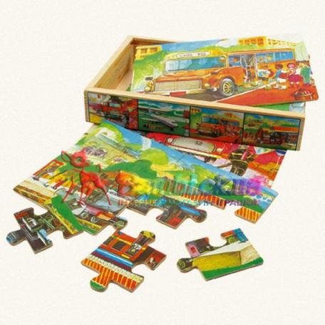
a puzzle

Slide 15
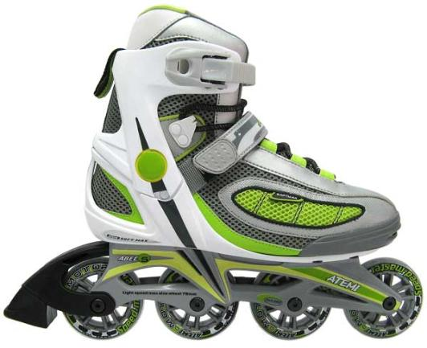
roller skates

Slide 16
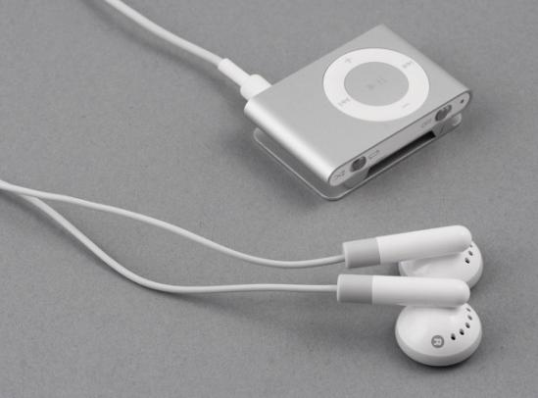
a player

Slide 17
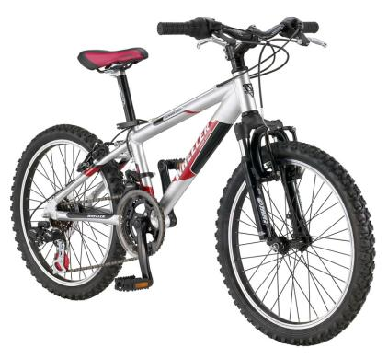
a bike

Slide 18
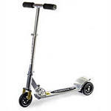
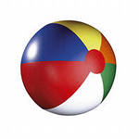
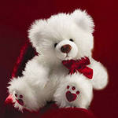
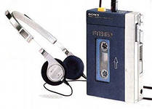
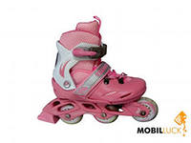
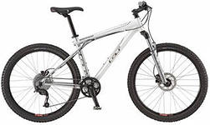
A scooter
A teddy bear
A ball
A book
a doll
A computer
A player
Roller skates
A bike
A puzzle
A computer game

Slide 19
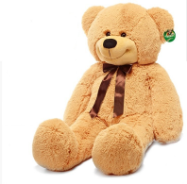
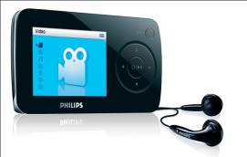
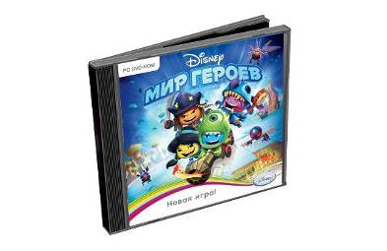

Slide 20
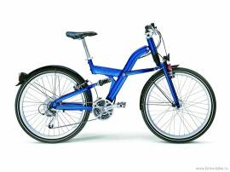
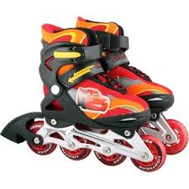

Slide 21
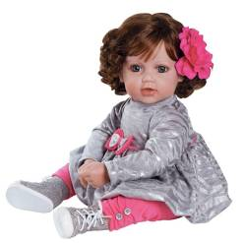
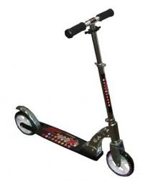

Slide 22
a | b | b | i | k | e | c | d | e | f
g | s | a | y | x | w | g | v | t | u
h | c | l | n | o | p | a | q | r | s
d | o | l | l | m | l | m | k | s | j
c | o | m | p | u | t | e | r | k | i
i | t | e | d | d | y | b | e | a | r
j | e | b | c | d | e | f | g | t | h
k | r | a | z | y | x | w | v | e | u
l | m | n | o | p | q | r | s | s | t
Find
the
names
of
the
presents

Slide 23
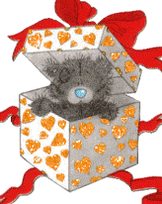
a | b | b | i | k | e | c | d | e | f
g | s | a | y | x | w | g | v | t | u
h | c | l | n | o | p | a | q | r | s
d | o | l | l | m | l | m | k | s | j
c | o | m | p | u | t | e | r | k | i
i | t | e | d | d | y | b | e | a | r
j | e | b | c | d | e | f | g | t | h
k | r | a | z | y | x | w | v | e | u
l | m | n | o | p | q | r | s | s | t
Check
your
answers

Slide 24
Station 3

Slide 25
Station 4
Listening

Slide 26
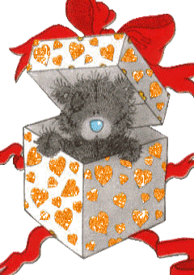
Station 5
«A magic box»

Slide 27
I’d like to present…
What would you like to present?

Slide 28
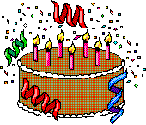
Station 6
Birthday card

Slide 29
Happy birthday to you!

Slide 30
Home task:
Ex.2 or 3, p.46 (WB)
Ex. 4, p.72 (TB)

