Slide 1
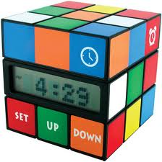

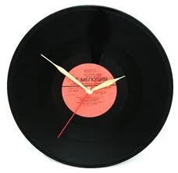
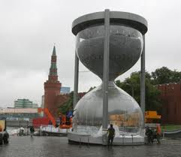
T I M E

Slide 2
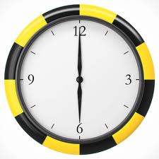
What time is it now? It’s 6 o’clock

Slide 3
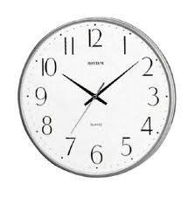
What time is it now? It’s 9 (minutes) past 10

Slide 4
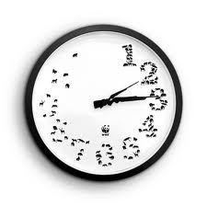
What time is it now? It’s…

Slide 5
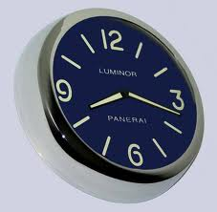
What time is it now? It’s…

Slide 6
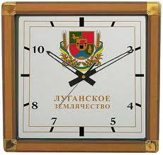
What time is it now? It’s …

Slide 7
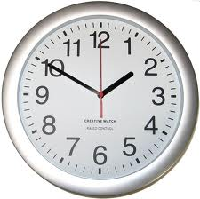
What time is it now? It’s 10 (minutes) to 2

Slide 8
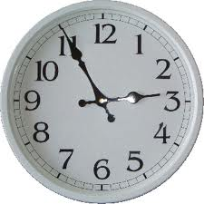
What time is it now? It’s…

Slide 9
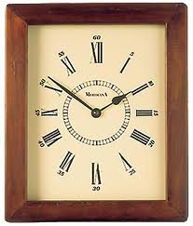
What time is it now? It’s…

Slide 10
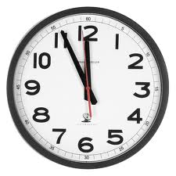
What time is it now? It’s…

Slide 11
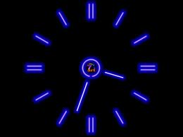
What time is it now? It’s…

Slide 12

What time is it now? It’s…

Slide 13
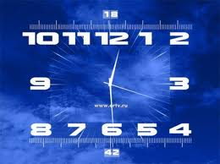
What time is it now? It’s half past 12

Slide 14
Referances:
Pictures:
http://www.annarbor.com/assets/thumbnails_cache/2012/07/19/300w_clock.jpg
http://img-fotki.yandex.ru/get/3103/thest0rm.e9/0_1ea4f_ef2cb5bf_XL
http://www.vokrugsveta.ru/img/cmn/2008/03/28/015.gif
http://cs304305.userapi.com/u47187/-14/x_817bc2bc.jpg
http://cs5153.userapi.com/u138934666/-14/x_0c8fcdb3.jpg
http://www.time66.ru/upload/items/full/33339.jpg

