Slide 1


Wendy and her family

Slide 2
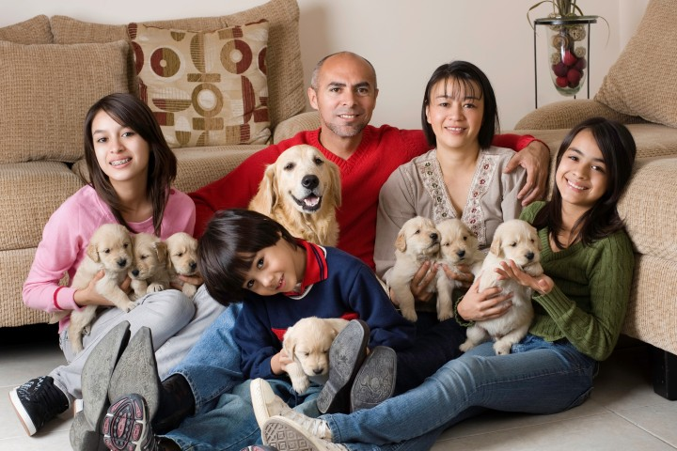
“My family and pets”

Slide 3


Slide 4


