Slide 3
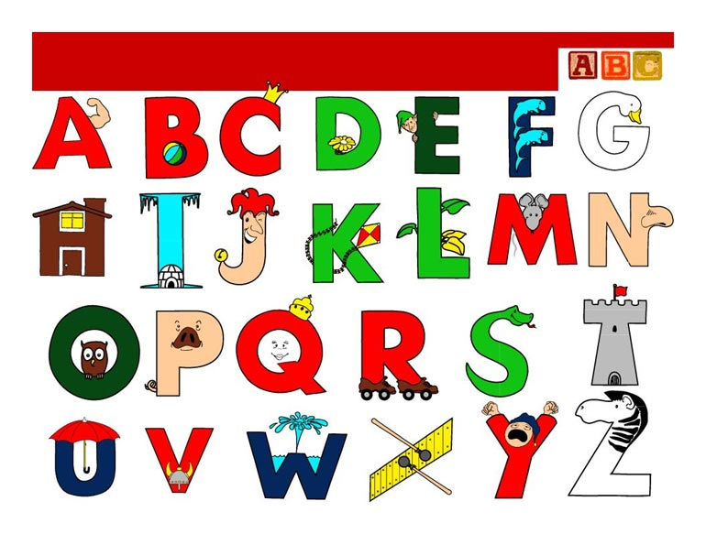

Slide 4
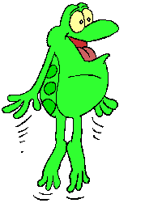
What can you do?
I can

Slide 5
one

Slide 6
two

Slide 7
three

Slide 8
four

Slide 9
five

Slide 10
six

Slide 11
seven

Slide 12
eight

Slide 13
nine

Slide 14
ten

Slide 15
[m]
[ei]
[k]
[w]
[ai]
[r]
[h]

Slide 16
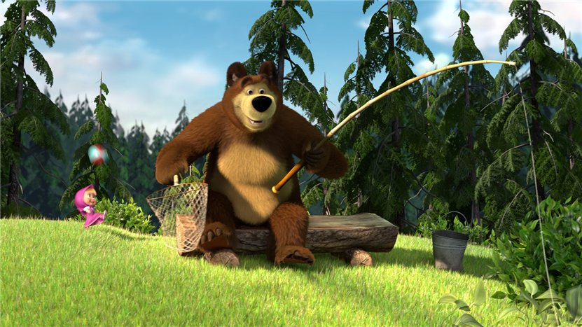
Bear

Slide 17
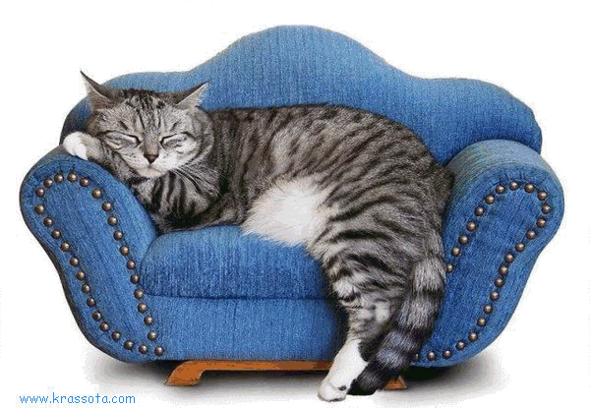
Cat

Slide 18
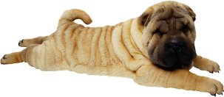
Dog

Slide 19
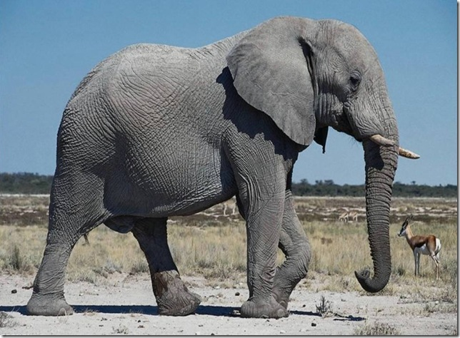
Elephant

Slide 20
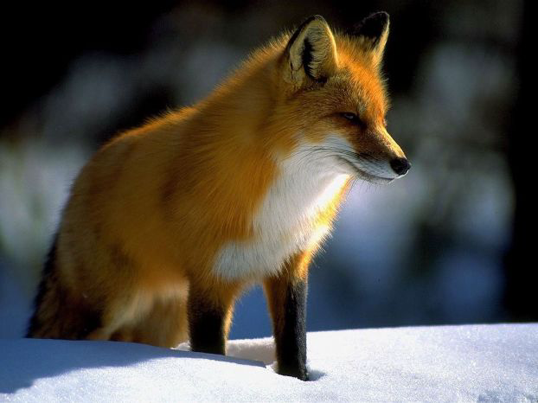
Fox

Slide 21
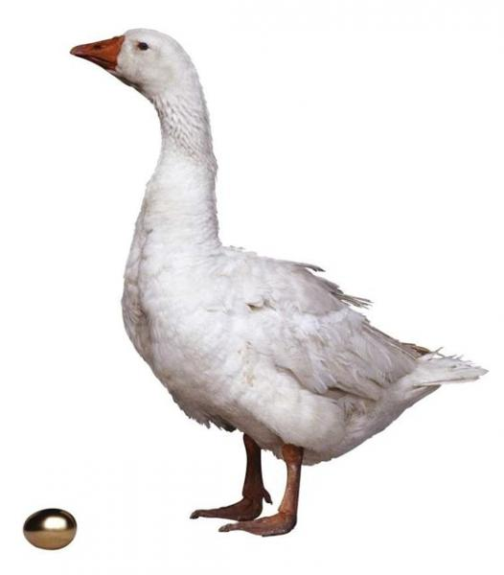
Goose

Slide 22
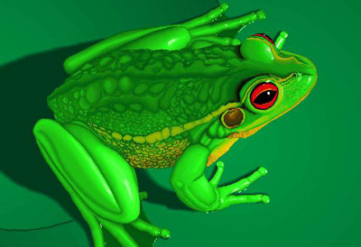
Frog

Slide 23
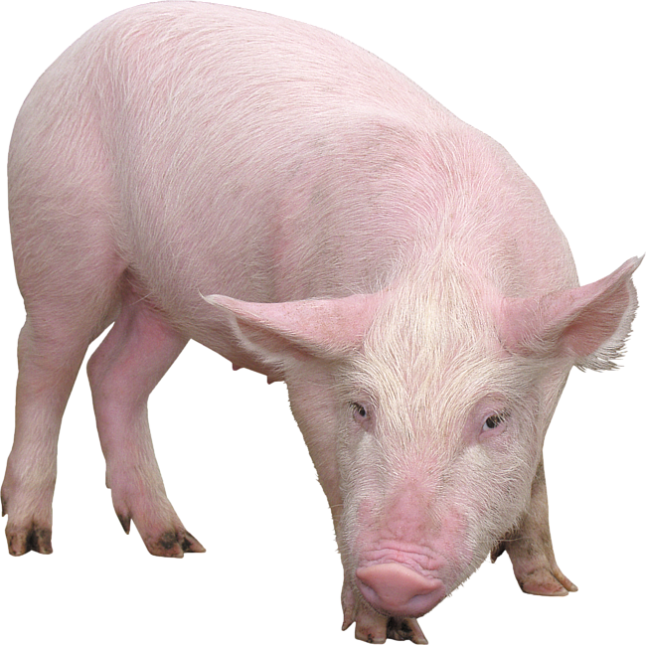
Pig

Slide 24
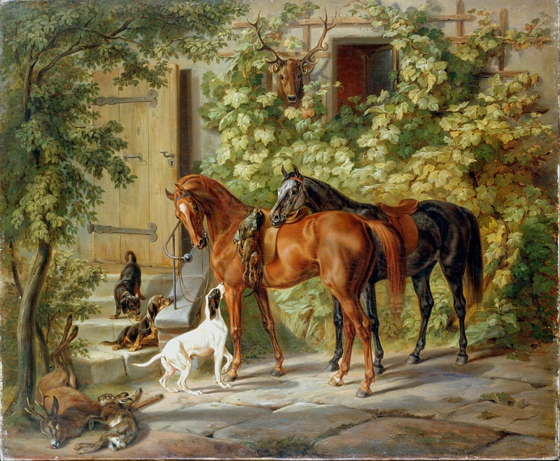
Horse

Slide 25
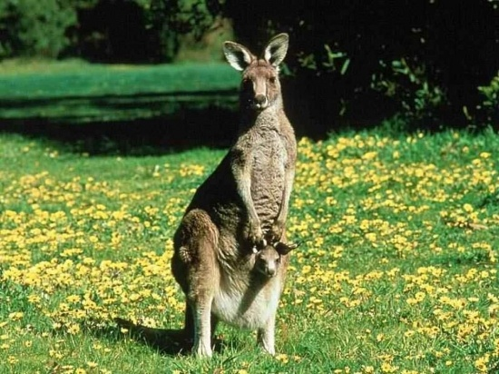
Kangaroo

Slide 26
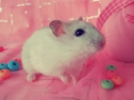
Mouse

