Slide 1
My house. Where is Chuckles?

Slide 2
What is it?
chair
It is a …

Slide 3
What is it?
table
It is a …

Slide 4
What is it?
bed
It is a …

Slide 5
Физминутка
для глаз

Slide 6
house

Slide 7
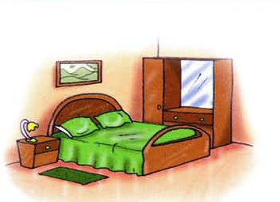
bedroom

Slide 9
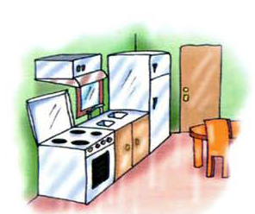
kitchen

Slide 10
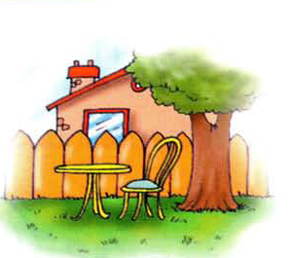
garden

Slide 11
Физминутка

Slide 12
Where’s…?
Где…?

Slide 13
Are you in the…?
Ты в …?ы в …?

