Slide 1
Professions
Презентация для 2 класса

Slide 2

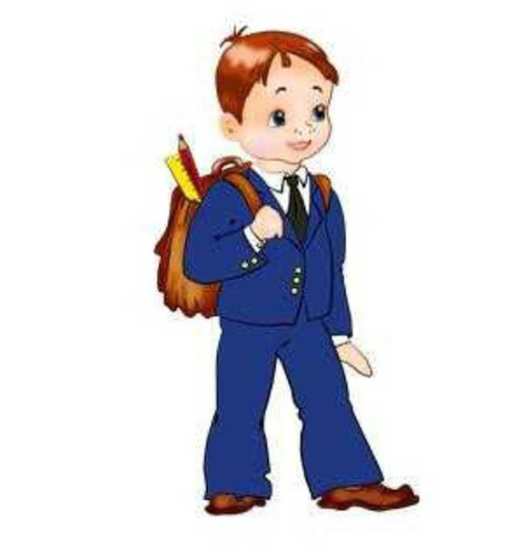
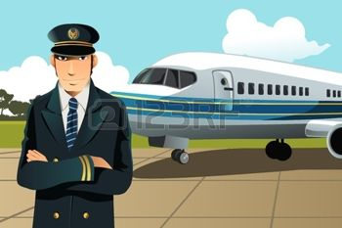


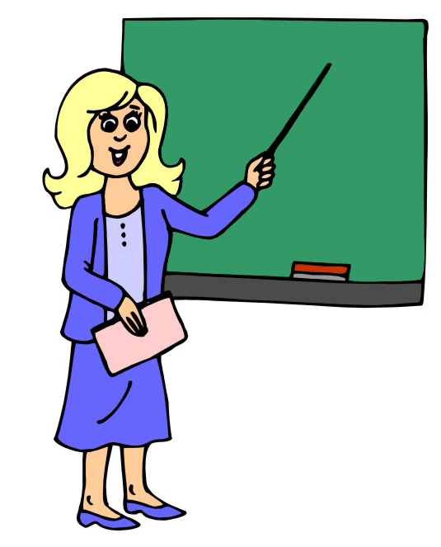

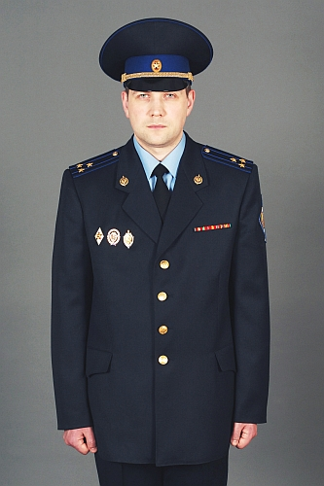

Slide 3
I am a pupil

Slide 4
He is a doctor

Slide 5
She is a teacher

Slide 6

Tom is a cook

Slide 7
My father is a pilot

Slide 8
His uncle is a sailor

Slide 9
My friend is a dentist

Slide 10
My brother is an engineer

Slide 11
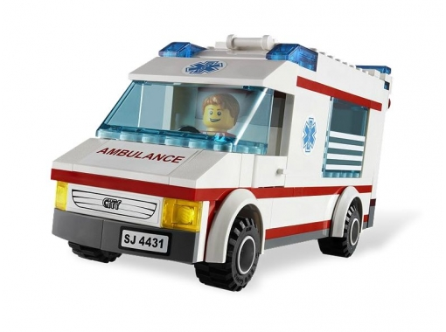



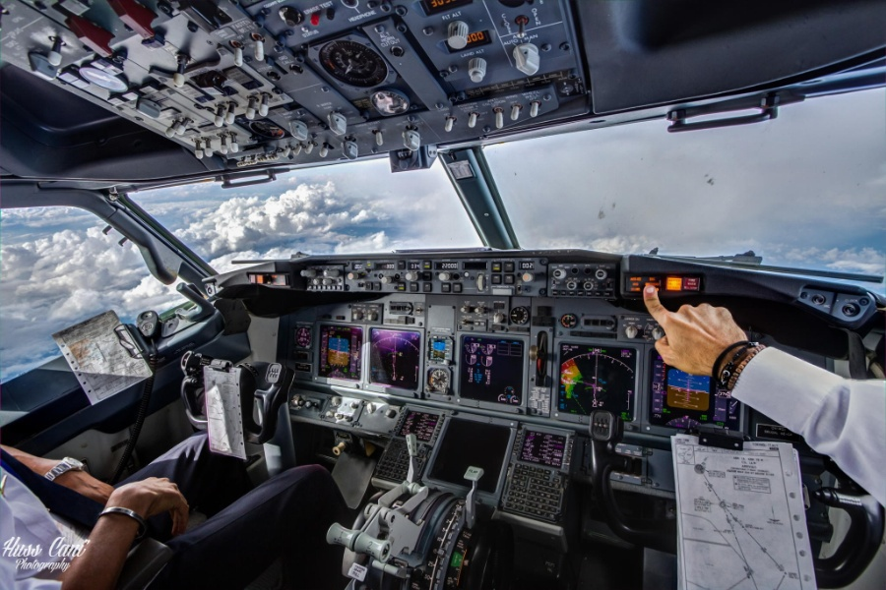
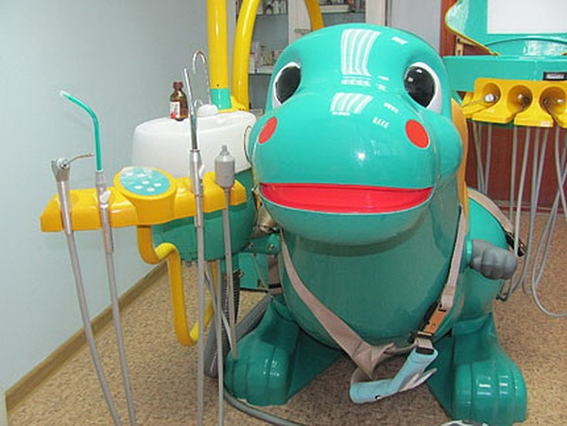

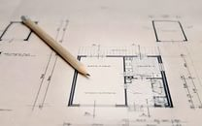
Назови профессию, связанную с каждым предметом

Slide 12

Проверь себя
a doctor a cook a teacher a sailor
a pilot a dentist a pupil an engineer

Slide 13
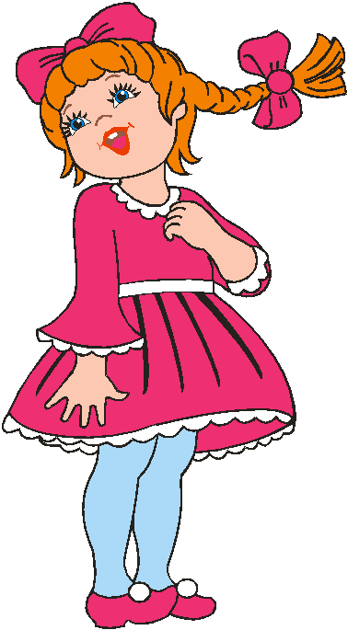
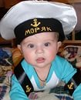

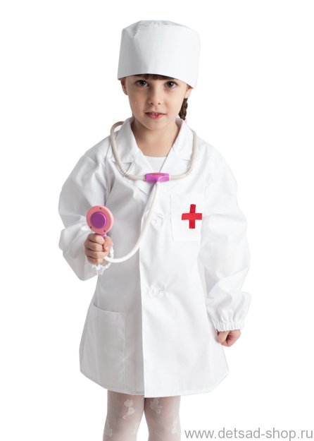


Slide 14
I want to be …
a teacher
a doctor
an engineer
a pilot
a dentist
a cook
a sailor

