Slide 1
One, two, three
Let me see
Who likes coffee
and who likes tea.
One, two, three.
Oh, now I see
You like coffee,
And you like tea.

Slide 2
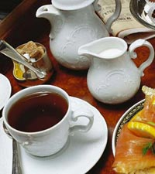
ENGLISH
TEA PARTY

Slide 3
http://www.youtube.com/watch?v=Vv8jAXUE7Xo
http://www.videosostav.ru/video/39ceed0099f6072f329323ce745fd397/
http://www.youtube.com/watch?v=qFvuasIQErw

Slide 4
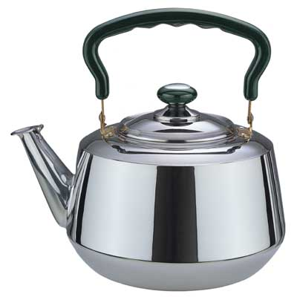
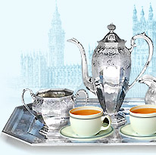
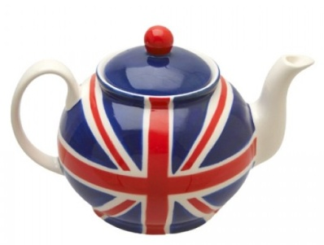
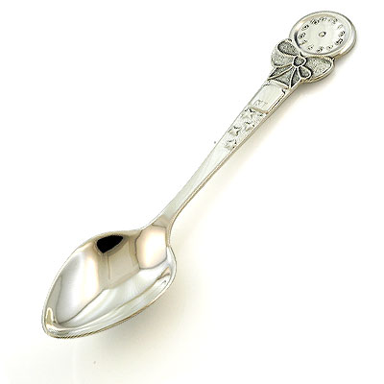
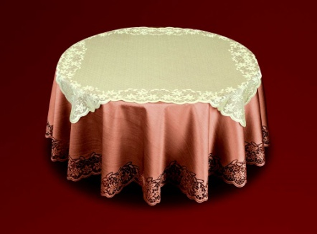
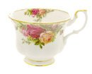
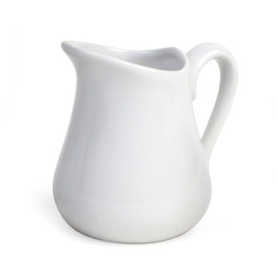
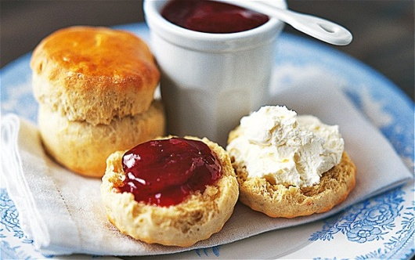
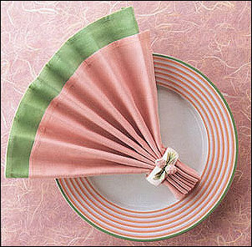
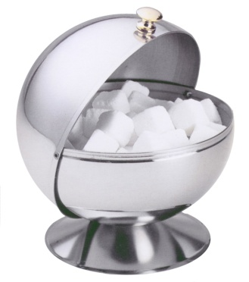
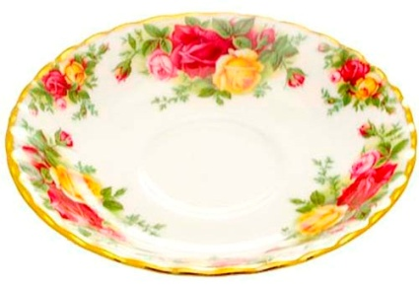
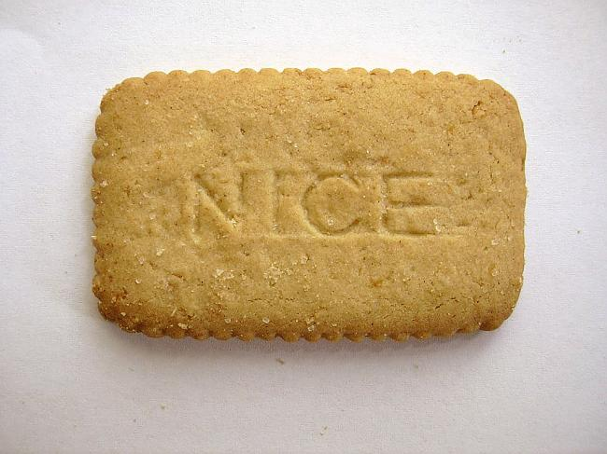
to lay the table
a teapot
a kettle
a spoon
a tablecloths
a cup
a milk jug
a scone
a saucer
a sugar bowl
a biscuit
a napkin

Slide 5
- Would you like some..?
- Yes, please. / No, thank you.
- Help yourself.
- May I have some …
- You are welcome.

Slide 6
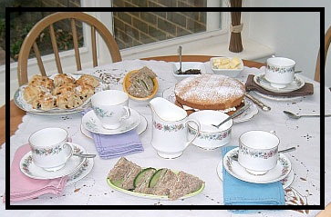

Slide 7
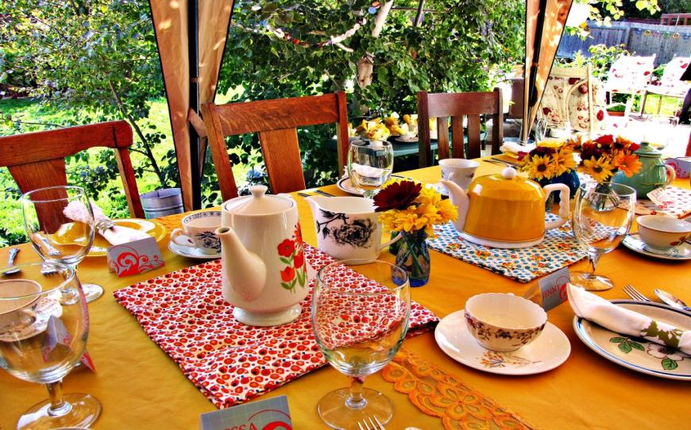

Slide 8
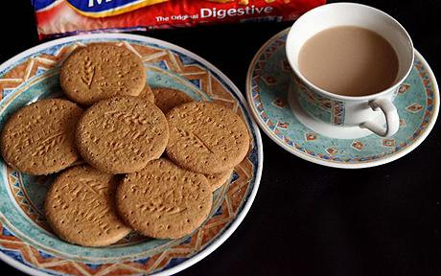
Let’s take
a nice cup of tea!

Slide 9
Puzzle
Find the words: чайник для заварки чая, чашка, ложка, сахар, чайник, булочка, пирожное, молоко
S | U | G | A | R | P | B | O
T | F | D | X | S | C | U | P
R | T | E | A | P | O | T | S
A | Y | W | N | O | Z | U | C
I | E | N | J | O | Y | M | O
N | M | B | R | N | C | I | N
E | U | K | E | T | T | L | E
R | G | Z | E | C | A | K | E

