Slide 1
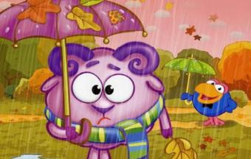
The leaves are falling One by one. Summer’s over School’s begun.

Slide 2
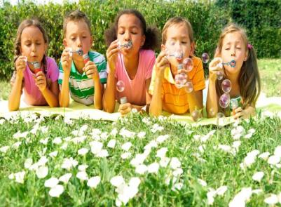
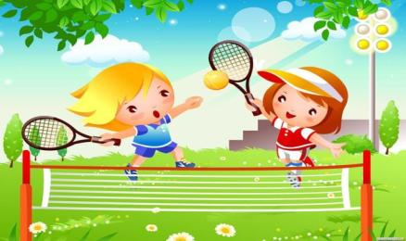
rumems
nitens
gmswinmi
dayloih
oprst
hidclrne

Slide 3
Autumn leaves are falling down, Falling down, falling down, Autumn leaves are falling down, Yellow, red, orange and brown!

Slide 4
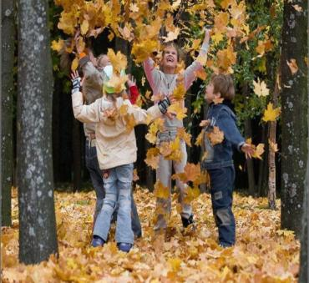
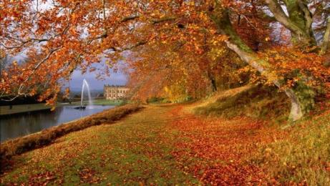
Down, down Yellow and brown The leaves are falling Over the town.

Slide 5
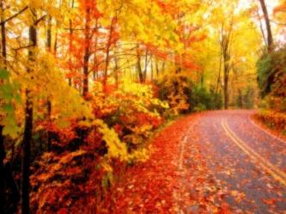
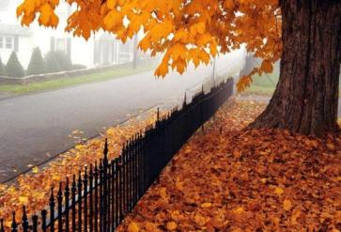
September is a time Of beginning for all, Beginning of school Beginning of fall.

Slide 6
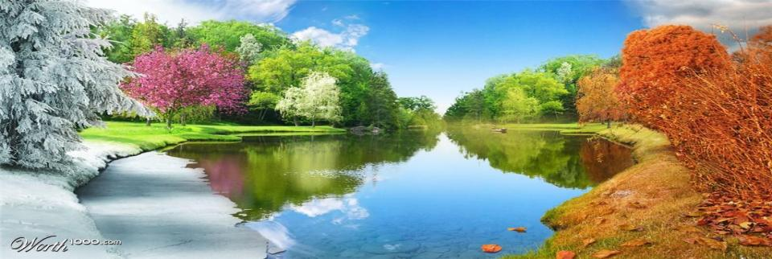
In the summer it is hot.
In the winter it is not.
In the spring there are flowers.
In the autumn there are showers.

Slide 7
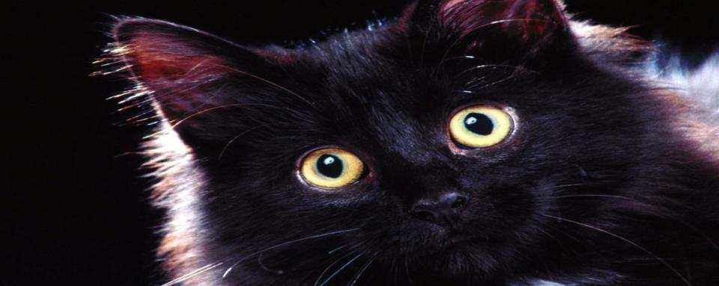
My cat is fat,
My cat is black.
My cat likes rats,
Thin and fat.

Slide 8
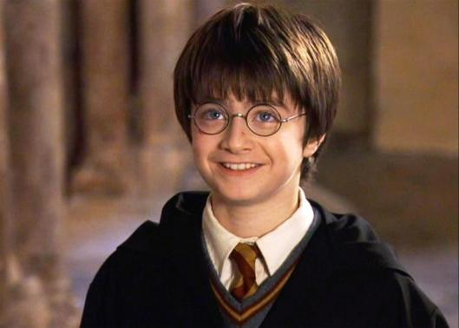
Harry is ……
He has got……

Slide 9
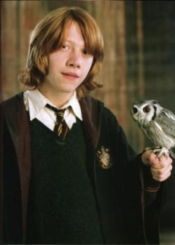
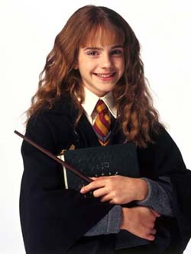
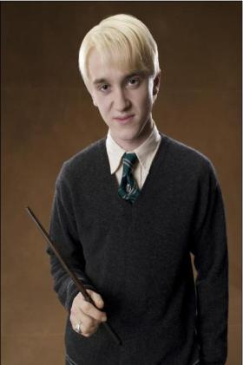
Draco
Ron
Germiona

Slide 10
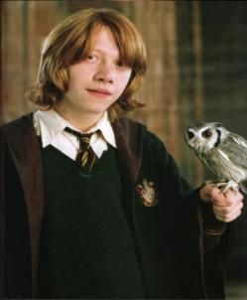
Two little eyes to look around,
Two little ears to hear each sound,
One little nose to smell what`s sweet,
One little mouth that likes to eat.

Slide 11
Rain on the green grass, Rain on the tree. Rain on the house-top But not on me!
Rain, rain, go away! Come again another day!

Slide 12
The birds sing and fly. The girls play and smile. The boys fight To prove that they are right.

Slide 13
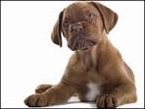
I see a dog, The dog sees me. I like the dogs, The dogs like me. Big white dogs. One, two, three. I like the dogs and the dogs like me.

Slide 14
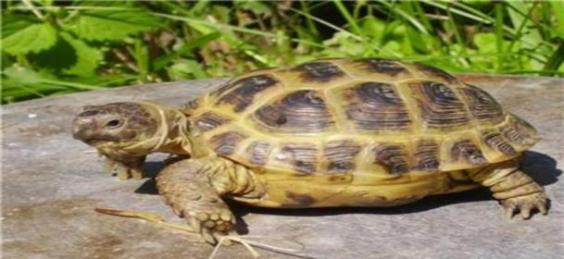
I have a little turtle, He lives in a box. He swims in the water And he climbs on the rocks.

Slide 15
October leaves are lovely They rustle when I run Sometimes I make a heap And jump in them for fun.

Slide 16
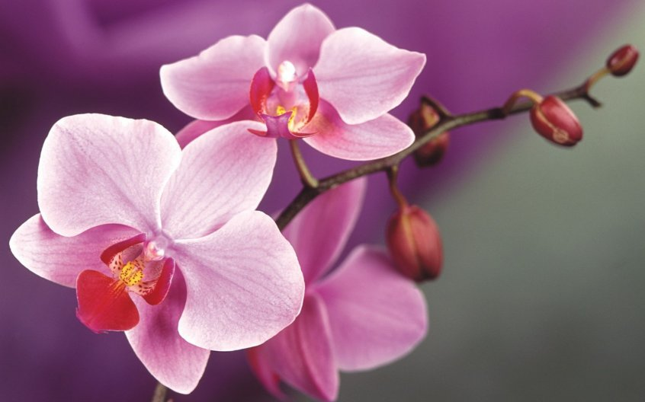

Slide 17
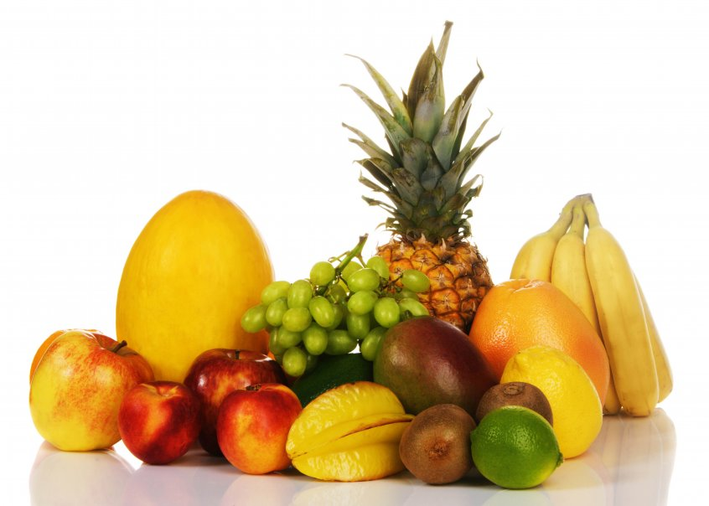

Slide 18
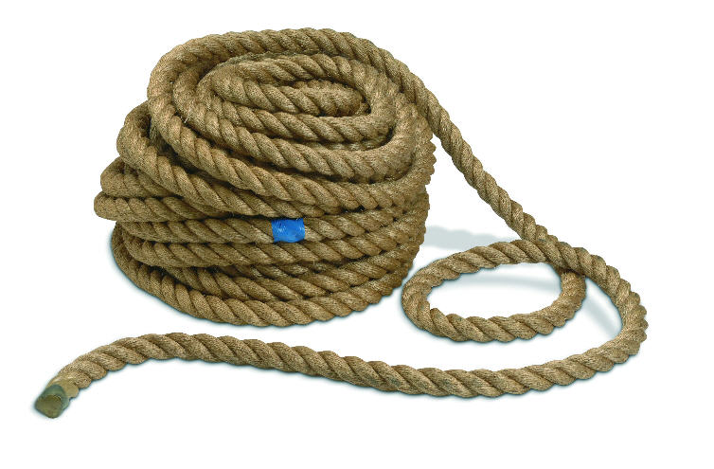

Slide 19
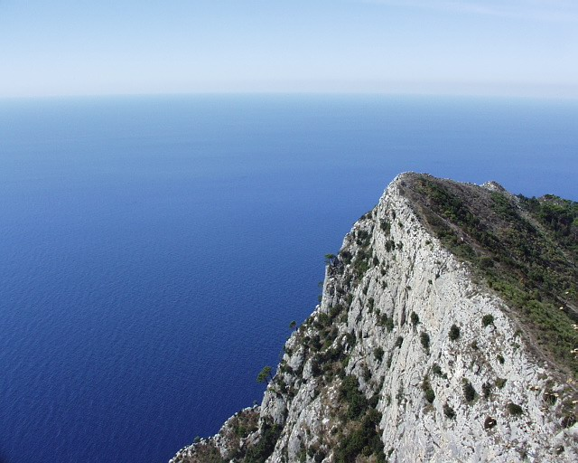

Slide 20
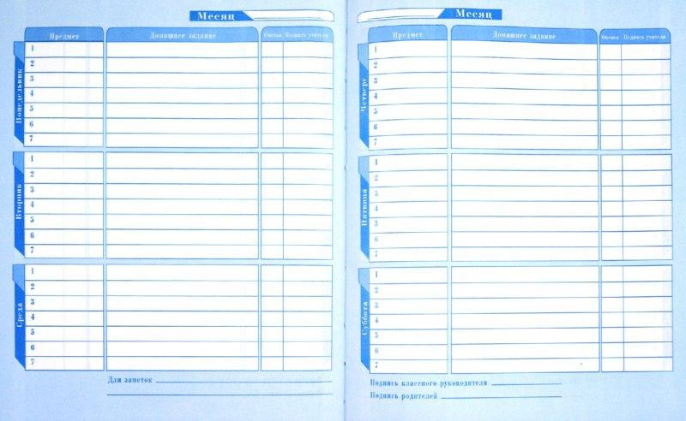

Slide 21
I went to school yesterday.

Slide 22
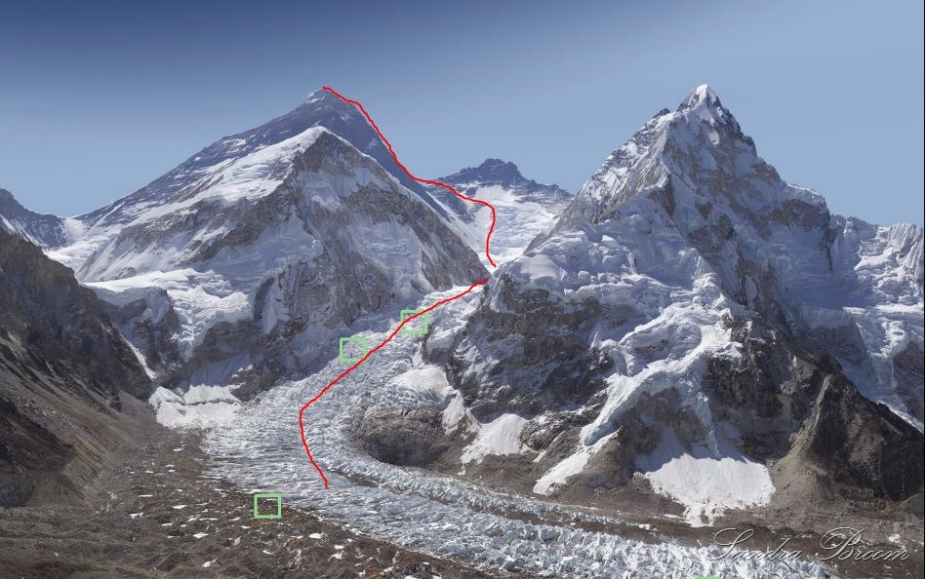

Slide 23
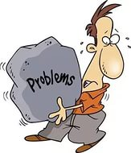

Slide 24
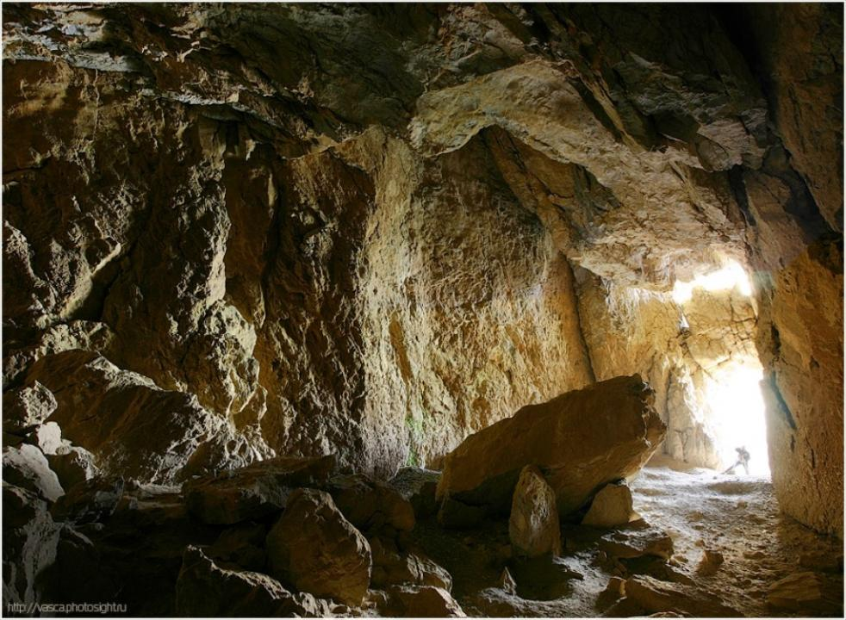

Slide 25
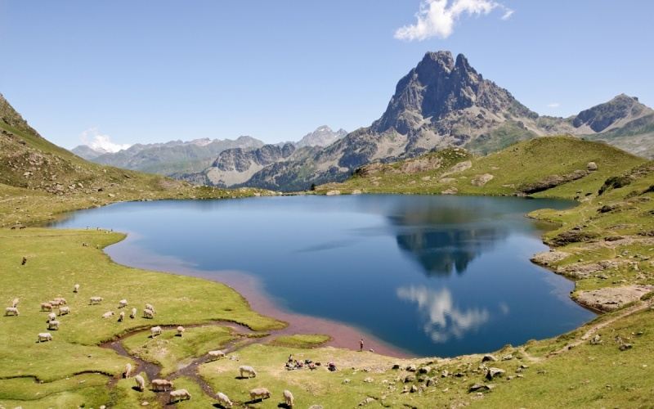

Slide 26
I was happy,
She was not
I was angry,
They were not
Were we merry
Yes, we were
Were they crazy?
They were not.

Slide 27
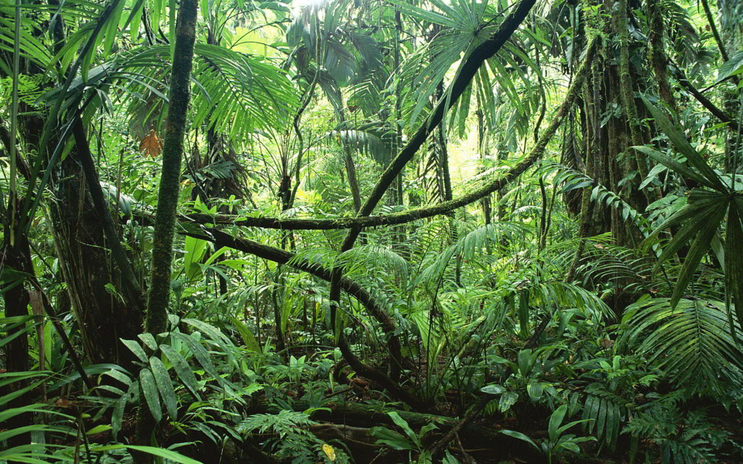

Slide 28
Rain on the green grass,
Rain on the tree,
Rain on the house-tops,
But not on me.

Slide 29
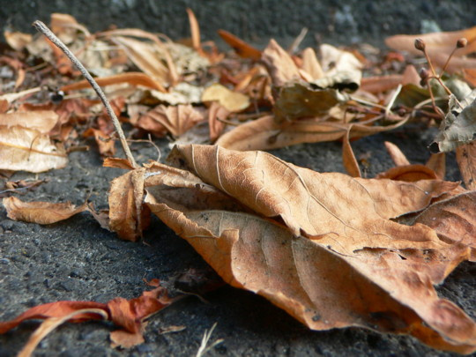

Slide 30
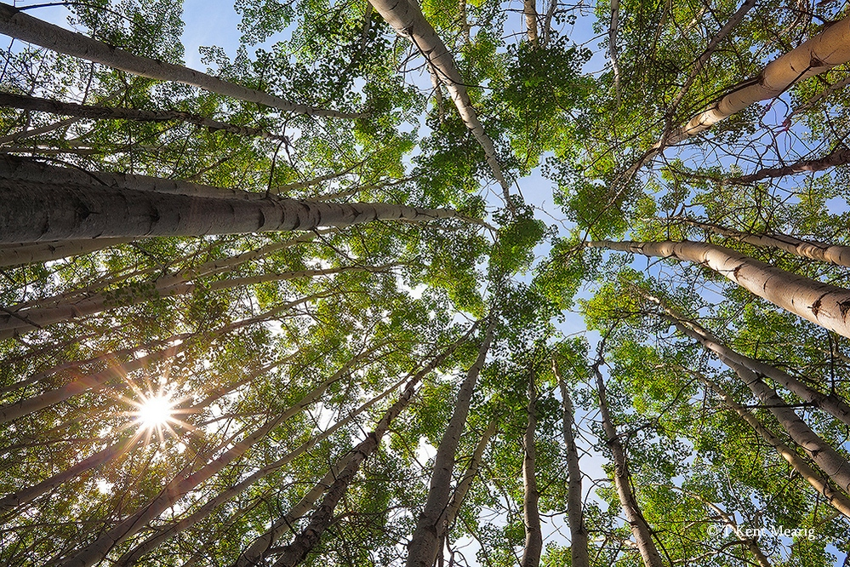

Slide 31
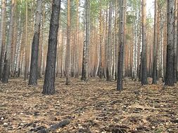

Slide 32
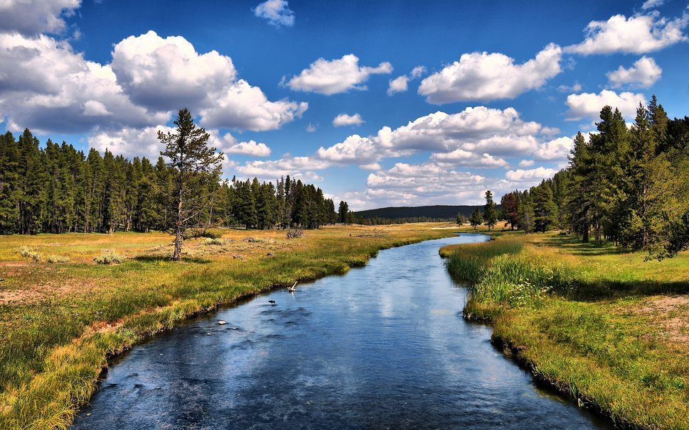

Slide 34
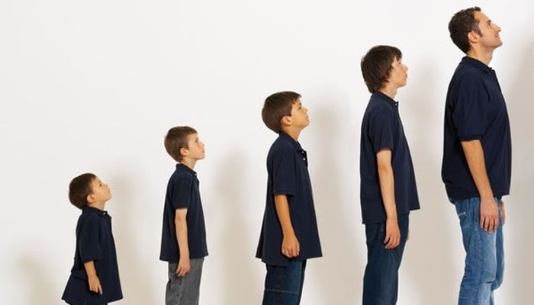

Slide 35
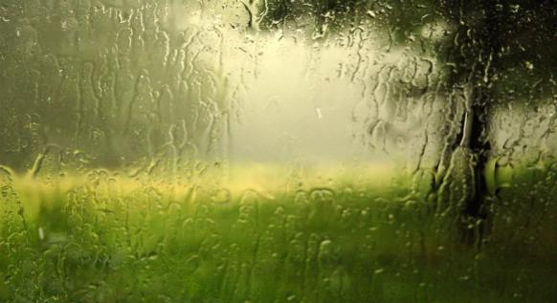
It rains on the duck, cow, and horse. It rains on the trees and leaves, of course! It rains on a little girl and fella. But I'm not wet. I have an umbrella!

Slide 36
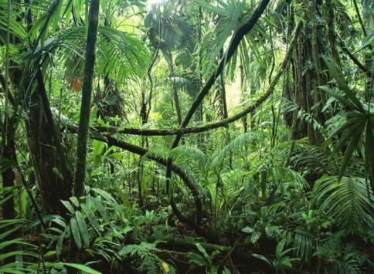
Rain
Weather
Tropical
Leaves
Hot
Wet
Tall
Animals
Plants
Canopy
Forest
Orchids

Slide 37
Whether the weather be fine,
Or whether the weather be not,
Whether the weather be cold,
Or whether the weather be hot,
We'll whether the weather
Whatever the weather
Whether we like it or not.

Slide 38
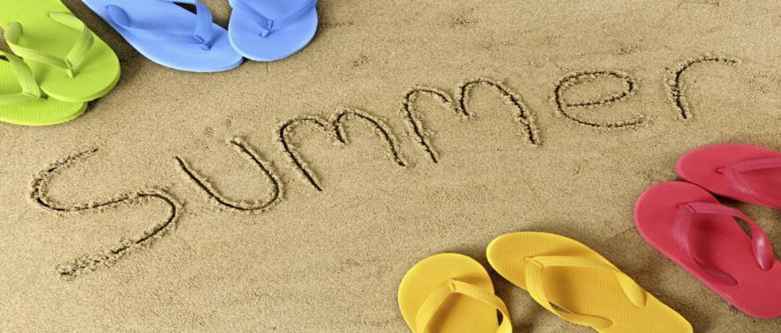
This is the season when nights are short.
And children have plenty of fun and sport.
Boating and swimming all day long
Will make us healthy and strong.

Slide 39
The water in the sea is cold,
It is cold as ice,
But I am not afraid at all:
My coat is warm and nice.

Slide 40
January, February, March, and April,
May, June, July, August, and September, October, November, and December,
These are the months of the year.

Slide 41
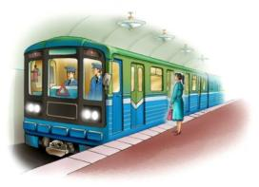
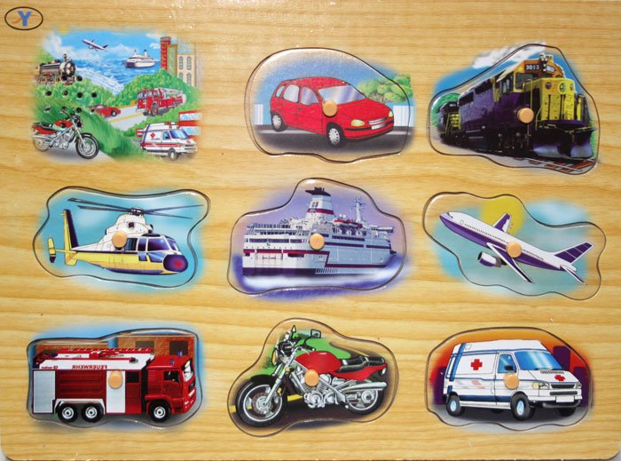
Take a bus or take a train, Take a boat or take a plane, Take a taxi, take a car, Maybe near or maybe far, Take a rocket to the moon, But be sure to come back soon.

