Slide 1
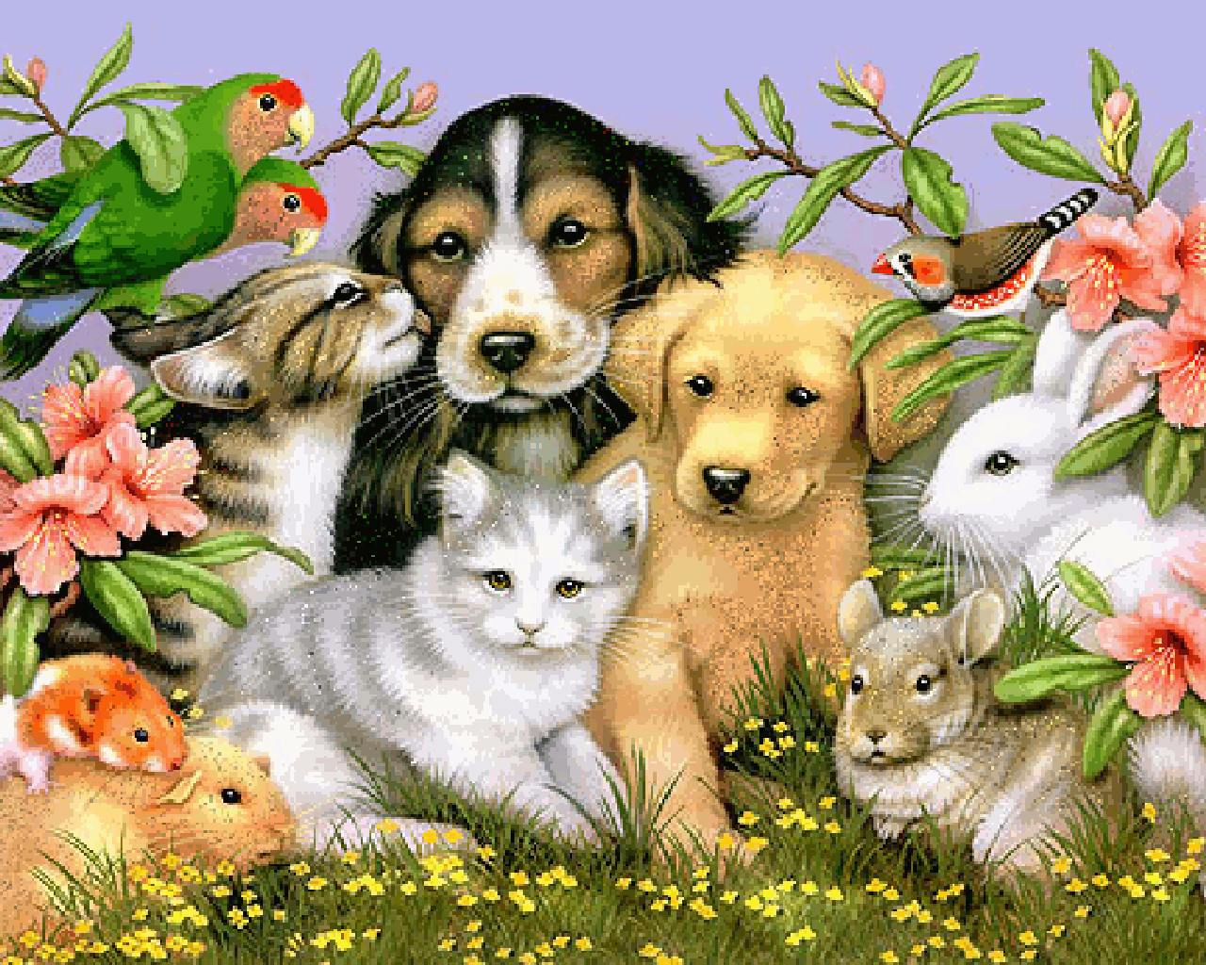
We are Friends

Slide 2
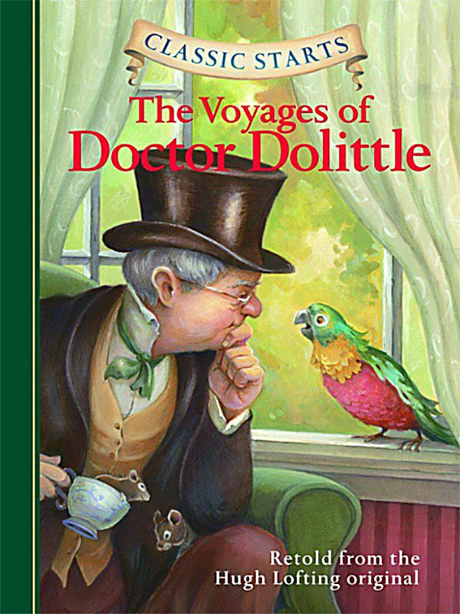
Doctor Dolittle
Polinesia is my pet.
Plinesia is my friend.
She is smart.
I like talking to Polinesia.
She is friendly. She likes helping me.
I like Polinesia.

Slide 3
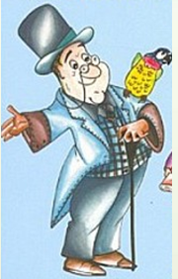
I like my pets
a pet – pets
a friend - friends

Slide 4
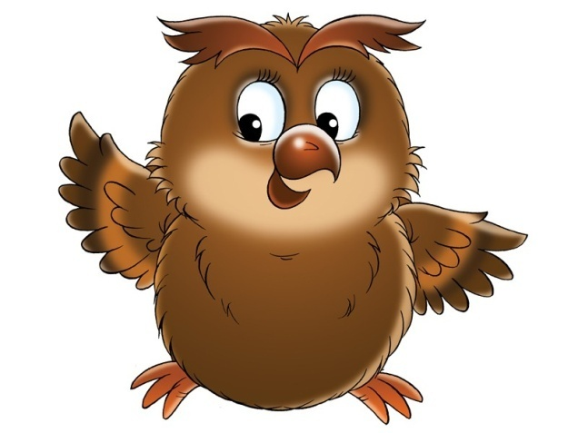
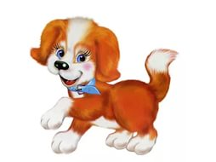
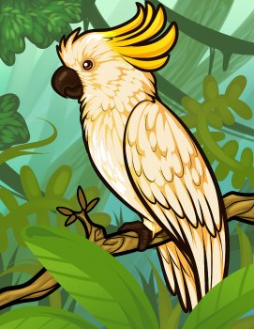
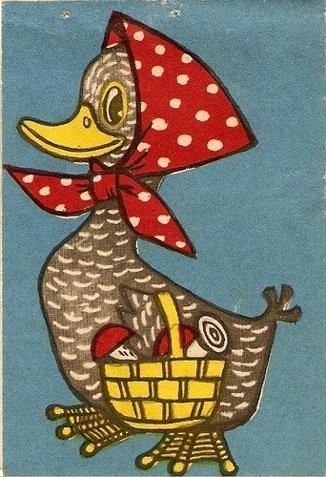
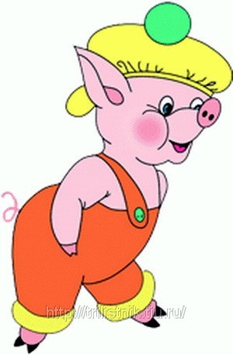
We are Friends
Jip the dog
Too-Too the owl
Polinesia the parrot
Cub-Cub the pig
Dub-dub the duck

Slide 5
I like my pets
They are friendly and funny.

Slide 6
We are good friends!

Slide 7
Физкультминутка

Slide 8
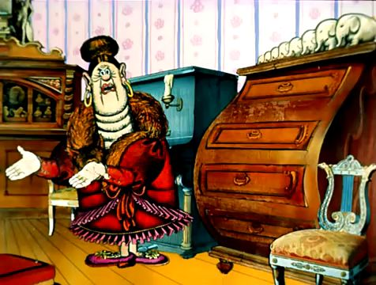
They are not funny!
They are not friendly!
We are not friends at all!

Slide 9
Polinesia likes singing songs.

Slide 10
We are …
They are …
They are not …
We are not…
are not = aren’t
is not = isn’t

Slide 11
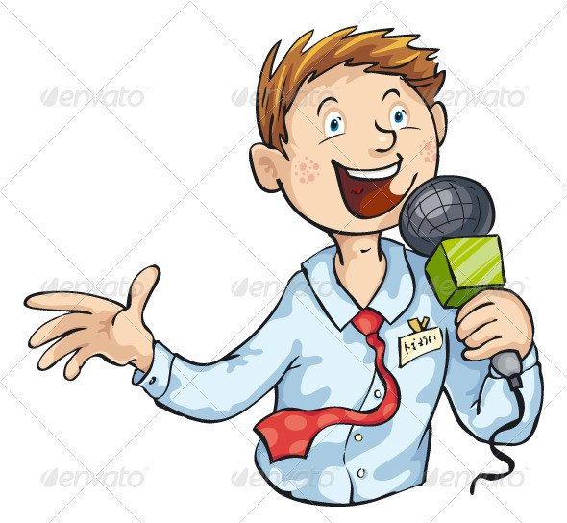
Hi, children! I’m Nick.
Who are you?
What are your names?

Slide 12
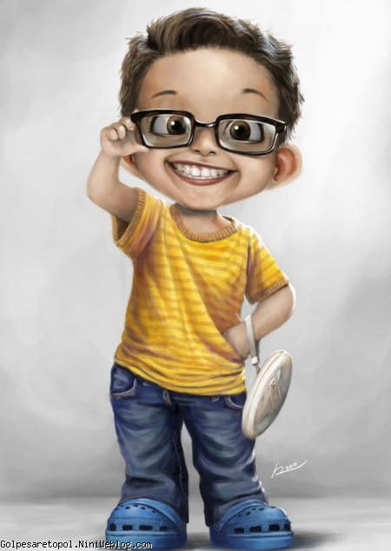
I’m a little boy.
My name is Charlie

Slide 13
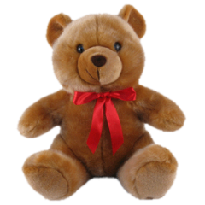
He is a bear.
His name is Teddy.
Teddy bear

Slide 14
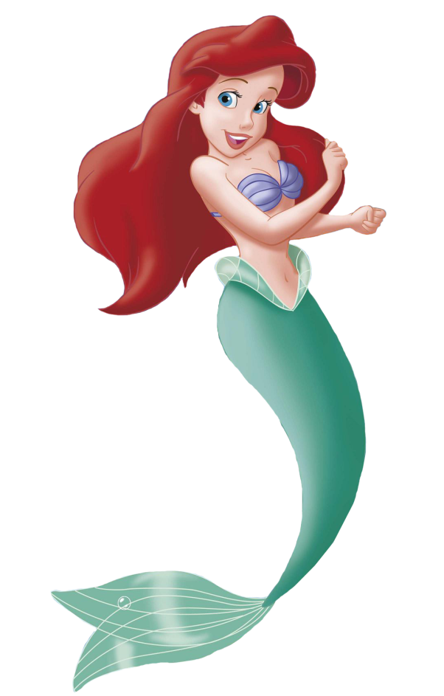
She is a little mermaid.
Her name is Ariel.
Ariel

Slide 15
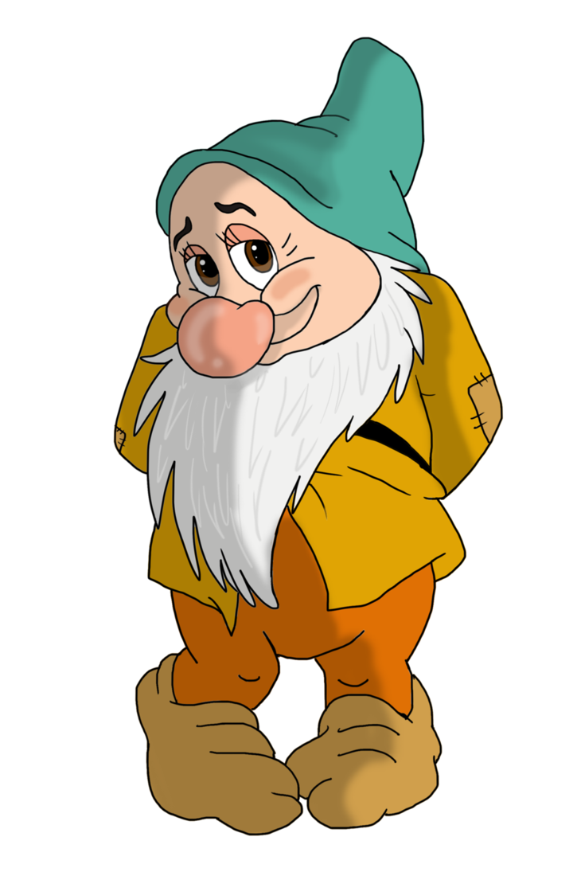
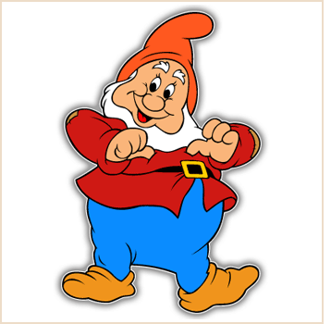
We are dwarfs.
Our names are Oin and Bombur.
Oin
Bombur

Slide 16
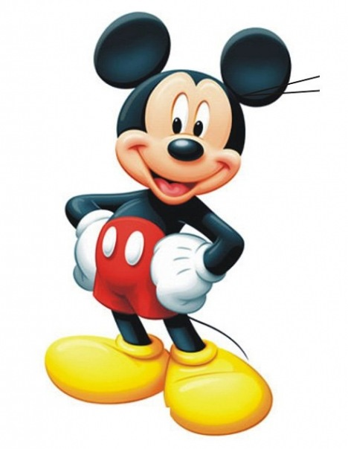
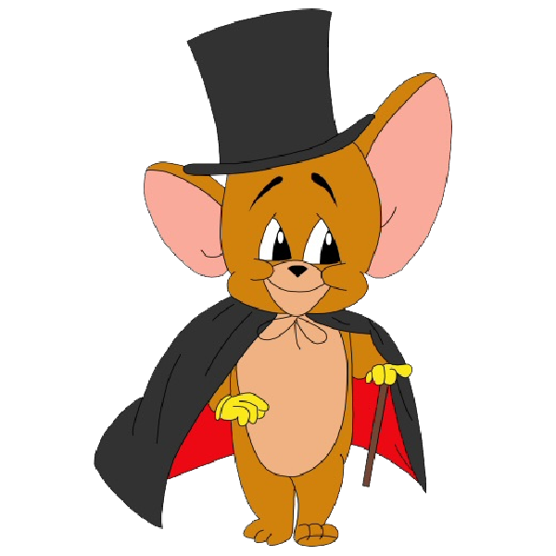
They are mice.
Their names are Mickey and Jerry.

Slide 17
I - my
he – his
she – her
it – its
we – our
you – your
they - their

Slide 18
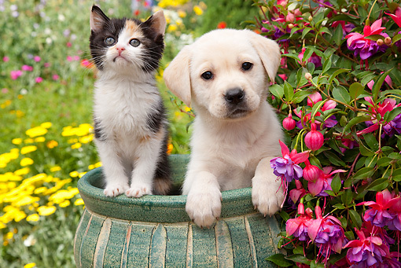
Well done!
Good bye!

