Slide 1
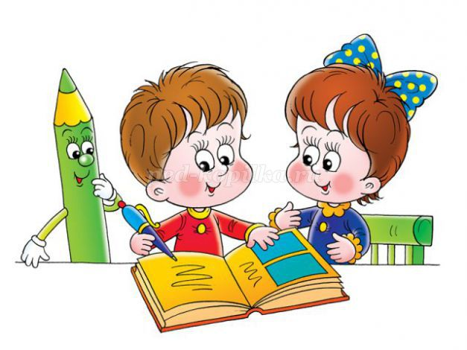
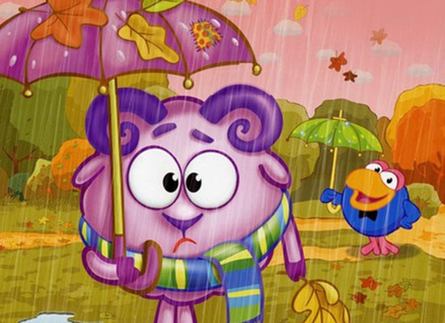
The leaves are falling One by one. Summer’s over School’s begun.

Slide 2
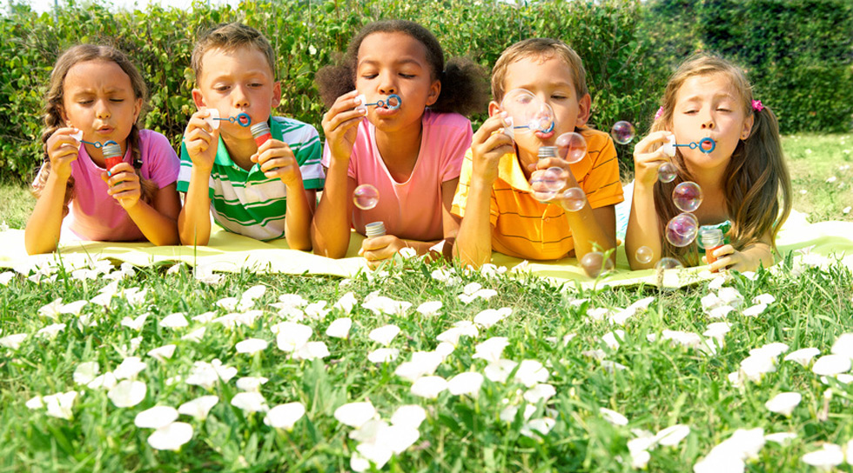
rumems
nitens
gmswinmi
dayloih
oprst
hidclrne

