Slide 1
some info about Washington, D.C.
УМК «СЧАСТЛИВЫЙ АНГЛИЙСКИЙ.РУ / «HAPPY ENGLISH.RU»
(К.И.КАУФМАН, М.Ю.КАУФМАН)
Стр. 140-142

Slide 2
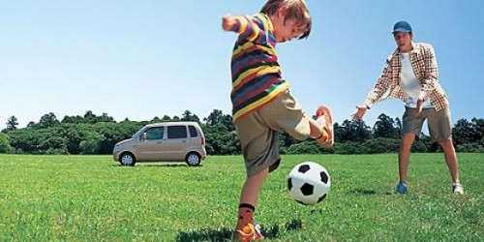
1. What is this picture about? Write one sentence.
..playing football..

Slide 3
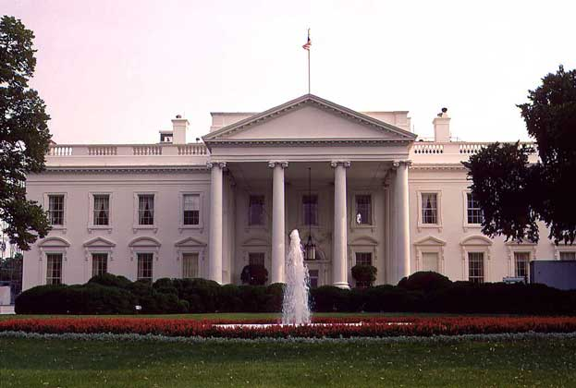
2.Remember some Interesting things about the White House

Slide 4
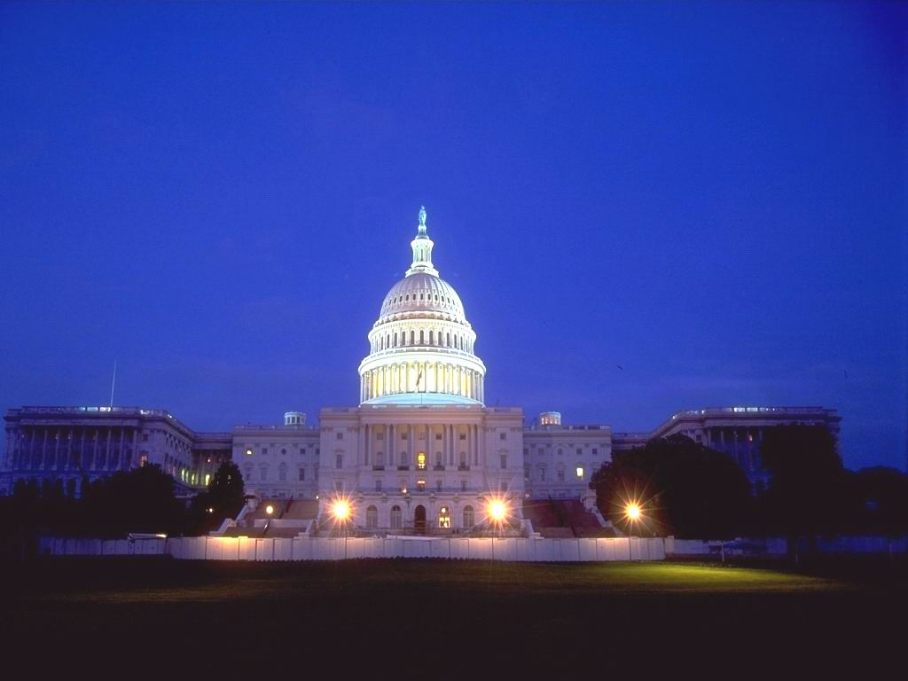
3. What a view ! What are your impressions?

Slide 5
4. Fill in the gaps
The 1)… is the tallest building in Washington, D.C., and the most famous building in the 2)… …, because this is where 3)… are made (= passed).
The Capitol has housed chambers of the 4)… and the House of Representatives. The 5)… of this impressive building was laid by George Washington himself. The Capitol is 6)… by a beautiful garden with many trees and flowers.

Slide 6
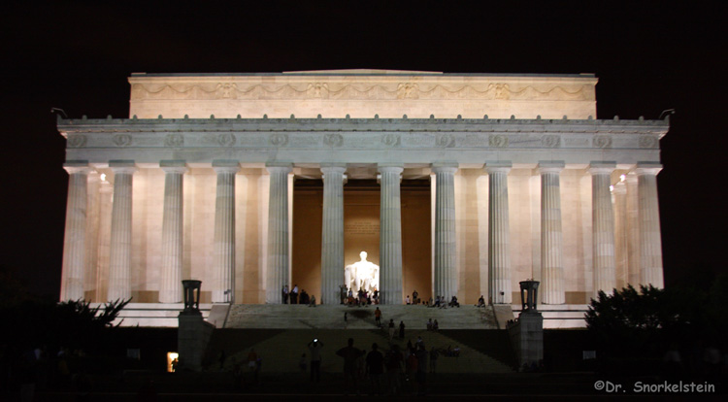
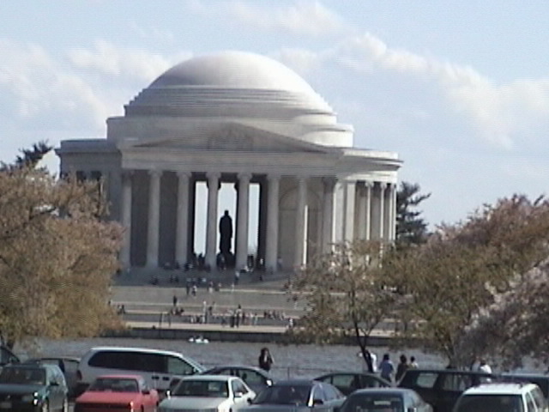
5. Compare these Memorials (complete the table)
 | ? | ?
Named in honor of
Surrounded by | Cherry trees
Was built in
Has …… columns |  | 36
In the middle of this memorial there is |  | The statue of one of the Presidents of America
On the walls of the Memorial you can see

Slide 7
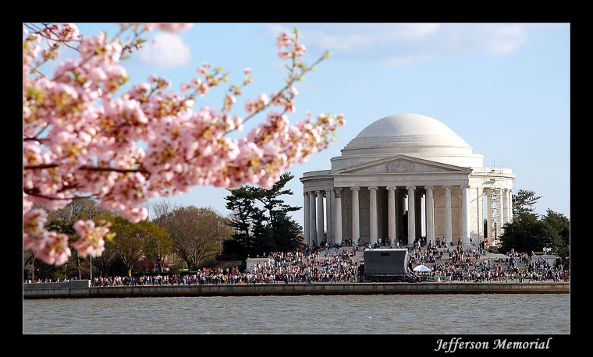
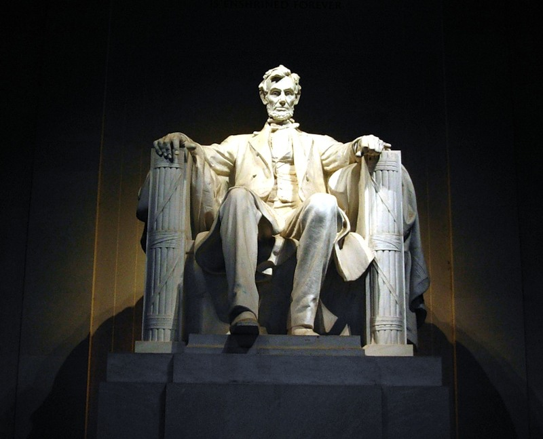
6. What is this man famous for?

Slide 8
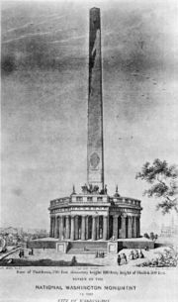
7. a couple of words about G.WASHINGTON MONUMENT
It has ……………………..stone structure.
It looks like an …………………………………
It honors the «…………. of the Country».

Slide 9
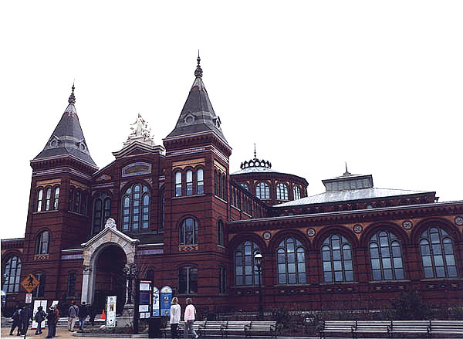
8. What is it? Chose the things that you can NOT see there.
1. full-size trains
2. A.Lincoln’s top hat
3. A lunar landing module
4. The statue of Lincoln
5. Jefferson’s works
6. minerals
7. Christmas tree
8. stones
9. Displays of prehistoric animals
10. Rockefeller’s words about human values

Slide 10
Keys
4. Fill in the gaps
Capitol… 2) USA, 3) laws… 4) Senate 5) coverstone 6) surrounded
5. Complete the table about two Memorials
 | Jefferson Memorial | Lincoln Memorial
Surrounded by | Cherry trees | 36 columns
Was built in | 1943 | 1922
Area | 74, 300 m | 2, 540,6 m
In the middle of this memorial there is | The bronze statue of Jefferson | The statue of Lincoln
On the walls of the Memorial you can see | Jefferson’s most famous works | «IN THIS TEMPLE AS IN THE HEARTS OF THE PEOPLE FOR WHOM HE SAVED THE UNION THE MEMORY OF ABRAHAM LINCOLN IS ENSHRINED FOREVER»
7. 1) four-sided 2) Egyptian obelisk 3) Father
8. 4,5,7,10

