Slide 1
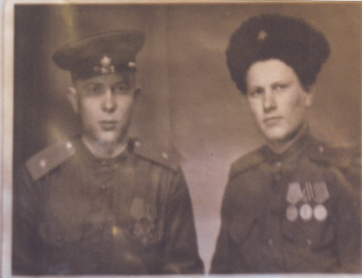
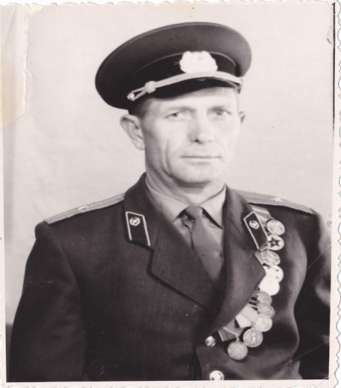
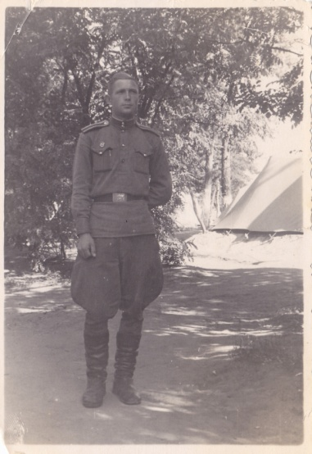
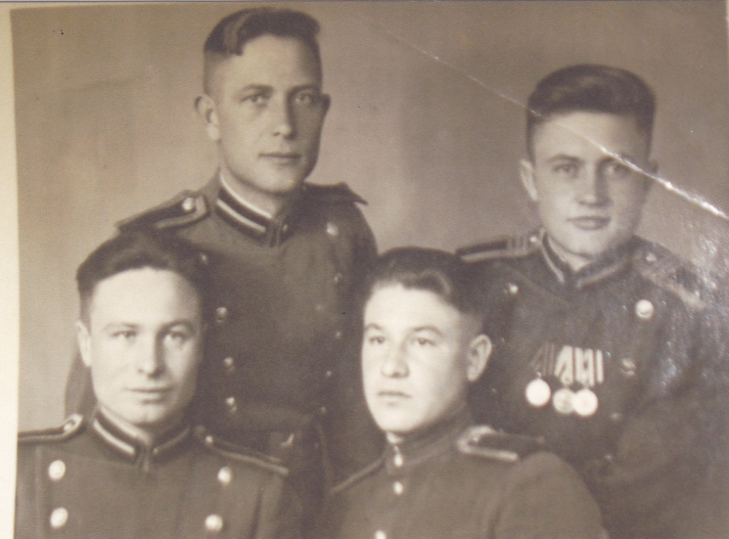
My great-grandfather
Saint-Petersburg
nursery school 125
Kudryasheva Veronika,
Kudryashev Fyodor

Slide 2
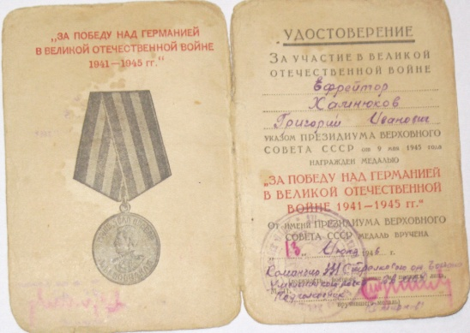
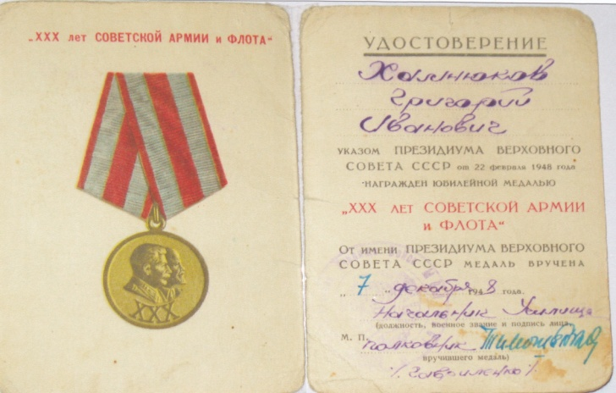
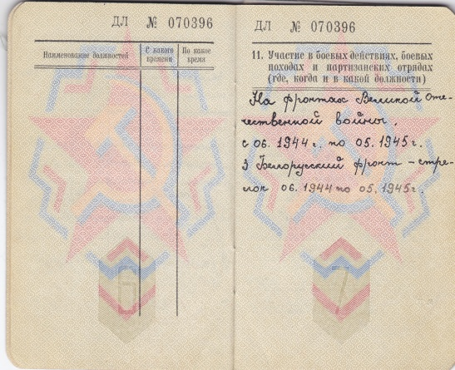
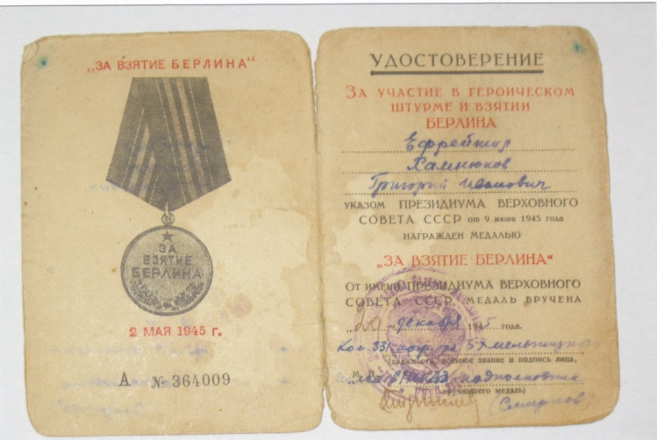
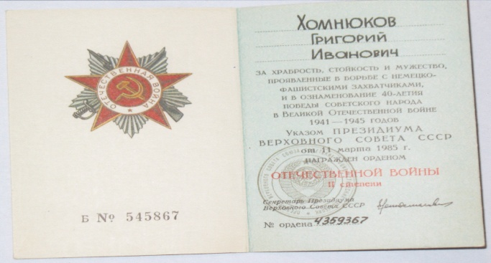
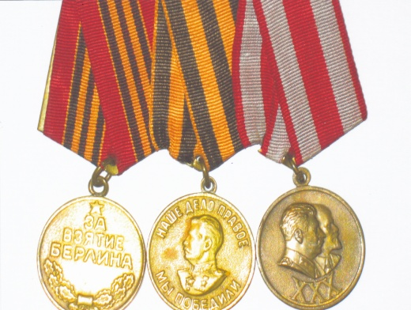
My great-grandfather Khomnyukov Grigoriy Ivanovich was not yet 16, when the Great Patriotic War began. He became a volunteer and went to the front to defend our Motherland. My great-granddad was a shot at war and fought on the third Belorussian Front. He was twice wounded in the battles and took treatment at the hospitals. In May 1945 he took Berlin by storm together with the thousands of other soldiers. He was awarded a medal «For the Capture of Berlin» and some more medals for courage and bravery, serves and battles and the order of Patriotic War second degree as well.

Slide 3
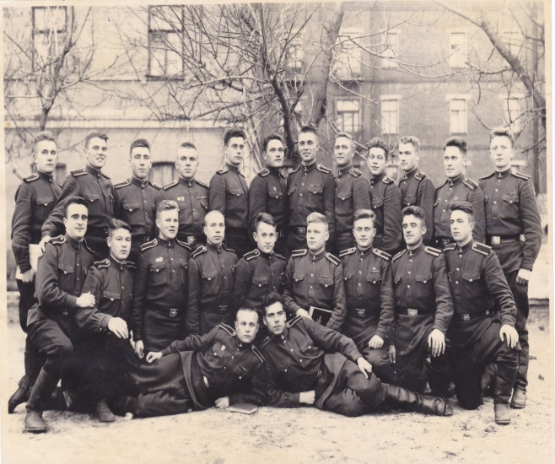
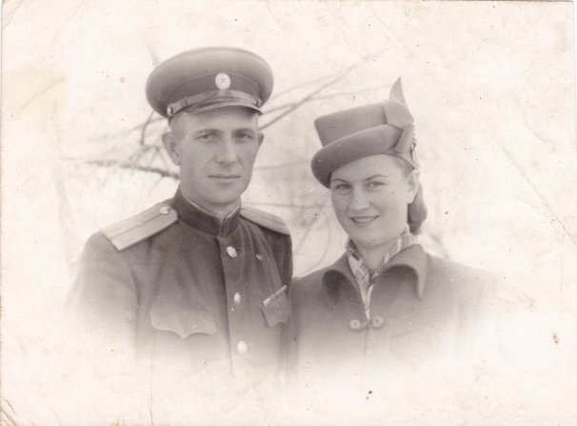
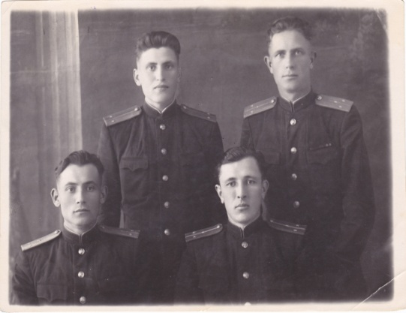
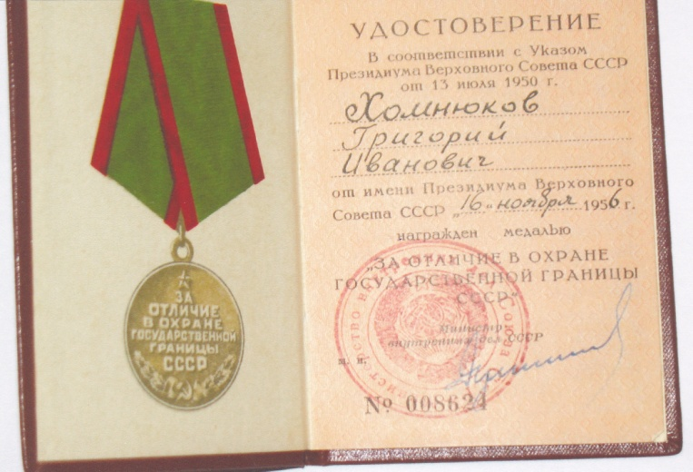
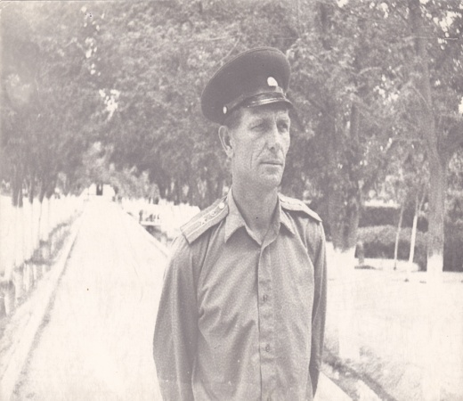
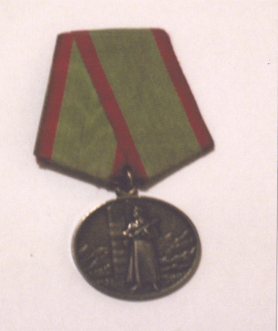
After the war he decided to devote his life to defence of our Motherland. So he went to Kharkov to study at Frontier College. He finished it and became an officer, a frontier-guard. In Kharkov great-granddad got acquainted with Galina my great-granny and married her. They were a beautiful couple. They were happy together. My great-granddad served in the army on border between Turkmenistan and Iran. He was a chief of the frontier post in the mountains. Every day the soldiers inspected the borderline on horseback or on foot with trained dogs. Several times they caught spies. My great-granddad was a colonel, when he retired. I am proud of him.

Slide 4
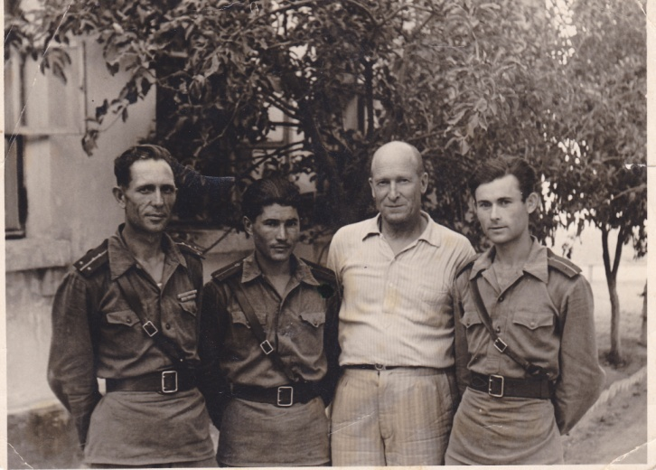
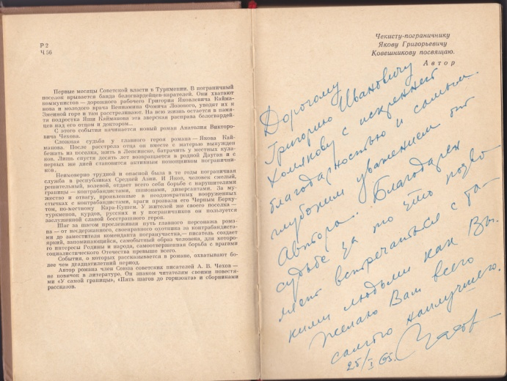
A.Chekhov’s book «The Black Golden Eagle» was published in 1965. A moscow writer devoted it to the defenders of Turkestan’s borderline. A.Chekhov visited great-granddad’s frontier post in 1965 and gave him a copy of his book. He keep it in memory of my great-granddad. My great-grandparents died but we always remember them.

Slide 5
Thank you for your attention!

