Slide 1
My favorite food.
Alisa Bokeria. 2nd class A

Slide 2
I like salad

Slide 3
My favorite soup is “Borsch’’

Slide 4
I like pizza!

Slide 5
I like bell pepper

Slide 6
My favorite fruit are bananas and apples

Slide 7
I like melon!

Slide 8
I like ice-cream !

Slide 9
I like cake!!!

Slide 10
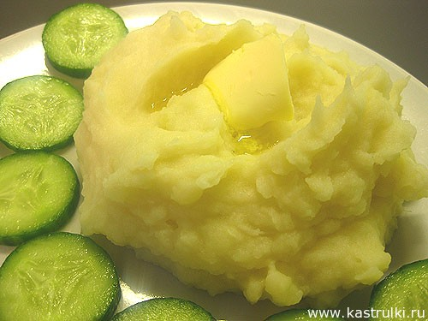
I like potato!

Slide 11
I don’t like mushrooms!

