Slide 1
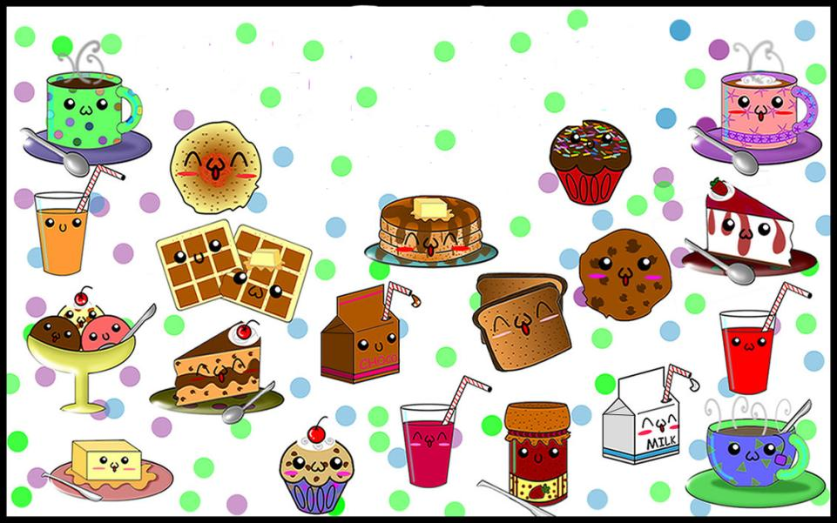
MY FAVOURITE FOOD!
SHKRYABIN DMITRII,
2a

Slide 2
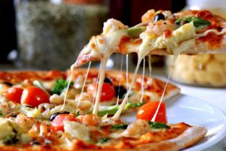
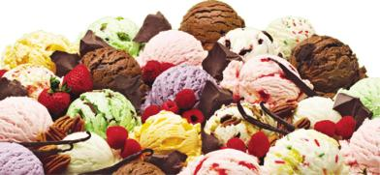
I like pizza
and ice cream

Slide 3
Also, I like orange juice
and cheese!!!

Slide 4
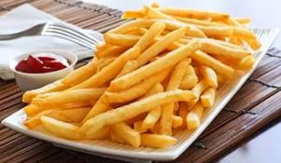
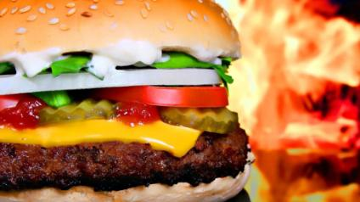
I don’t like chips and burgers!!!

Slide 5
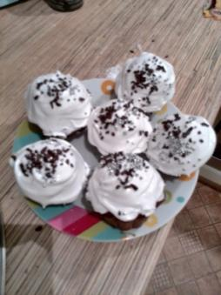
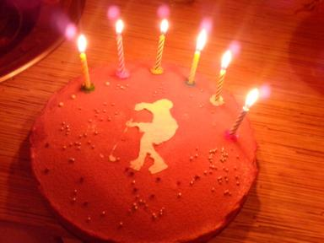
But
my
favourite
food
- my mother’s
chocolate cakes!!!

Slide 6
YUMMY!!!!!

