Slide 1
My Favourite Food!
Micha Kostin
2 «A» class

Slide 2
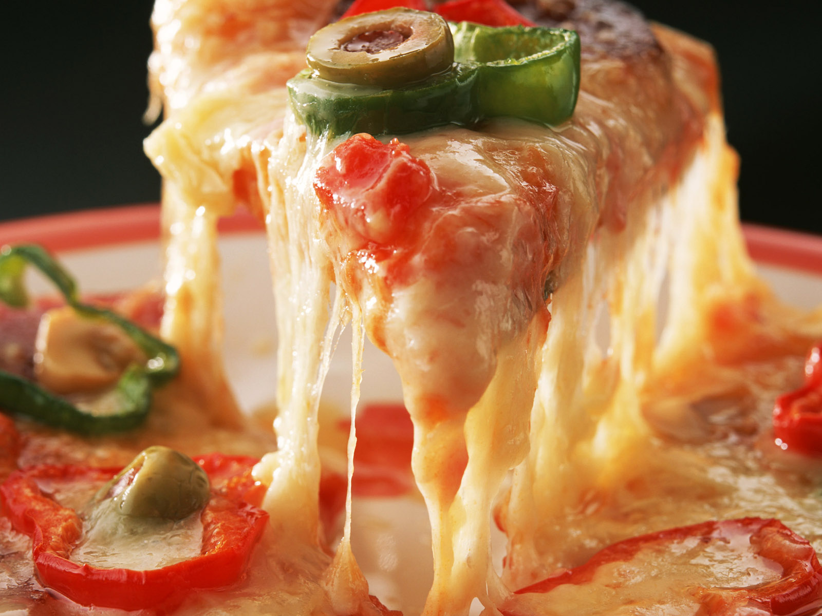
I like pizza.

Slide 3
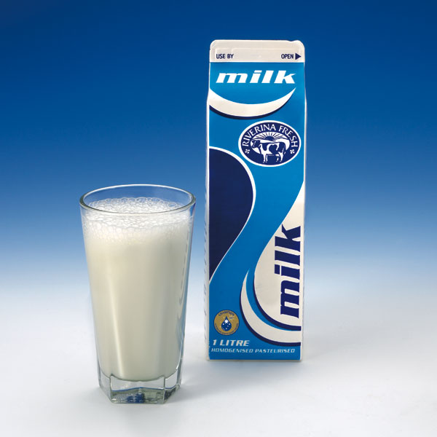
I like milk.

Slide 4
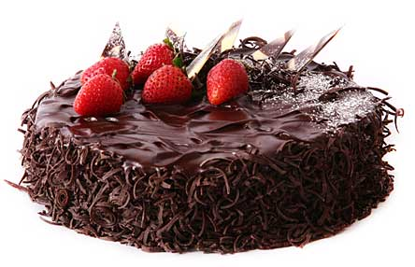
I like chocolate cake.

Slide 5
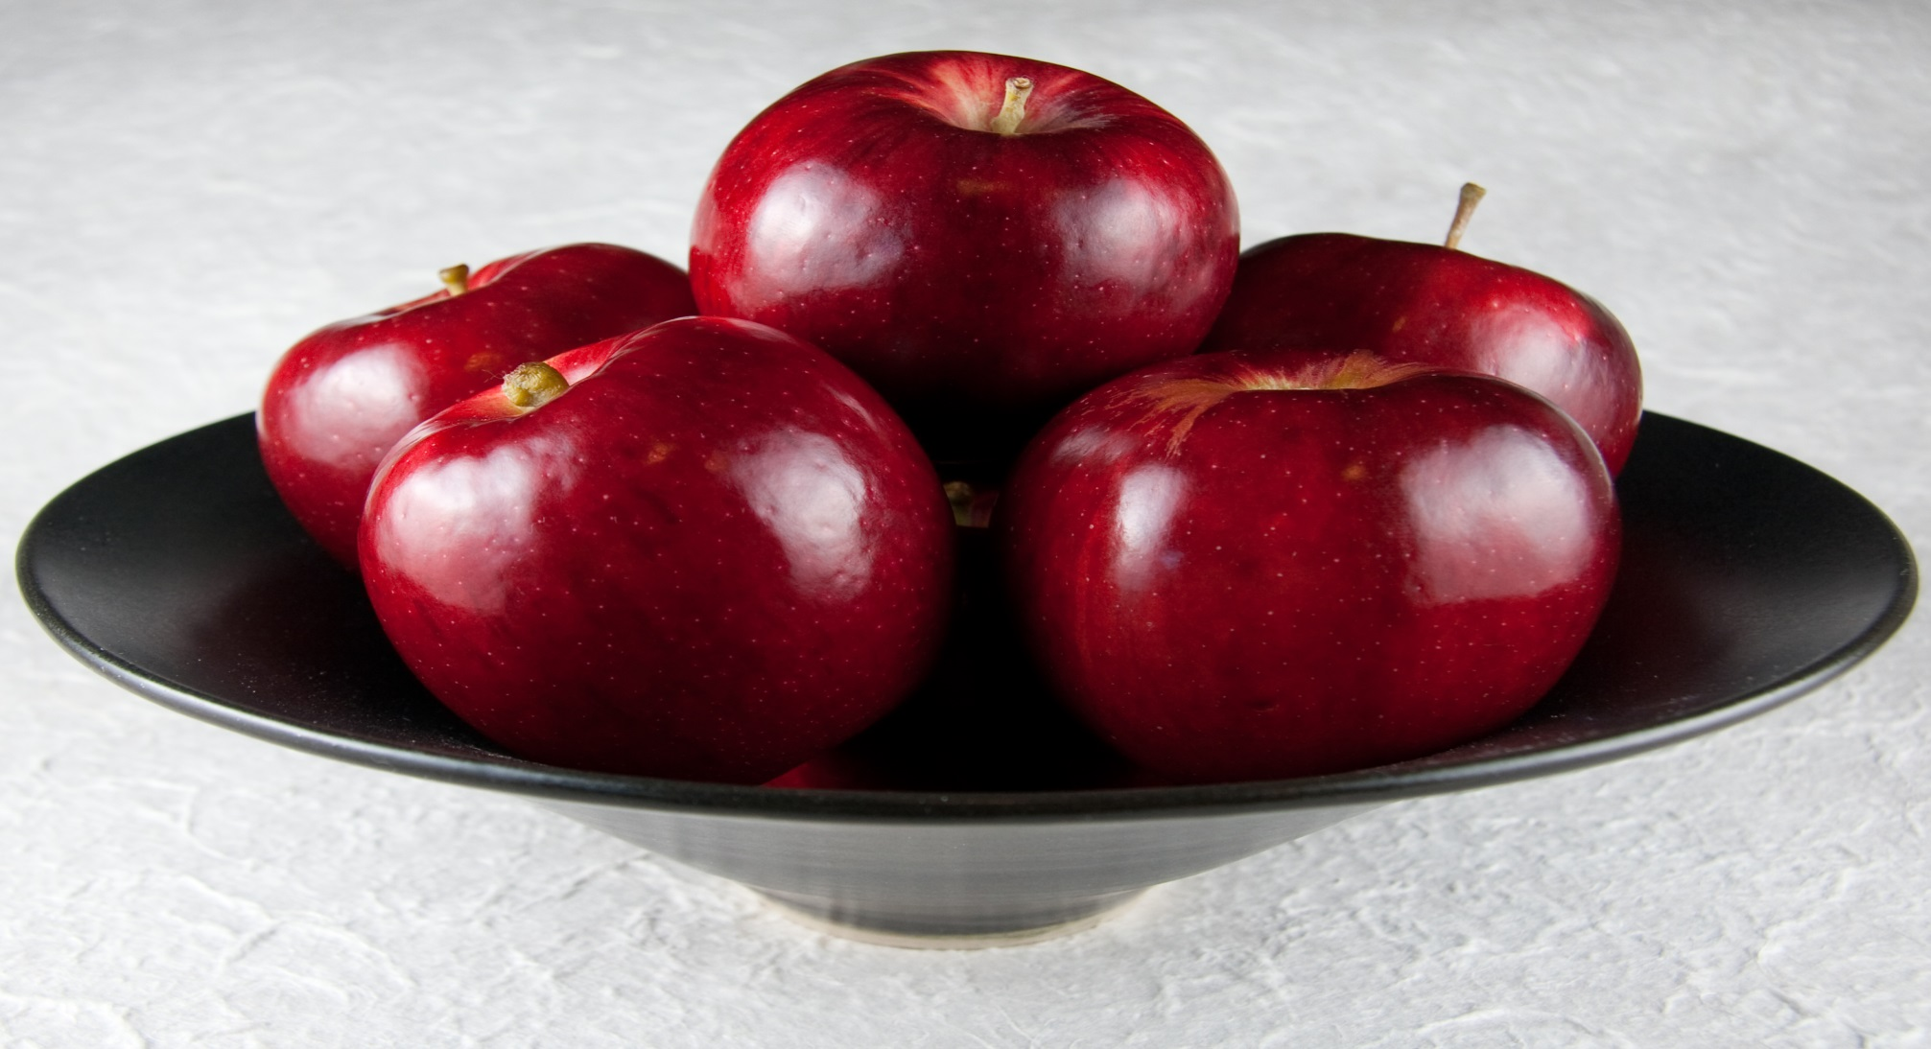
I like apples.

Slide 6
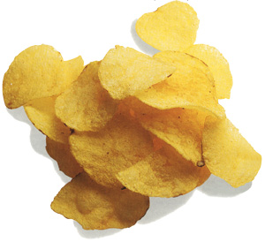
I don ‘t like chips.

