Slide 1
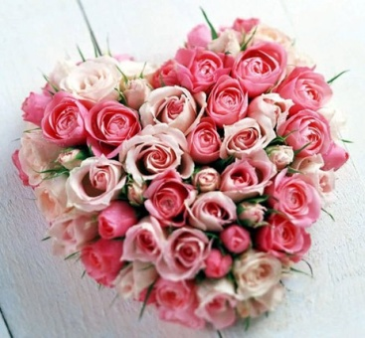
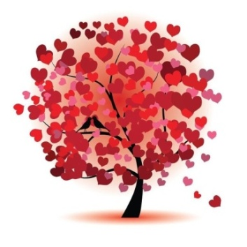
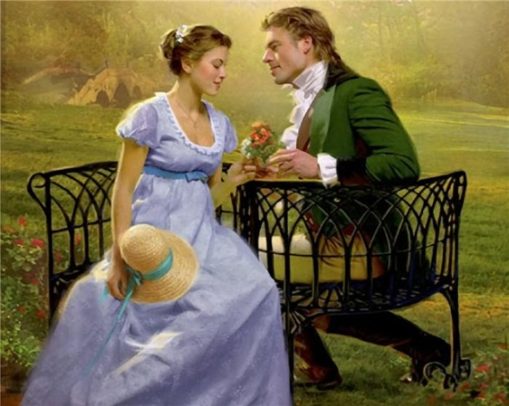
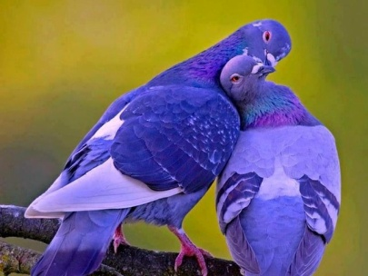
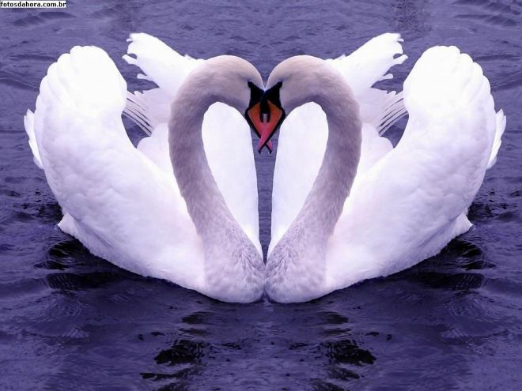
Love is the best feeling in the world. All people want to love and to be loved. When love is mutual, it is the best thing that can ever happen to a man.

Slide 2
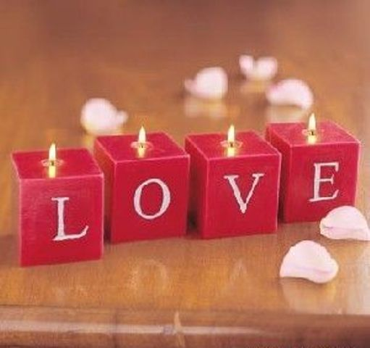
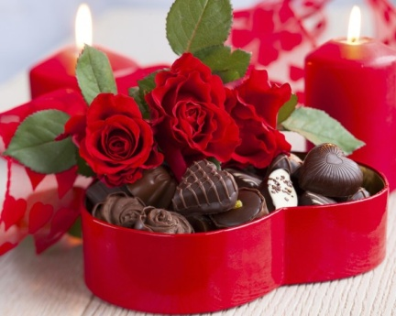
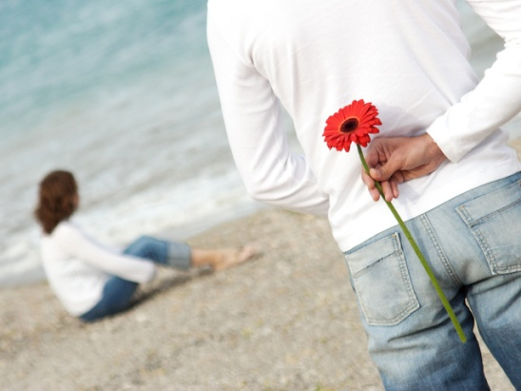
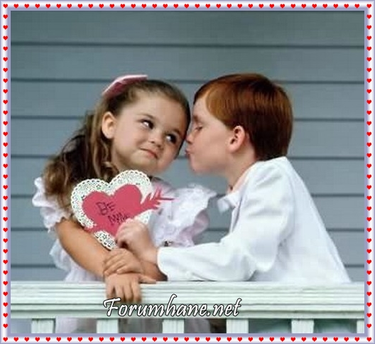
‘If you have love, you don't need to have anything else, and if you don't have it, it doesn't matter much what else you have,’ said Sir James M. Barrie, a Scottish author.

Slide 3
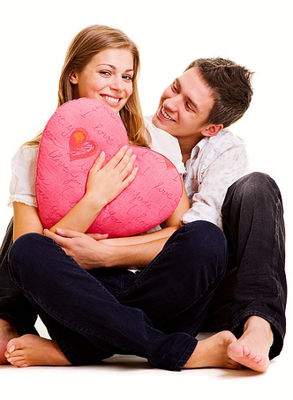
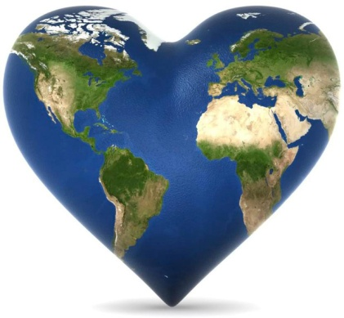
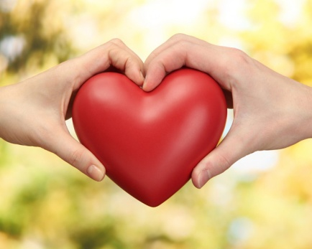
We’d like to finish by paraphrasing the sayings we’ve touched upon at the beginning. We are absolutely sure that
‘LOVE talks’,
‘LOVE makes the world go round’,
‘LOVE is power’.
And the song proves it.

