Slide 1
Can’t buy me love
(by The Beatles)
Elizaveta Bankovskaya
Anastasia Bystrova
Maya Kalinina
Julia Kargina
Kristina Kishoyan
Ekaterina Lavrinova
School № 175

Slide 2
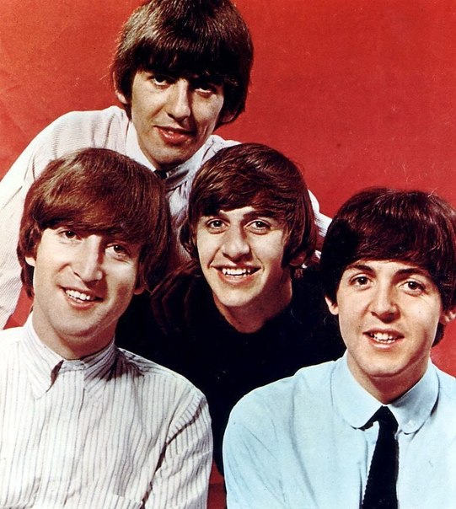
Good afternoon ladies and gentlemen! We are students of Nizhny Novgorod school № 175. Let us start by explaining the choice of our song. The song is ‘Can’t buy me love’ by the most popular English band, ‘The Beatles’.

Slide 3
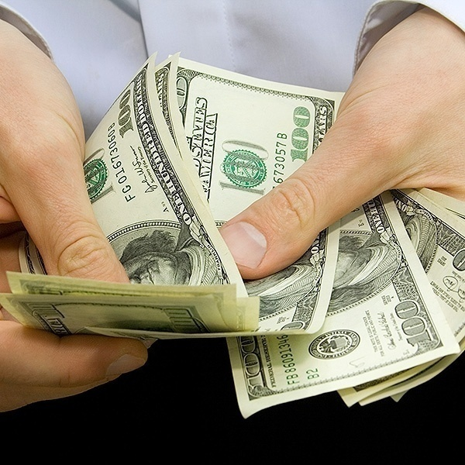
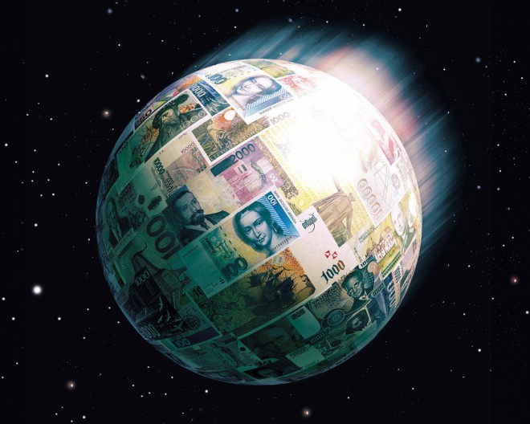
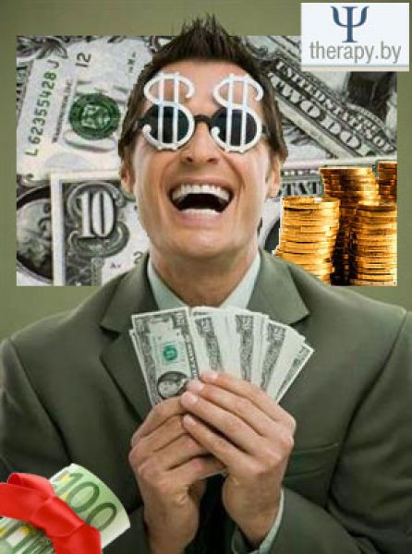
People often use the proverbs ‘Money talks’, ‘Money makes the world go round’ or ‘Money is power’ to say that money is important in every person’s life.

Slide 4
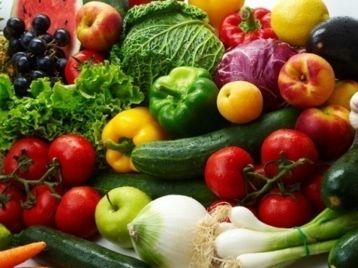
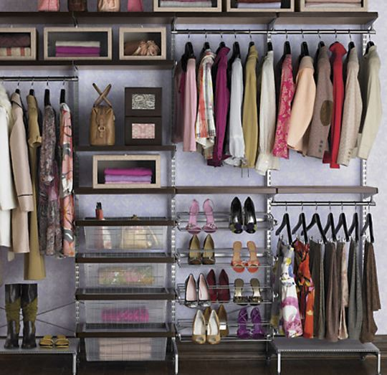
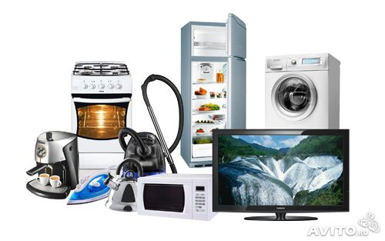
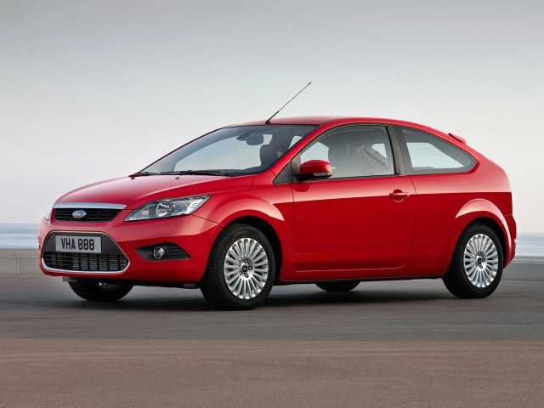
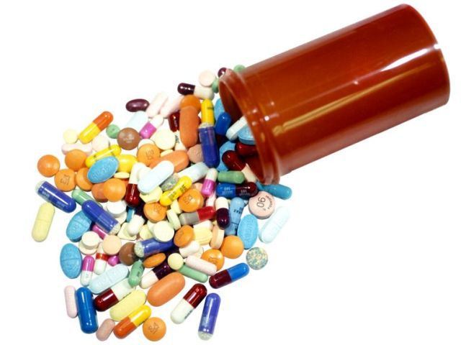
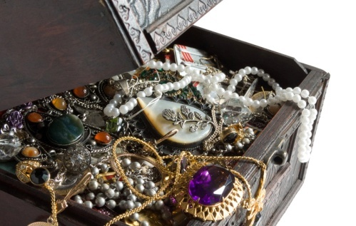
It is really so because with the help of money we can buy all kinds of things, such as food, clothes, accommodation, domestic appliances, cars, electronic devices, jewellery, medicine and many other things. However, money can’t buy love and happiness.

