Slide 1
Sport and
sports games
“Enjoy English - 2”
Unit 2 Lesson 26

Slide 2
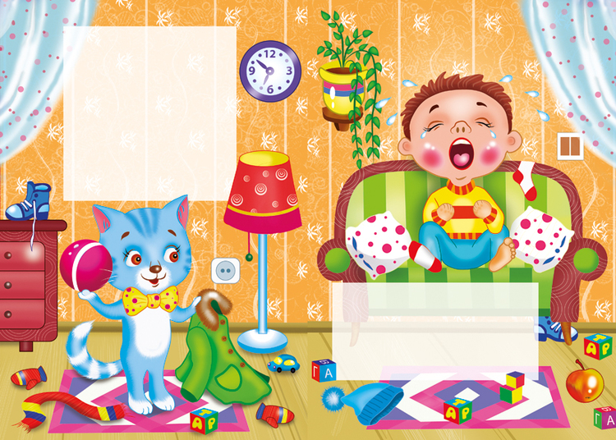
Why do you cry, Willy?
Why do you cry?
Why, Willy? Why, Willy?
Why, Willy, why?

Slide 3
[z]
[g]
[au]
[w]
[ei]
[t]
[d]
[f]
[h]

Slide 4
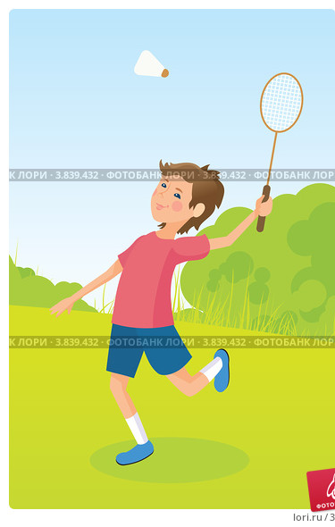
Badminton

Slide 5
Basketball

Slide 6
Volleyball

Slide 7
Table tennis

Slide 8
Tennis

Slide 9
Football

Slide 10
Hockey

Slide 11
Chess

Slide 12
Y y [ai] why, fly
[i] Willy

Slide 13
Let’s sing the ABC

Slide 14
Homework:
Рабочая тетрадь
стр. 22 № 1,2; стр. 23 № 1, 2
Учить алфавит!!!

Slide 15
I can jump, I can run,
I can sing, I can dance,
I can swim, I can’t fly.
I can climb and say: Good bye!

