Slide 1
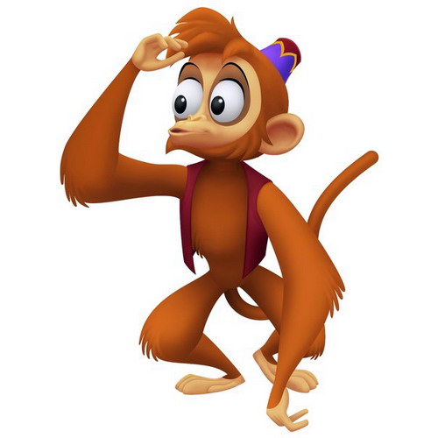
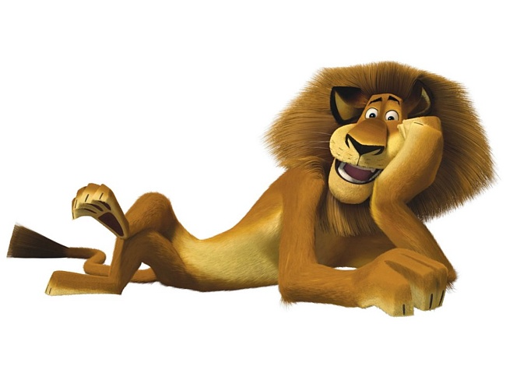
ABC Party!!!

Slide 2
Be my friend!
Hello! What’s your name?
Hello! Come and play
Hello! Don’t be shy
Come and be my friend.
Let’s run and jump and ride our bikes
Kick a ball and fly our kites
Watch TV and stay the night
Come and be my friend!

Slide 3
A B C D E F G
H I J K LM N O P Q R S T U V W X W Z

Slide 4
A B C D E F G H I J K
L M N O P
Q R S T U V
W X Y and Z
Now you know the ABC
Want you come
And sing with me!

