Slide 2
Расставьте слова в утвердительных, отрицательных и вопросительных предложениях по порядку.
a market – is – the river – there – near
TV – there – a good film – on – is
any – in the sky – there – clouds – aren’t
in my coffee – is – sugar – any – there ?
sailors – are – in the boat – five – there

Slide 3
Упражнение 2. Вставьте is или are.
There _____ two cups of tea on the table. There _____ some milk in the cup. There _____ an orange in the salad. There _____ six balls in the box. There _____ some cheese on the plate. There ______ a blue chair at the door. There _____ five chicks and a hen on the farm. There _____ a table and nine desks in the classroom. There _____ a big window to the left of the door. There _____ three rooms in our country house.

Slide 4
_____________ any sausages in the fridge? ____________________. _____________ any sugar in the cupboard?____________________. _____________ any rolls on the table?____________________. _____________ any eggs in the fridge?____________________. _____________ any jam in the fridge?____________________. _____________ any biscuits in the cupboard?____________________.

Slide 5
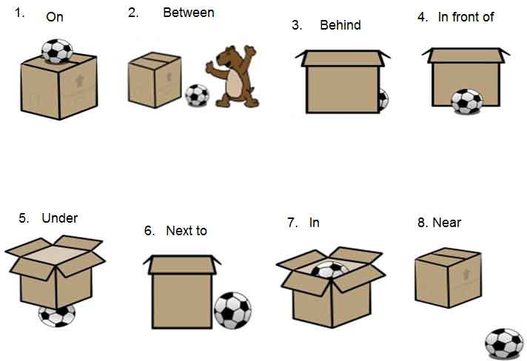

Slide 6
Выберите подходящий предлог и переведите предложения.
The clock hangs on the wall, … the table. (above/under/on)
He has played Hamlet … the stage many times. (on/in/next to)
The bank is … the post-office and the beauty salon. (behind/at/between)
The ball has rolled … the bed. (on/under/above)
Bob and Jane were sitting in the café … each other. (between/behind/in front of)
The gym is … my college. (next to/on/between)
The monument is … the right. (in/at/on)

